Slide 1
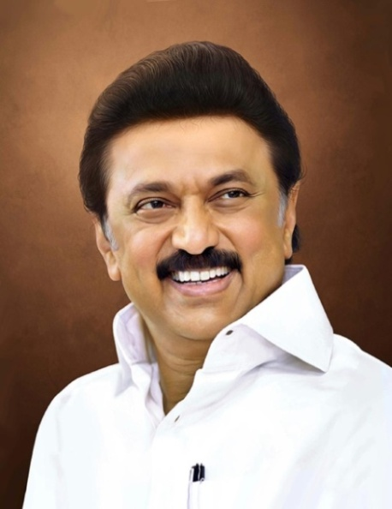
Review of
Water Resources Department
by the
Chief Secretary to Government
20.09.2024
Andiappaanur odai dam, Thirupathur District

Slide 2
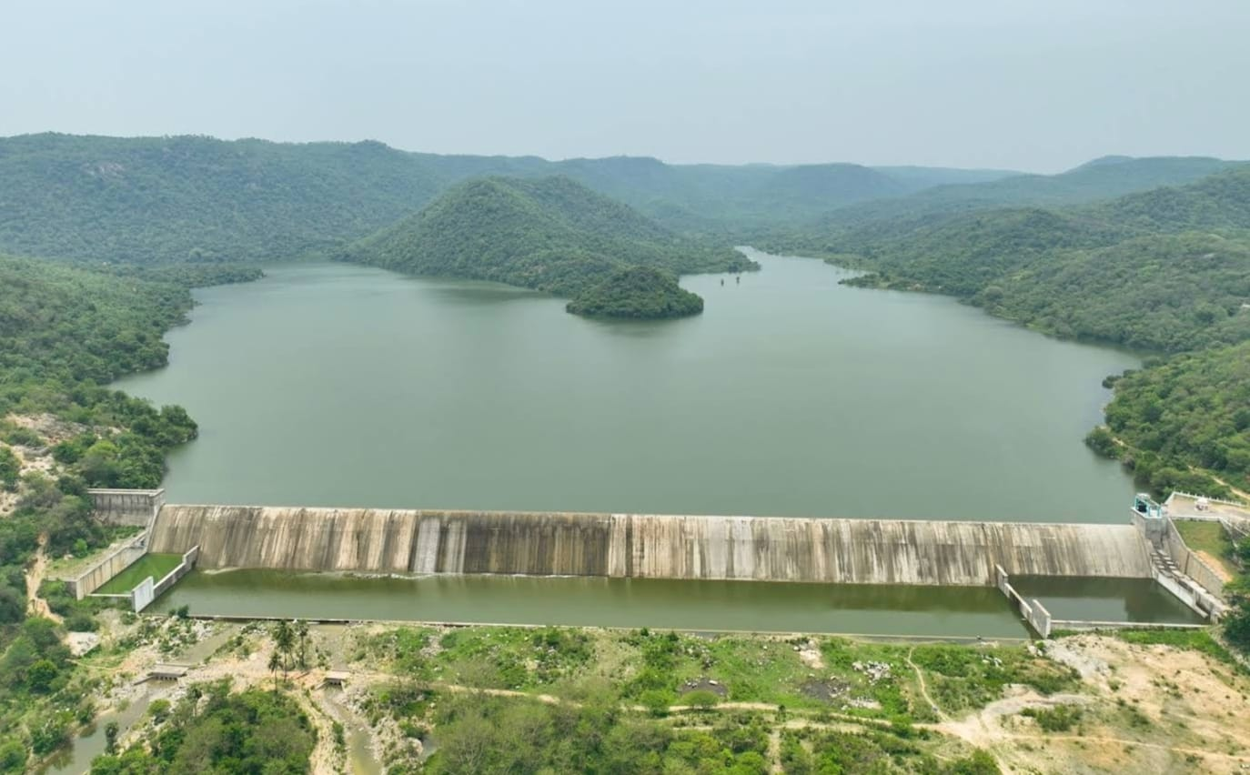
Flagship Schemes
Mordhana Dam, Vellore District

Slide 3
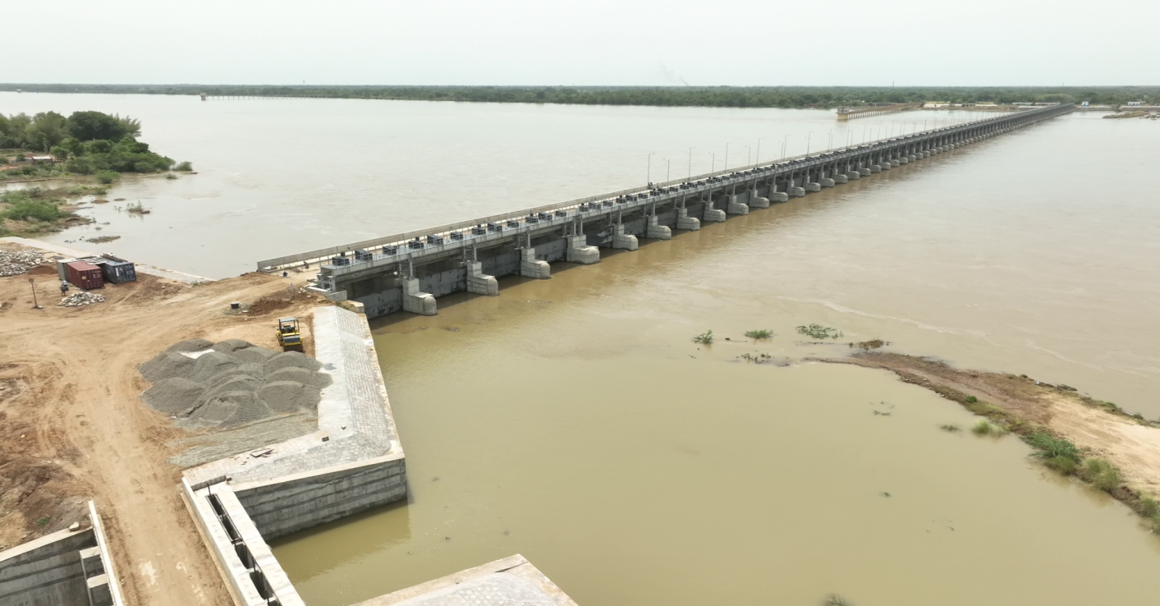
1. Construction of a Barrage with Head Sluices across the River Coleroon at RD 74/3 mile in Adhanur Village( Cuddalore District) and Kumaramangalam village (Nagapattinam District)
Attach Photo Only
Announcement Year
2014-15
Admin Sanction
2018
Work Order Issued
04.05.2019
Est. Cost (Rs. in cr)
Rs. 465.43 Cr
Work Progress(%)
99%
Financial Progress (%)
92%
AS | G.O.(Ms) No.290 PW (Q2) Department, dated 02.11.2018. Rs.396.41 crore
RAS 1 | G.O.(Ms) No.13 PW(Q2) Department, dated 06.01.2020. Rs.463.25 crore
RAS 2 | G.O.(Ms) No.32 WR (S2) Department, dated 01.03.2024. Rs.465.43 crore
Commenced on
04.05.2019
Prob. Date of Completion
30.09.2024
Ayacut Benefited in Ha.
10,945.24

Slide 4
This barrage is constructed across river Coleroon at RD 74/3 mile for a length of 1064.40m to store 0.334TMC water.
Barrage consists of 72 vents of size 10.60 x 3.05m and 12 Scour vents of size 10.60 x 3.55m with the discharging capacity of 4,55,726 cusecs.
To stabilize an Ayacut of 6320 Acres in Mayiladudurai and Sirkazhi Taluks of Nagapattinam District through Southrajan channel and 16313 Acres in Kattumannarkoil and Chidambaram Taluks of Cuddalore District through Northrajan channel and Khansahib canal.
307 deep bore wells nearby the river course on both sides of the river would be stabilized.
Work commenced on 04.05.2019 and nearing completion.
Expenditure incurred Rs.430.25 crore

Slide 5
Land Acquisition cost of Rs.31.35 crore vide G.O.(Ms) No.48 Public Works (Q2) Department, dated 23.02.2018.
The compensation amount of Rs. 31.35 Crore for acquiring 103.075 Ha of Patta Lands and 49.94 Ha of Poramboke lands has been transferred to the District Collectors of Cuddalore, Mayiladuthurai and Thanjavur districts.
Completion of work getting delayed due to Court case.

Slide 6
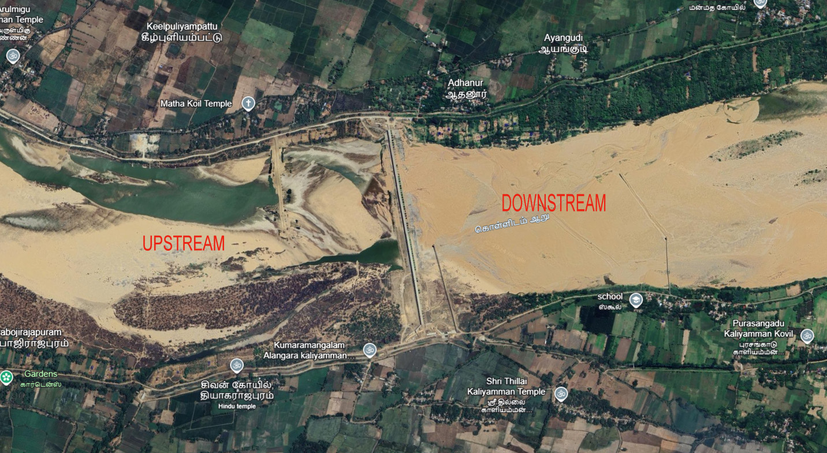

Slide 8
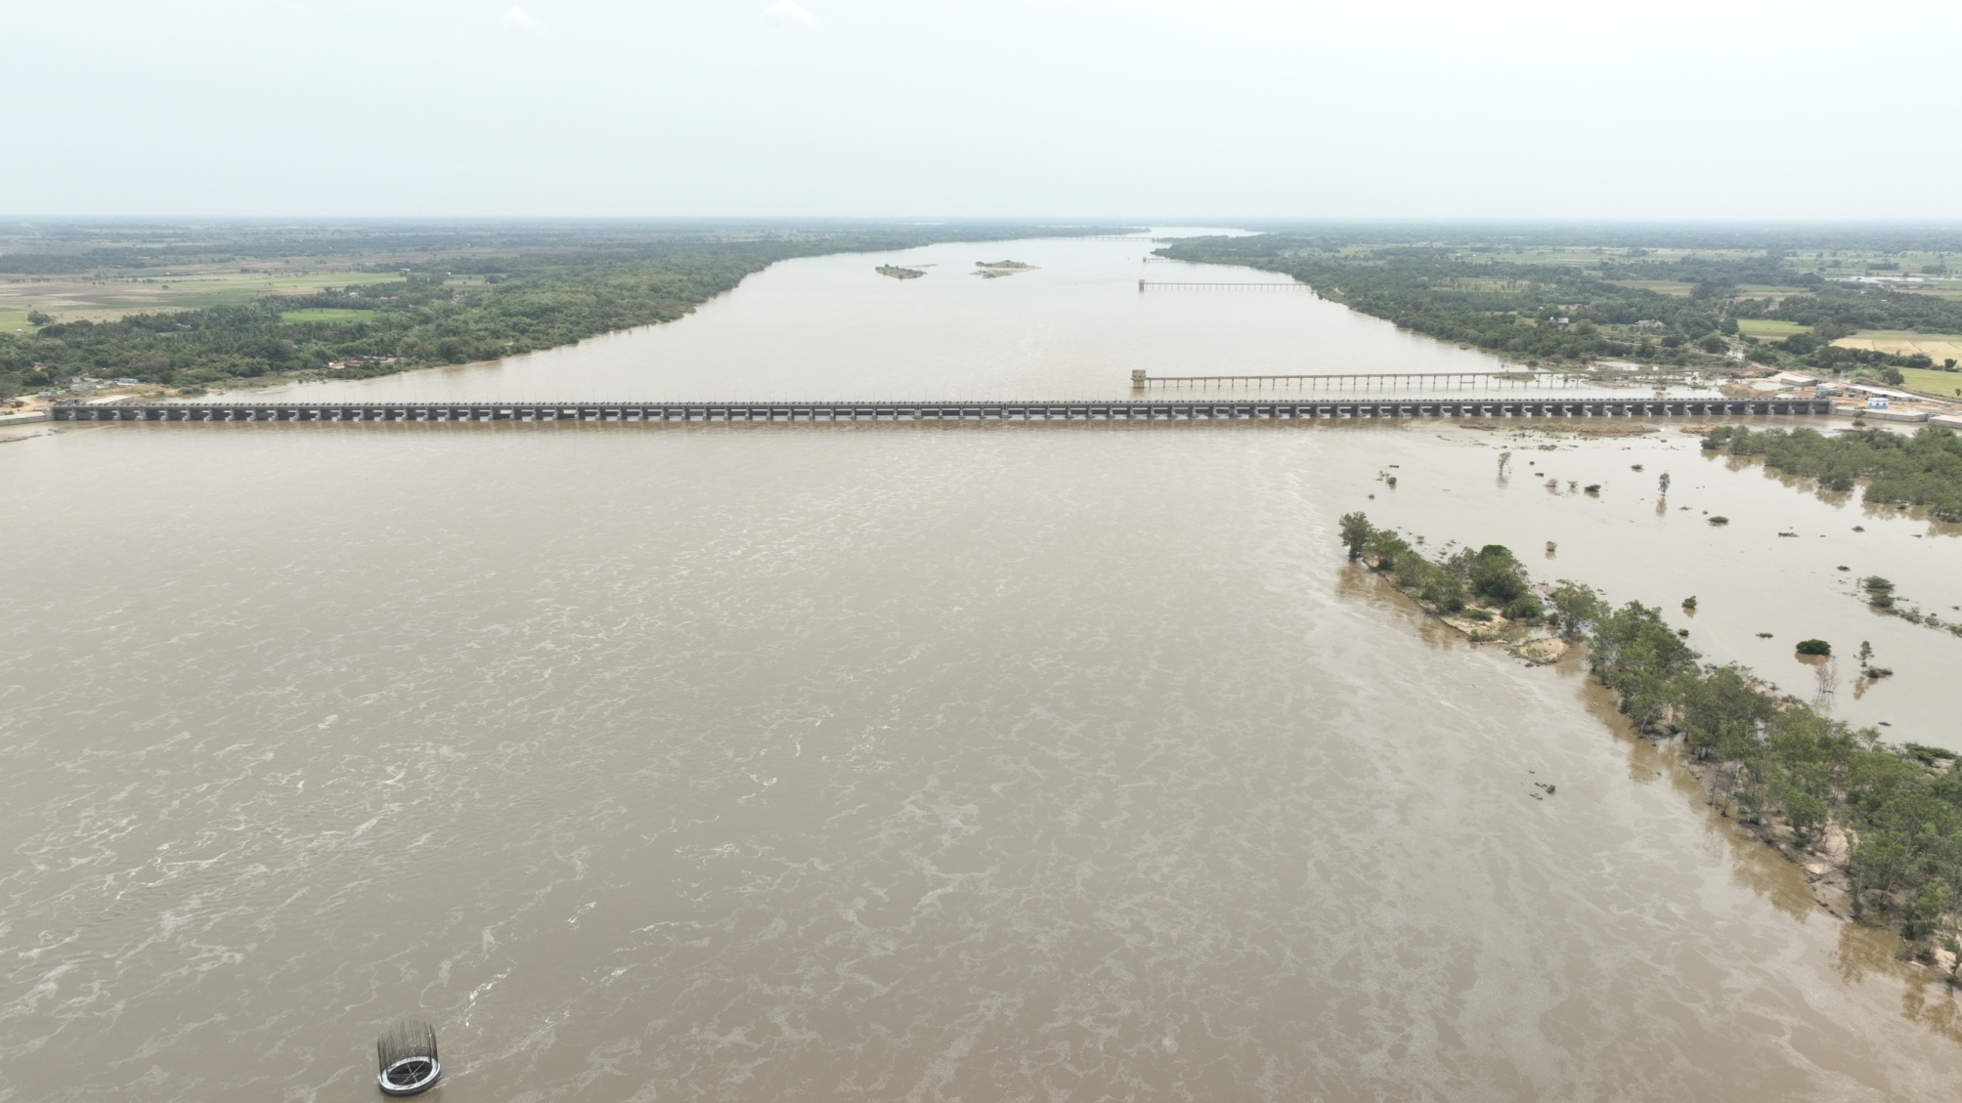
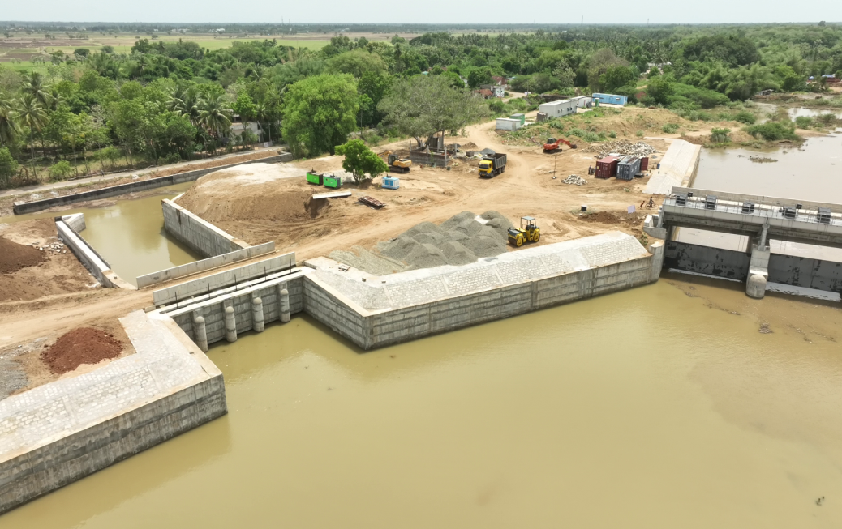
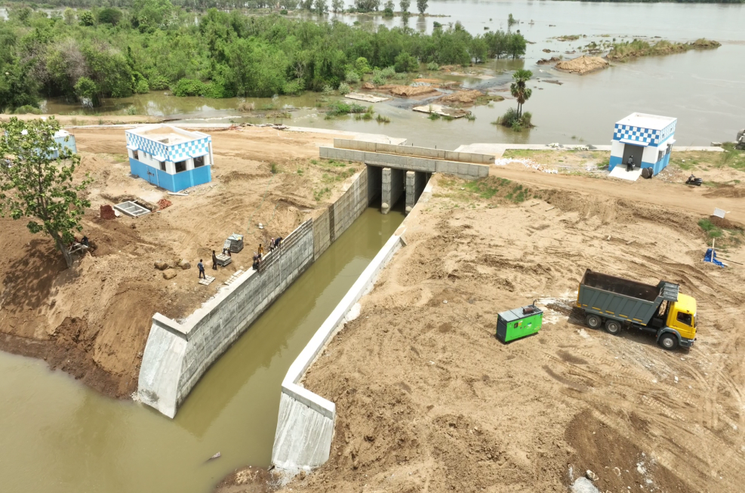
NORTHRAJAN HEAD SLUICE
SOUTHRAJAN HEAD SLUICE

