Slide 1
Review of
Water Resources Department
by the
Chief Secretary to Government
20.09.2024
Andiappaanur odai dam, Thirupathur District

Slide 2
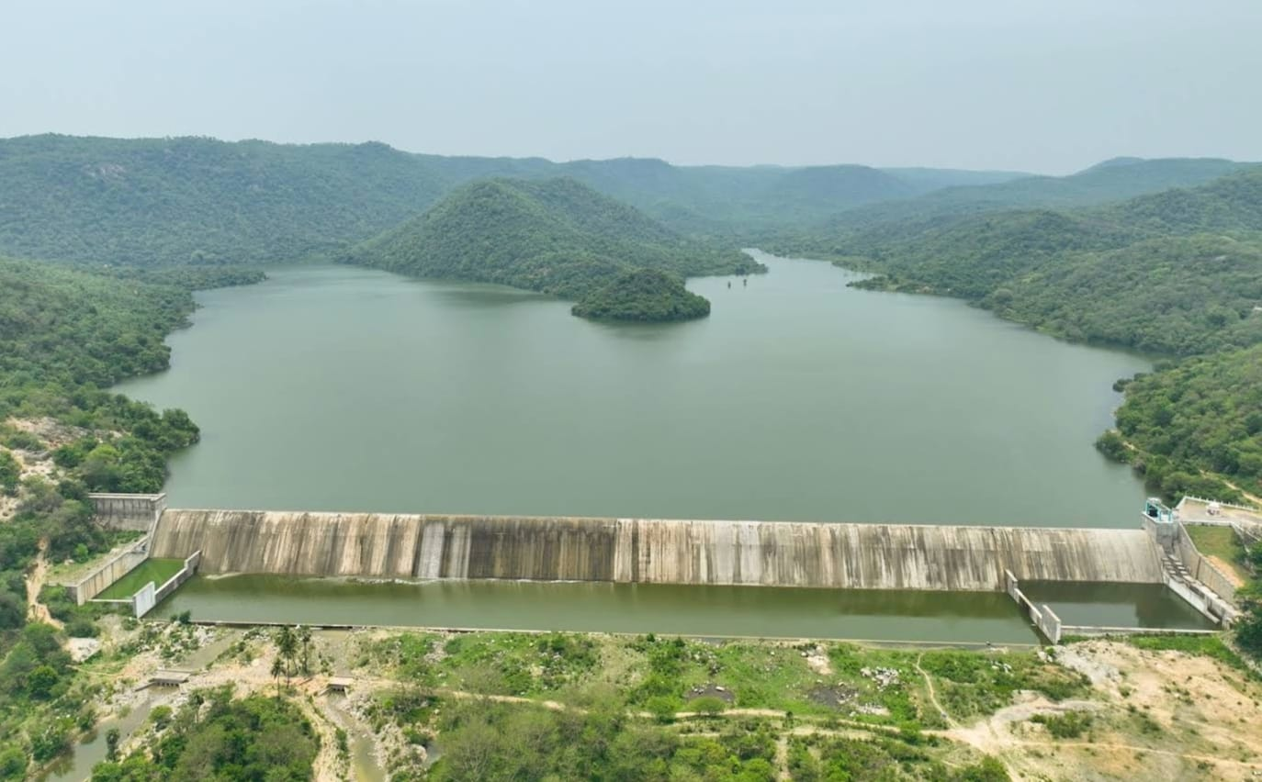
Flagship Schemes
Mordhana Dam, Vellore District

Slide 3
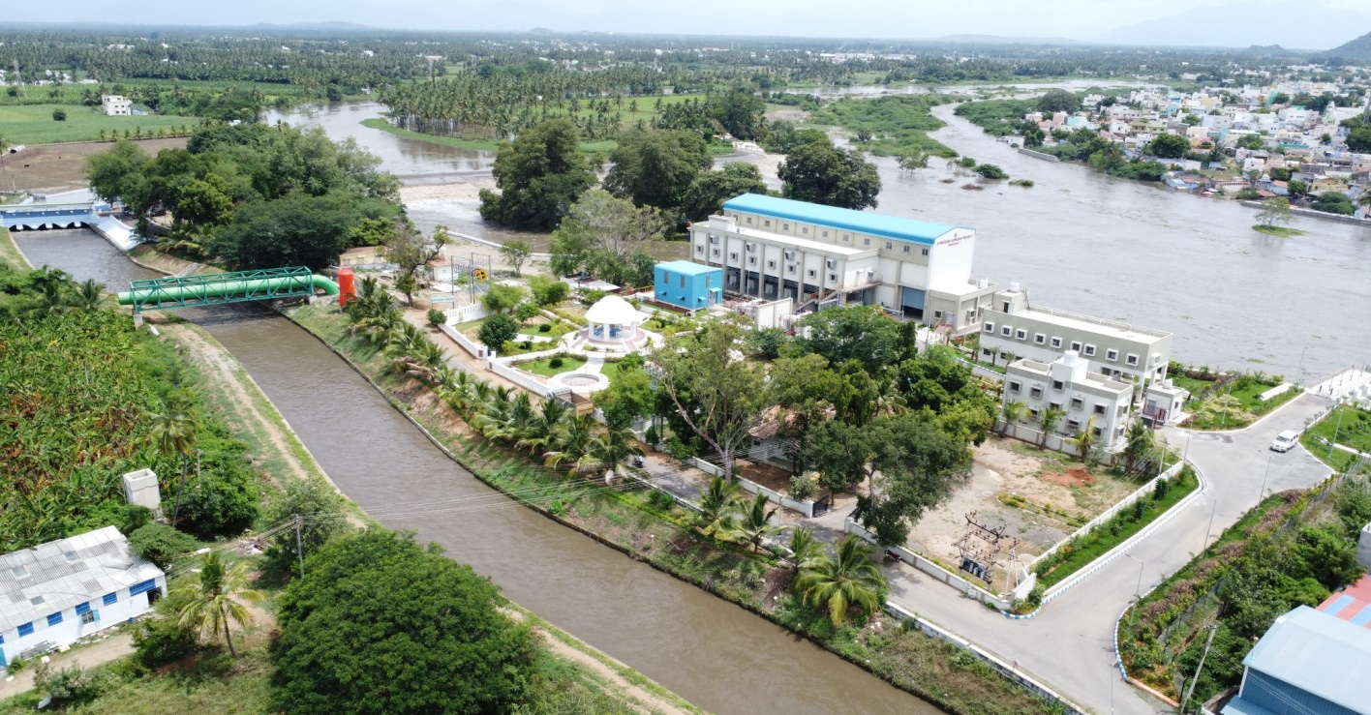
2.Athikadavu-Avinashi, Irrigation, Ground Water Recharge and Drinking Water Supply Scheme in Coimbatore, Tiruppur and Erode Districts
Attach Photo Only
Announcement Year
2017-2018
Admin Sanction
2018
Work Order Issued
04.03.2019
Est. Cost (Rs. in cr)
Rs. 1916.42
Work Progress(%)
100 - Completed
Financial Progress (%)
92.80
AS | G.O.(M.S.) No.84, PW (I.Spl.2) Dept., dt.28.03.2018 /Rs.1652 cr
RAS 1 | G.O.(Rt) No.142, PW (I.Spl.2) Dept., dt.08.04.2021/ Rs.1756.88 cr
RAS 2 | G.O.(M.S.) No.34, WR (W2) Dept., dt.02.06.2023 /Rs.1916.42 cr
Commenced on
25.12.2019
Prob. Date of Completion
Completed on 16.08.24
Ayacut Benefited in Ha.
9902.06

Slide 4
PROJECT INAUGURATED ON 17.08.2024

Slide 5
To lift 1.50 TMC of surplus water of the Bhavani River from the downstream of Kalingarayan Anicut by pumping through pipelines for 70 days in a year at the rate of 250 cusecs.
To feed and fill 1045 Nos. of tanks / Ponds (32 Nos. of WRD tanks, 42 Nos of Union tanks and 971 Nos of village ponds).
To benefit the drought prone and ground water depleted areas (Critical:1 & Over-exploited:12) of Erode (Perundurai, Chennimalai, Nambiyur, Gobi, Bhavanisagar blocks), Tiruppur (Uthukuli, Avinashi, Tiruppur blocks) and Coimbatore Districts (Annur, Sulur, Sarkar Samakulam, Periyanaickenpalayam and Karamadai blocks) for the benefit of an irrigable area of 24,468 acres.
6 Pump Houses have been constructed with erection of 46 Vertical Turbine Pumps and 1065 km length of pipe laid.
159.27 Mcft of water has been pumped from 17.08.2024 to 18.09.2024

Slide 6
WRD Tanks | 32 Nos
Union Tanks | 42 Nos.
Ponds | 971 Nos.
Total | 1,045 Nos.
Quantity | 1,500 Mcft

Slide 7
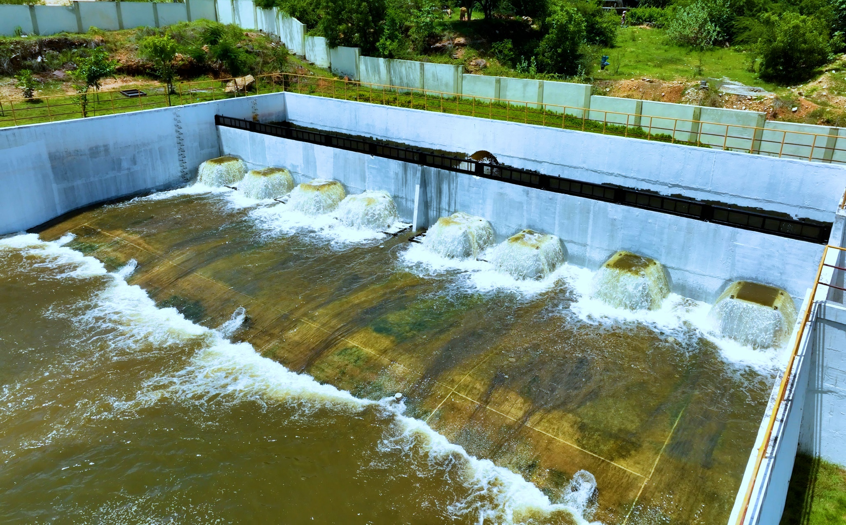
Forebay Sump @ Pump House 2 - Nallagoundenpalayam

Slide 8
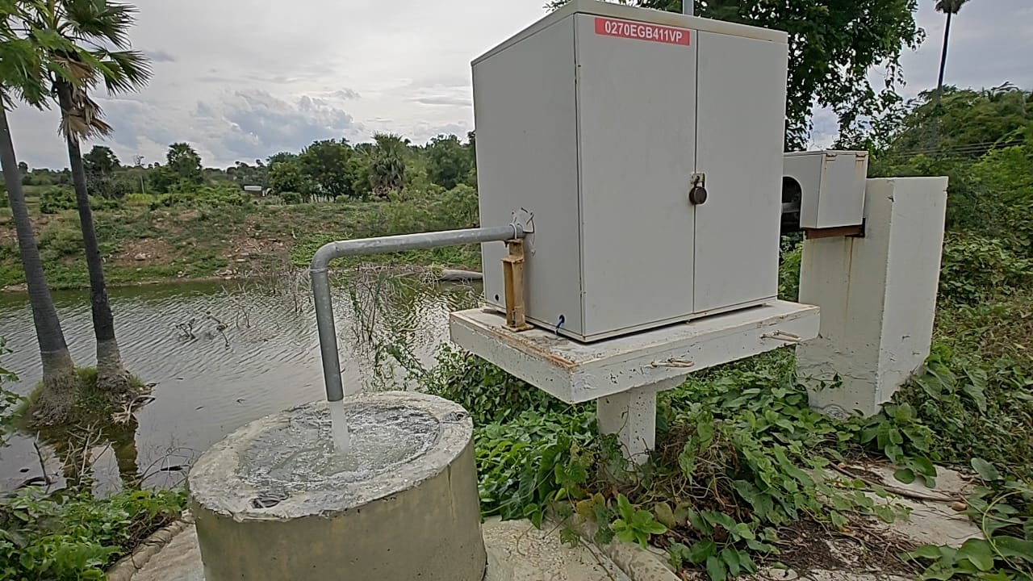
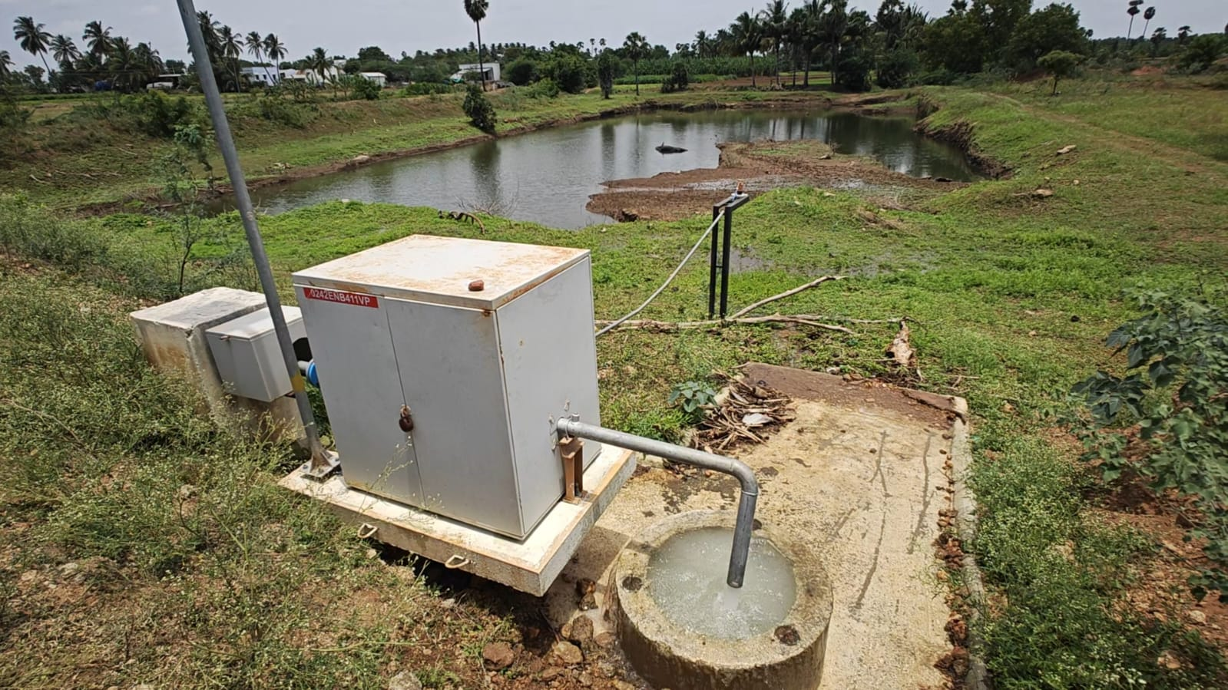
Pond ID : 0270EGB411VP
Pond ID : 0091TUK409VP
Pond ID : 0242ENB411VP
Pond ID : 0093EPD409VP

