Slide 1
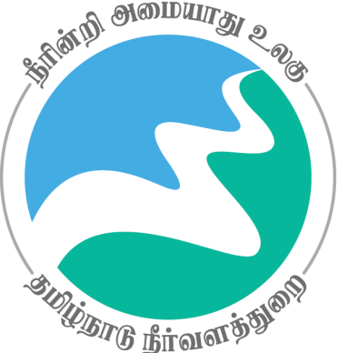
Review of
Water Resources Department
by the
Chief Secretary to Government
20.09.2024
Andiappaanur odai dam, Thirupathur District

Slide 2
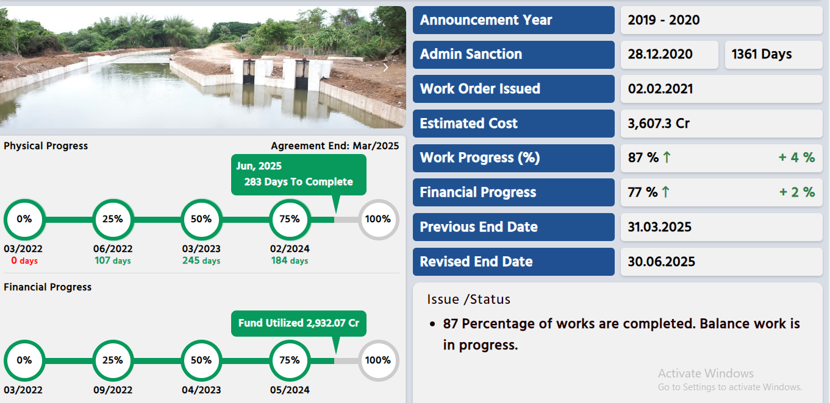
Extension , Renovation and Modernisation of Irrigation infrastructure Cauvery Sub Basin
Out of 33 packages ,12 packages completed and 88% of work completed in 21 packages

Slide 3
Administrative Sanction accorded for Rs. 224.80crore in G.O(Ms) No.331 Public Works (W1) Dept., dated 28.12.2020 for 2 packages.
Administrative Sanction accorded for Rs.3159.20crore in G.O(Ms) No.40 Public Works (W1) Dept., dated 08.02.2021 for 31 packages.
Revised Administrative Sanction accorded for Rs.3607.30 crore in G.O. (Ms) No.13 WR.,(S2) Dept., dated 06.02.2024.
Components:Regulators-275 , Head sluices-1205, Bed dam -16, inlet & outlet-468, Syphon-103, Aqueducts-13, Retaining wall, River training wall & RCC wall -39.49 km, regrading of channel -87.10 km
About 3,54,147 acre of ayacut in Thanjavur, Nagapattinam, Pudukkottai, Mayiladuthurai and Tiruvarur Districts would be benefited.
Work commenced on 04.03.2022 and 88 % work completed. Proposed to complete the work on 30.06.2025
Expenditure incurred: Rs.2,932.07 crore

Slide 4
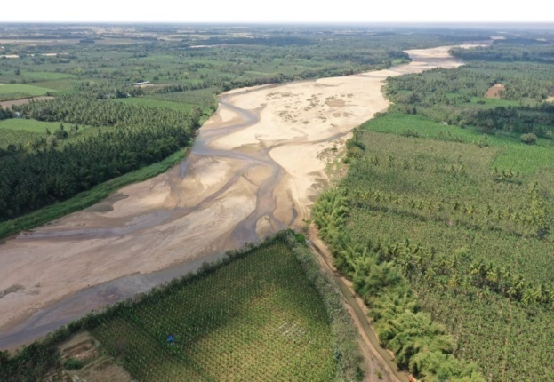
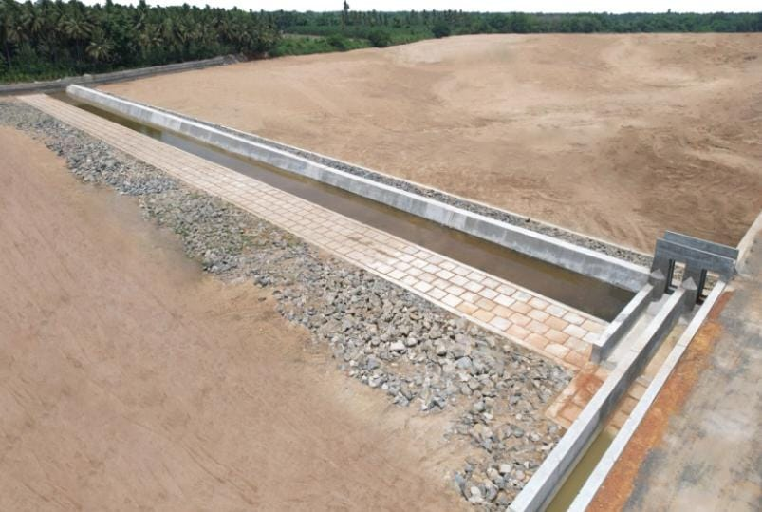
Before Execution
Grade Wall at Cauvery River @ Mile 35/06+50 in Kaduveli Village of Thiruvaiyar Taluk in Thanjavur District
After Execution

Slide 5
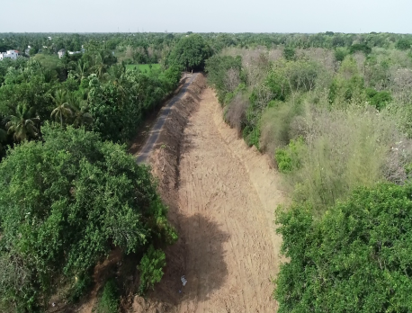
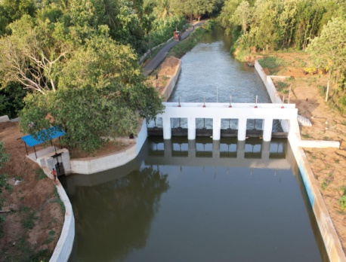
Before Execution
Regulator across Nattar river at LS 60/6+50 Srinivasanallur Village of Kumbakonam Taluk in Thanjavur District.
After Execution

