Slide 1
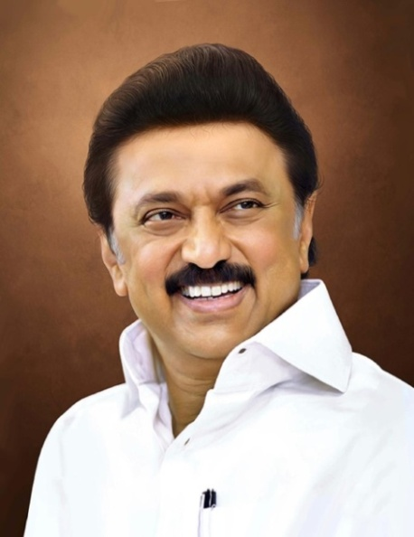
Review of
Water Resources Department
by the
Chief Secretary to Government
20.09.2024
Andiappaanur odai dam, Thirupathur District

Slide 2
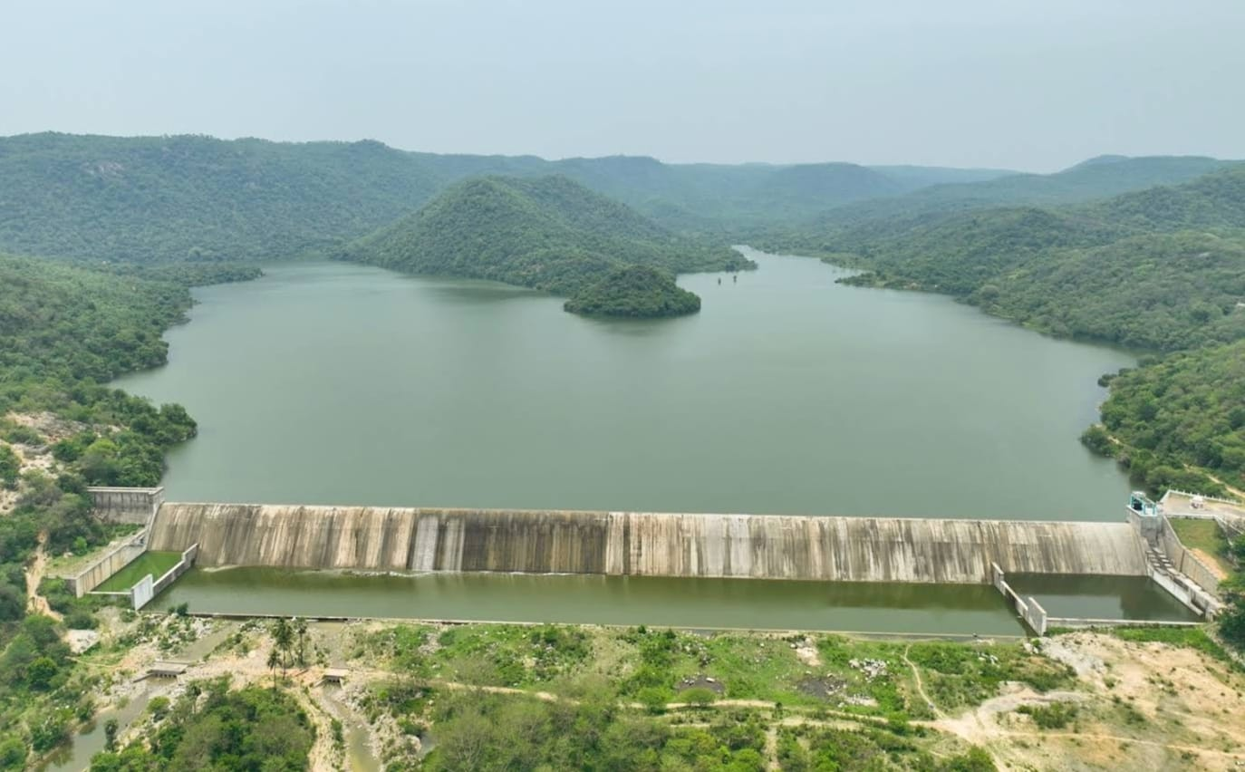
Flagship Schemes
Mordhana Dam, Vellore District

Slide 3
3. Inter linking Cauvery – Vaigai – Gundar
Government of India is in the process of implementing the inter-linking of Peninsular Rivers, viz., Mahanadi - Godavari - Krishna - Pennar - Palar - Cauvery - Vaigai – Gundar, for which National Water Development Agency prepared Feasibility Report in 2004.
Anticipating this link project, Government of Tamil Nadu, as early as in 2008, took up the construction of Kattalai Barrage at Mayanur across Cauvery and completed it in 2014.
National Water Development Agency(NWDA) has decided to implement the Godavari-Krishna-Pennar-Cauvery link in Phase-I and prepared Detailed Project Report for the same in April, 2021 and sent to concerned States for their views.

Slide 4
As an interim planning, NWDA has carried out a preliminary Technical study in October 2022 which envisages the diversion of 4000 MCM (141 TMC) of water from Godavari to Krishna, Pennar and Cauvery basin.
In the revised DPR, the first phase of the project is to take the link canal to a higher contour after crossing the Palar Dusimamandur tank and linked it with Manimuktanadhi which is (south of Cauvery – Kattalai barrage) the tributary of Vellar. Water diverted from Godavari is 148 TMCft. Allocation to Tamil Nadu is 41 TMCft.
Out of this, 1,13,663 hectares (17.2 TMCft) have been allocated to Tamil Nadu for irrigation and 9.4 TMCft for drinking water needs and 12.4 TMCft for industrial use.

Slide 5
This project is proposed for implementation in 3 Phases
Phase I Cauvery – South Vellar (118.45 km)
Phase II South Vellar – Vaigai (109.50 km)
Phase III Vaigai- Gundar (33.41 km)
Total : 261.362 km
It is proposed to divert 8.588 TMC of surplus flood water.
Besides fulfilling the drinking water supply requirements an ayacut of 60698 acres ( 24279 ha.) in Trichy, Karur and Pudukottai Districts would be benefited under Phase- I.
In principle approval has been accorded for Rs.6941.00 crore for Phase-I. Administrative Sanction accorded for 2 Reaches only.

Slide 6
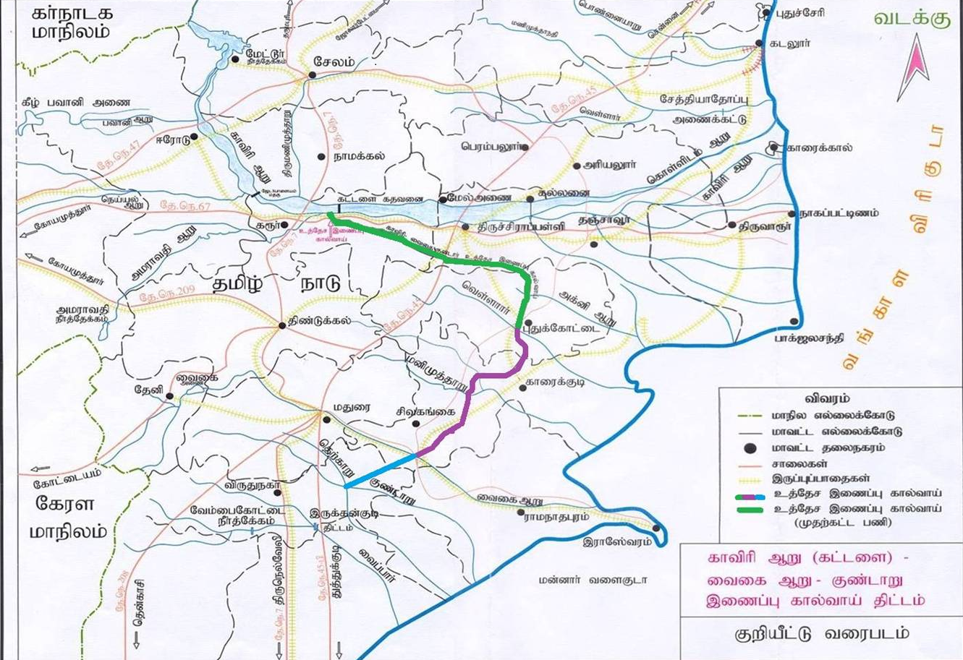
Phase - I
Phase-II
Phase- III
Index Map of the project

Slide 7
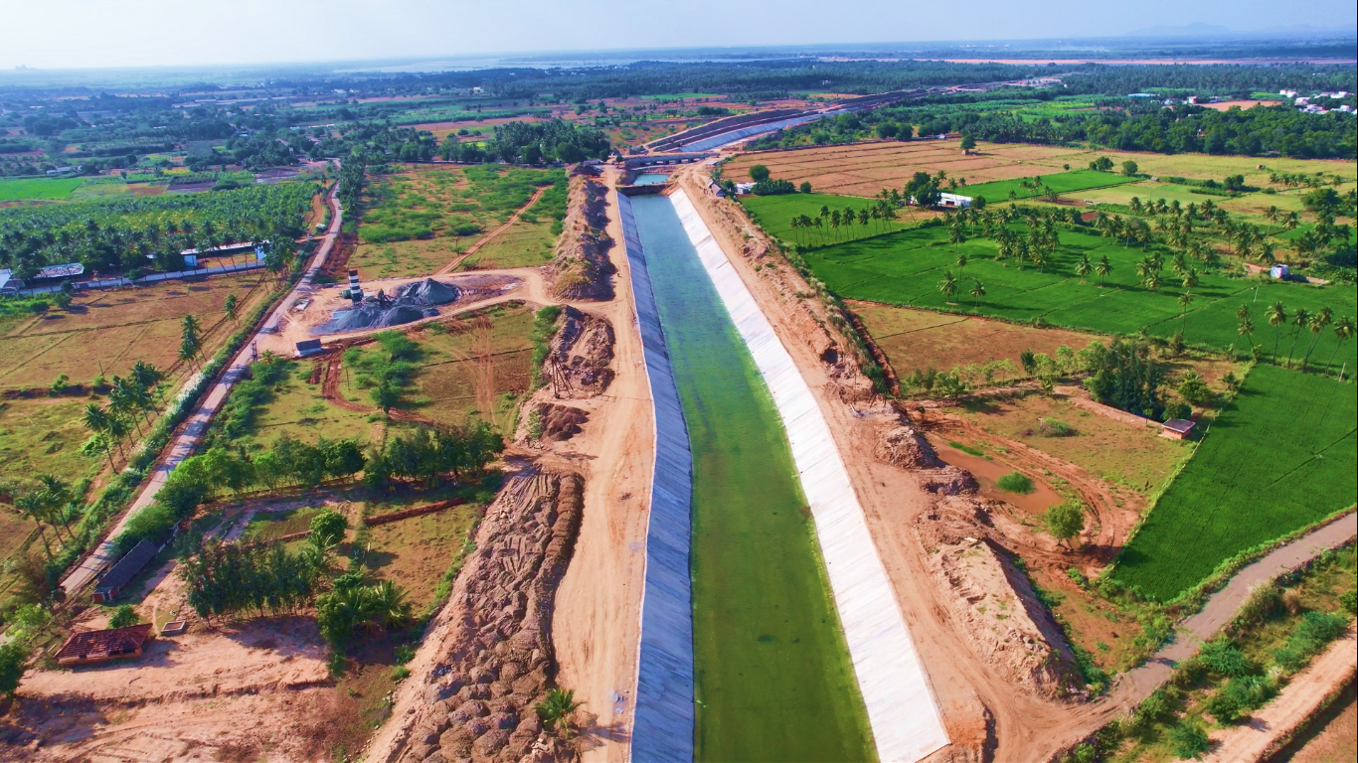
Cauvery-Vaigai-Gundar flood carrier canal Reach 1 - Slice I
(Ls 0.00 km to 4.10km) in Karur District.
Announcement Year
2020-2021
Admin Sanction
10.11.2020
Work Order Issued
11.02.2021
Est. Cost (Rs. in cr)
Rs. 177.03 cr
Work Progress(%)
85
Financial Progress (%)
73
AS | G.O.MS.No.280/PW(I.SPl.2)D/ Dt:10.11.2020, Rs. 171.00 cr
RAS | G.O (Ms).no12/Date:05.02.2024, Rs. 177.03 cr
Commenced on
11.02.2021
Prob. Date of Completion
10.03.2025
Ayacut Benefited in Ha.
750.00

Slide 8
Date of commencement of project is 11.02.2021
85% of work have been completed. Under the fund of State government, the expenditure was incurred for Rs.12469.66 Lakhs (financial progress - 73% against estimate cost)
Issues:
Requisition of pre closure by contractor on 18.6.2024.
Delay Reason:
Comprehensive model study is to be carried out for the initial reached to assess the hydrodynamic and hydraulic influences of the silt ejector, Railway canal syphon and NHAI canal syphon. Further, due to Land Acquisition issues in Amma Park.

Slide 9
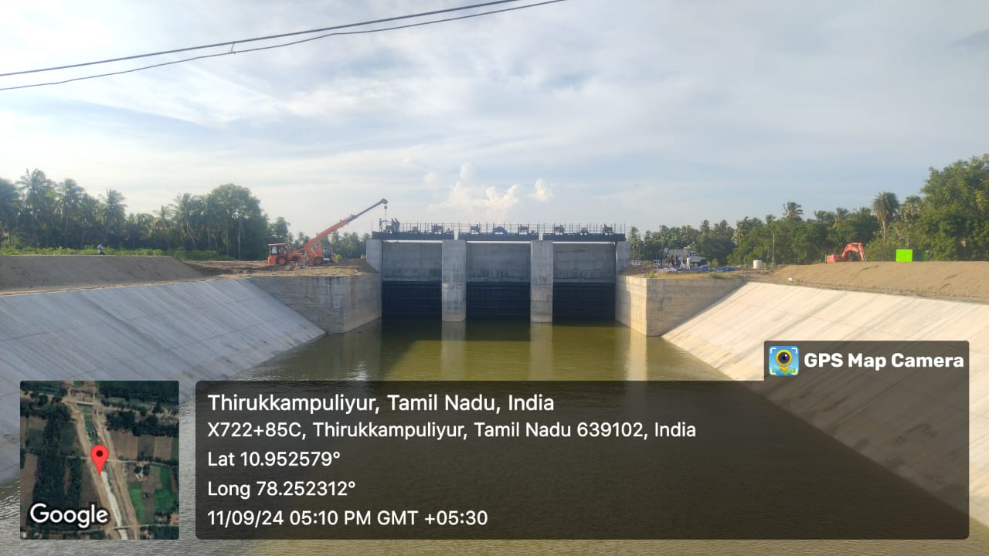
Road Work @ Reach - I
CVG Head Regulator work @ LS 2.335Km

Slide 10
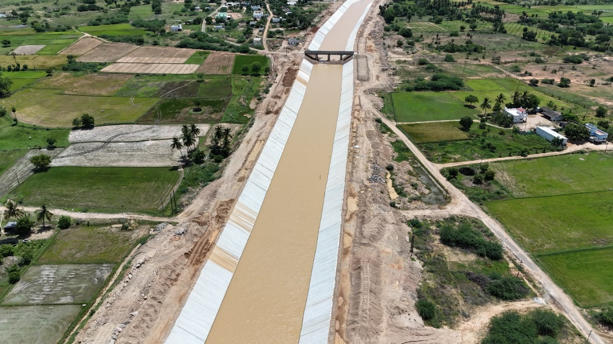
Cauvery-Vaigai-Gundar flood carrier canal Reach 2
LS 54.695 Km to 60.050 Km (Slice IV & V) Pudukottai District
Announcement Year
2020-2021
Admin Sanction
10.11.2020
Work Order Issued
11.02.2021
Est. Cost (Rs. in cr)
Rs. 169.68 cr
Work Progress(%)
88
Financial Progress (%)
74
AS | G.O.MS.No.280/PW(I.SPl.2)D/ Dt:10.11.2020, Rs. 160.00 cr
RAS | G.O (Ms).no12/Date:05.02.2024, Rs. 169.68 cr
Commenced on
21.02.2021
Prob. Date of Completion
31.12.2024
Ayacut Benefited in Ha.
750.00 trichy &17066.28 pudukottai

Slide 11
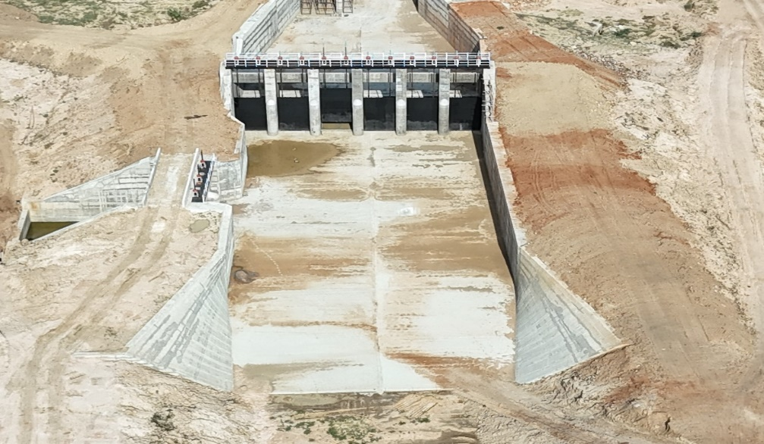
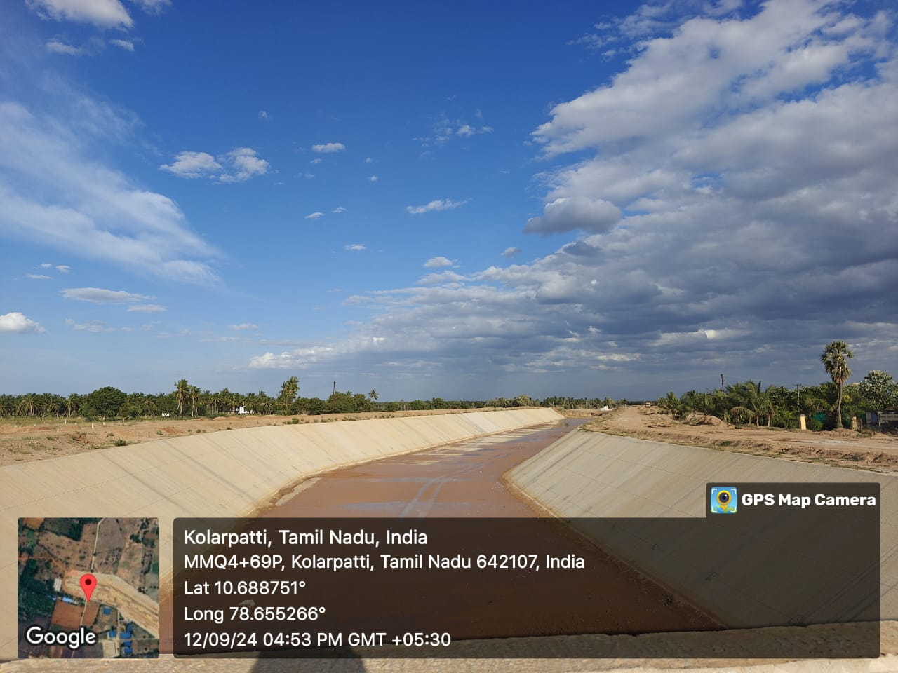
Canal lining
Canal lining – Reach -II
Cross regulator at LS 59.880 Km

