Slide 1
Dam Rehabilitation and Improvement Project (DRIP-I) (SPMU, O&M & SDSO)
To ensure the strength, safety and to improve the operational performance of the existing Dams of Tamil Nadu, DRIP-I was implemented with World Bank loan assistance.
Project cost Rs. 803.49 crore - WRD: Rs.527.94crore, TANGEDCO: Rs.260.14crore and AED: Rs.15.41crore
Project period 2012- 2021.
69 TNWRD Dams and 19 TANGEDCO Dams were rehabilitated.
Catchment area treatment works in Krishnagiri & Kundha Dams were carried out by AED.
Over all project expenditure up to April-2021 : Rs.660.39crore.

Slide 2
LIST OF DRIP-I DAMS
Sl. No. | Name of the Dams | Sl. No. | Name of the Dams | Sl. No. | Name of the Dams | Sl. No. | Name of the Dams | Sl. No. | Name of the Dams
1 | Adavinainarkovil | 15 | Gunderipallam | 29 | Manjalar | 43 | Poigaiyar | 57 & 58 | Thunakadavu & Peruvaripallam
2 | Aliyar | 16 | Kariakoil | 30 | Marudhanadhi | 44 | Ponnaniyar | 59 | Upper (Tirpur)
3 | Amaravathi | 17 | Karuppanadhi | 31 | Mettur | 45 | Poondi | 60 | Upper (Trichy)
4 | Anaikuttam | 18 | Kelavarapalli | 32 | Mordhana | 46 | Ramanadhi | 61 | Upper Nirar Weir.
5 | Anaimaduvu | 19 | Kesarigulihalla | 33 | Nagavathi | 47 | Red Hills | 62 | Vadakkupaichaiyar
6 | Bhavanisagar | 20 | Kodaganar | 34 | Nambiar | 48 | Sathanur | 63 | Vaigai
7 | Chembarampakkam | 21 | Kodumudiyar | 35 | Noyyal Athupalayam | 49 | Shanmuganadhi | 64 | Vaniar
8 | Chinnar | 22 | Krishnagiri | 36 | Palar Porundalar | 50 | Sholayar | 65 | Varattupallam
9 | Chittar I | 23 | Kullursandai | 37 | Pambar | 51 | Shoolagirichinnar | 66 | Veeranam
10 | Chittar Ii | 24 | Kuthiraiyar | 38 | Parambikulam | 52 | Siddhamalli | 67 | Vembakottai
11 | Cholavaram | 25 | Lower Anicut | 39 | Pechiparai | 53 | Sothupparai | 68 | Vidur
12 | Gatana | 26 | Lower Nirar | 40 | Perunchani | 54 | Thirumurthi Dam | 69 | Willington Reservoir
13 | Golwarpatti | 27 | Manimukthanadhi | 41 | Pilavukkal Project Kovilar | 55 | Thoppaiyar
14 | Gomukhinadi | 28 | Manimuthar | 42 | Pilavukkal Project Periyar | 56 | Thumbalahalli Dam

Slide 3
TANGEDCO Dams under DRIP
Sl.No. | Name of the Dams | Sl.No. | Name of the Dams
1 | Avalanche Dam | 11 | Manalar Dam
2 | Bangihallah Earthen Dam | 12 | Mukkurthy Dam
3 | Emerald Dam | 13 | Papanasam Diversion Weir (Desilting dropped)
4 | Eravangalar Dam | 14 | Pegumbahallah Dam
5 | Glenmorgan Dam | 15 | Periyar Forebay Dam
6 | Highwavys Dam | 16 | Porthimund Dam
7 | Kadamparai Dam | 17 | Servalar Dam
8 | Kodayar Dam | 18 | Upper Aliyar Dam
9 | Kundah Palam Dam | 19 | Upper Bhavani Dam
10 | Kuttiyar Dam | 20 | Vandal Dam

Slide 4
Dam Rehabilitation and Improvement Project –Phase II (DRIP-II)
DRIP-II has been proposed for rehabilitating 37 dams initially ( WRD -33 Dams , WRD & AED - 3 Dams , AED only for 1 Dams ) with the Project cost of Rs.610.26 crore during the project period from April 2021 to December 2027.
The funding pattern is 70 : 30 ( 70 % Loan Share by IBRD and AIIB, 30 % - State fund)
As per the World Bank Mid Term Review Mission (January 17th - May 3rd - 2024) the project cost under DRIP-II is revised as Rs.544 crore (3rd revised allocation).
As per the 3rd revised allocation the Dams proposed under DRIP-II is 10 Dams by WRD & Catchment Area Treatment (CAT) works in 2 Dams by AED.
The remaining 25 WRD Dams and CAT works in 2 Dams by AED are proposed to be taken under DRIP –III.
Rehabilitation Works are in progress in Sathanur, Kelavarapalli, Sholayar & Upper Nirar dams.
The Project Expenditure up to 08/2024 is Rs. 245.01 crore

Slide 5
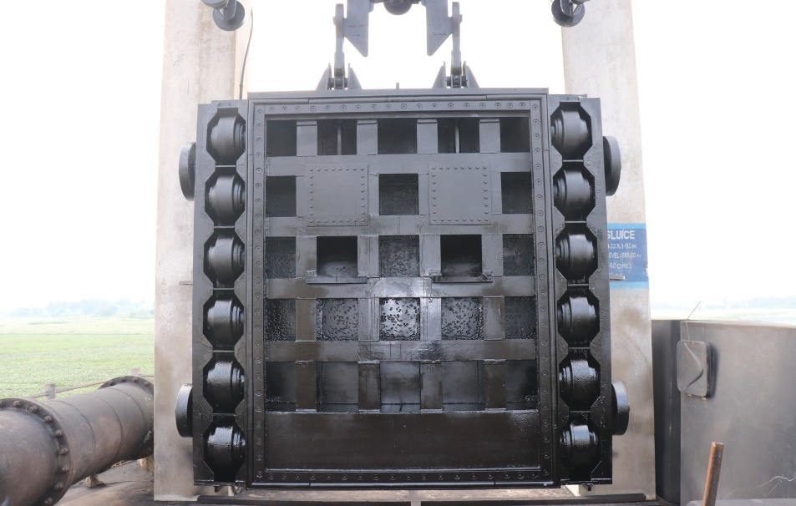
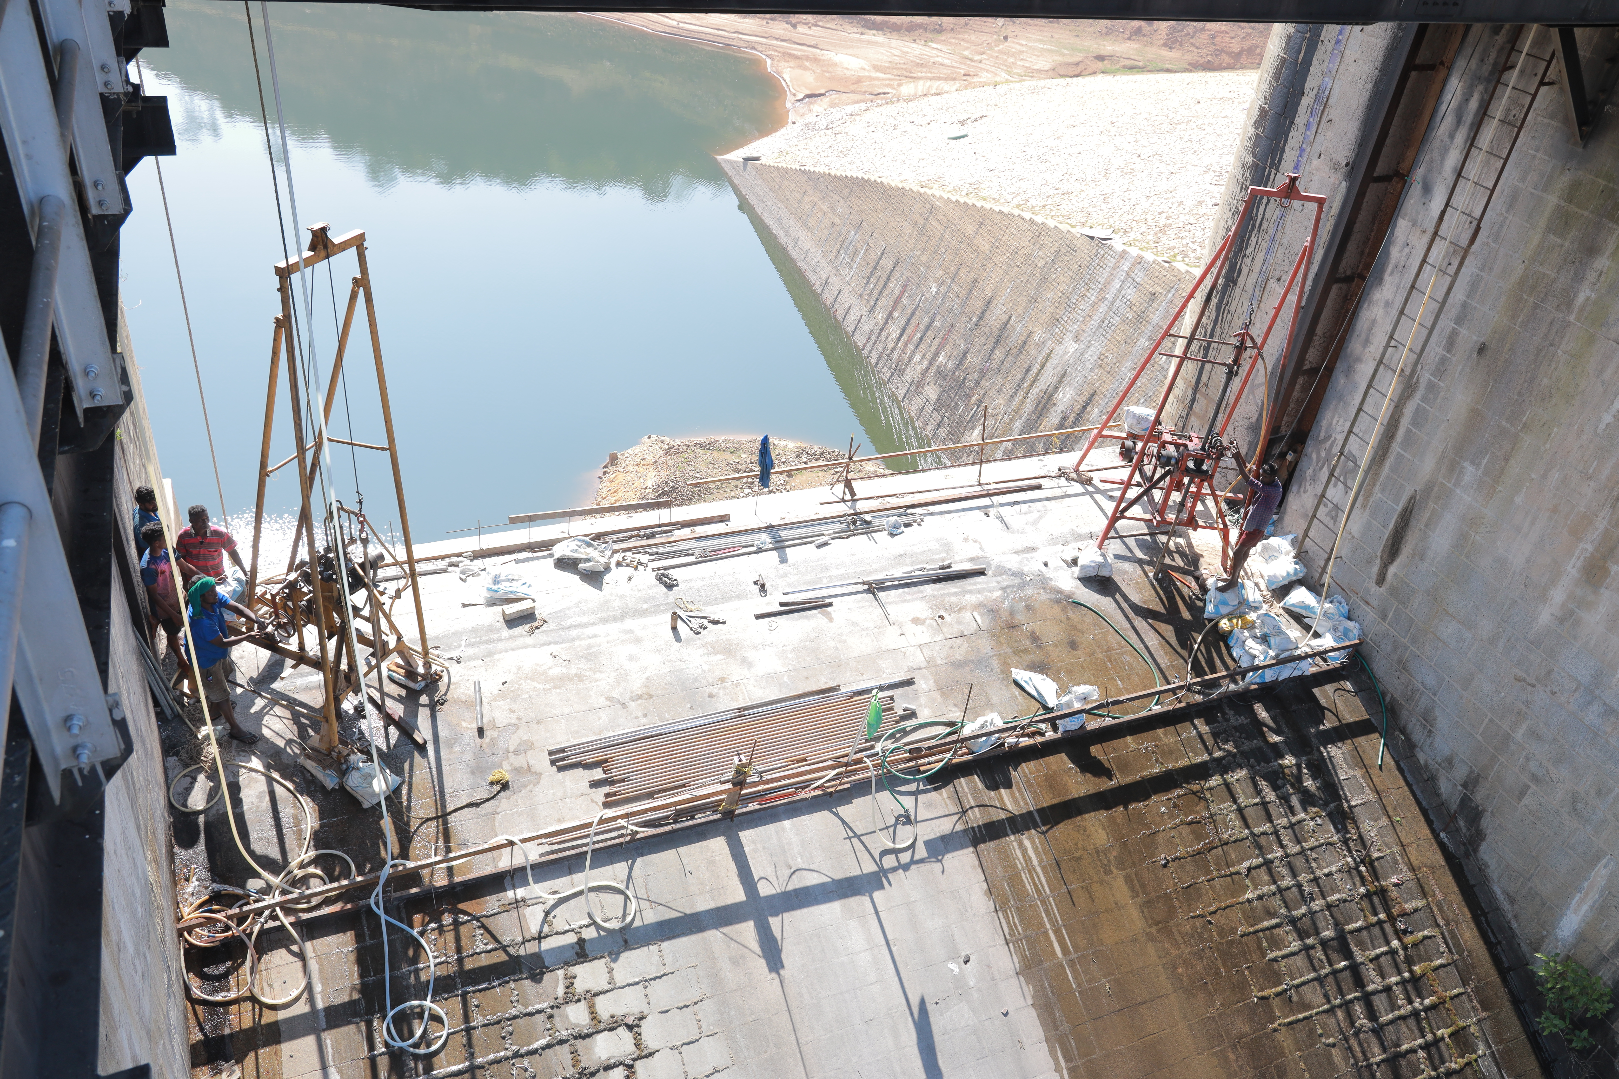
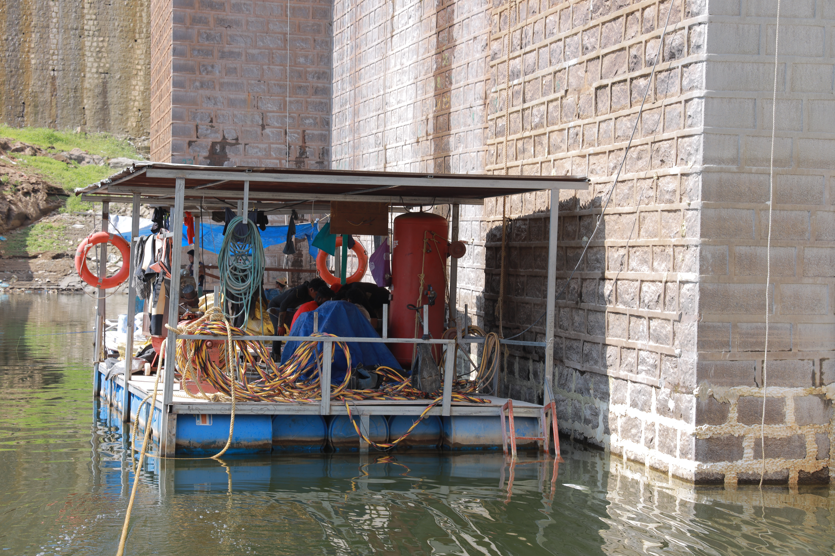
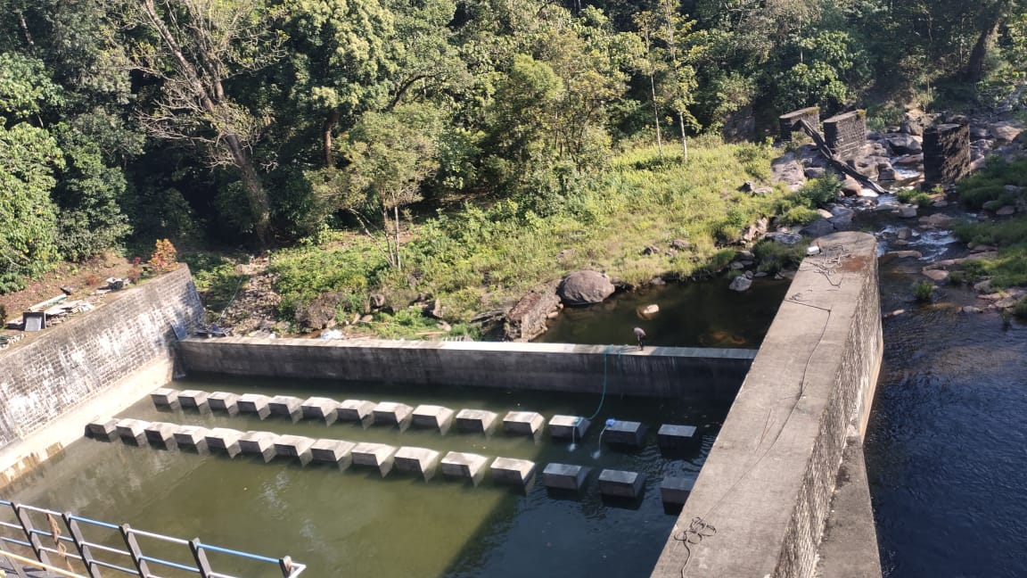
River Sluice Emergency Shutter at Kelavarapalli Dam
Core Drilling activity in spillway portion of Sholayar Dam
Racking and pointing in upstream face RR Joints at under water at Sholayar Dam
Stilling Basin at Upper Nirar weir

