Slide 1
Review of
Water Resources Department
by the
Chief Secretary to Government
20.09.2024
Andiappaanur odai dam, Thirupathur District

Slide 2
Flood Mitigation works

Slide 3
Flood Mitigation & Flood Protection Works
(Unprecedented Rainfall & Michaung cyclone)
The Government have accorded Administrative Sanction for the Permanent Restoration of damaged structures of Water Resources Department during floods in Southern District of TamilNadu for an amount of Rs.280.00crore and Additional Flood Mitigation works in and around-Chennai, Chengalpattu,Kancheepuram and Tiruvallur Districts proposed based on vulnerability met during 2023 Floods for an amount of Rs.350.00 Crore, vide the G.O.(Ms).No.16/ Water Resources (I.Spl.2) Department dated 10.02.2024
Total Works | Region | Total Estimate (In Crore) | No of works completed | No of works to be completed
22 | Chennai | 350.00 | 2 | 20
480 312-CERC 168-State Fund | Madurai | 280.00 | 136(CERC) 60(SF) | 176(CERC) 108(SF)

Slide 4
Flood Protection Works -2023-24
Sl.No. | G.0 | Estimate Amt. (Rs in Crore) | Total Works | No of works completed | No of works in progress
1 | G.O.Ms.No. 94 / Water Resources (S1) Dept, Dated: 09.05.2023 | 19.05 | 2 | 2 | -
2 | G.O.Ms.No. 42 / Water Resources (S1) Dept, Dated: 20.06.2023 | 43.19 | 1 | - | 1
3 | G.O.Ms.No. 327/ R&DM (DM.II) Dept, Dated: 03.07.2023 | 14.50 | 1 | 1 | -
4 | G.O.Ms.No. 145 / Water Resources (I-Spl.2) Dept, Dated: 14.07.2023 | 91.36 | 5 | 5 | -
5 | G.O.Ms.No. 146 / Water Resources (I-Spl.2) Dept, Dated: 14.07.2023 | 15.48 | 2 | 1 | 1
6 | G.O.Ms.No. 172 / Water Resources (I-Spl.2) Dept, Dated: 03.08.2023 | 69.45 | 4 | 1 | 3
7 | G.O.Ms.No. 173 / Water Resources (I-Spl.2) Dept, Dated: 03.08.2023 | 11.43 | 8 | 7 | 1
8 | G.O.Ms.No. 45 / Water Resources (S2) Dept, Dated: 01.09.2023 | 57.24 | 7 | 4 | 3
9 | G.O.Ms.No. 524/ R&DM (DM.II) Dept, Dated: 17.10.2023 | 7.00 | 2 | 1 | 1
10 | G.O.Ms.No. 541 / R&DM (DM.II) Dept, Dated: 26.10.2023 | 96.50 | 1 | - | 1
11 | G.O.Ms.No. 593/ R&DM (DM.II) Dept, Dated: 20.12.2023 | 81.13 | 1 | - | 1
 | Total | 506.33 | 34 | 22 | 12

Slide 5
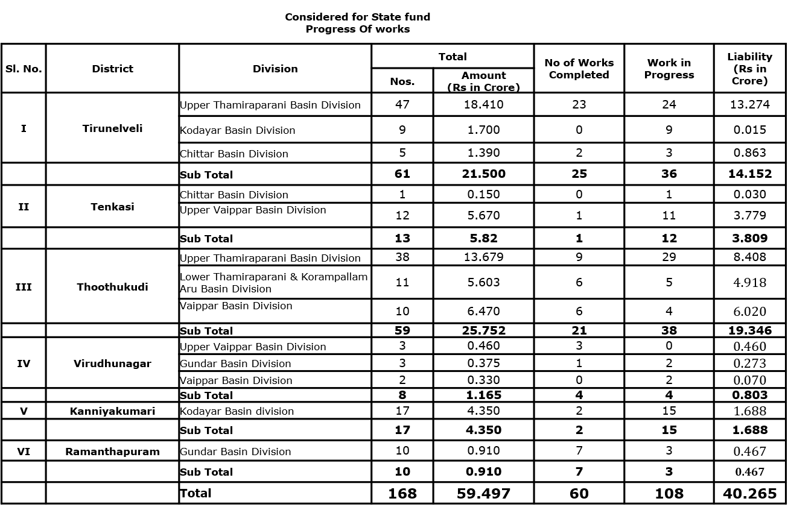
Permanent Restoration works Considered for CERC under State Fund Progress Of works

Slide 6
Permanent Restoration works Considered for CERC under TNIAM Project Progress Of works
Sl. No. | District | Division | Total |  | No of Works Completed | Work in Progress | Liability (Rs in Crore)
 |  |  | Nos. | Amount (Rs in Crore)
I | Tirunelveli | Upper Thamiraparani Basin Division | 99 | 60.514 | 66 | 33 (PQ submitted to TAC for 1 work) | 48.490
 |  | Chittar Basin Division | 63 | 20.120 | 15 | 48 | 11.740
 |  | Sub Total | 162 | 80.634 | 81 | 81 | 60.23
II | Tenkasi | Chittar Basin Division | 54 | 13.563 | 29 | 25 | 9.028
 |  | Sub Total | 54 | 13.563 | 29 | 25 | 9.028
III | Thoothukudi | Upper Thamiraparani Basin Division | 23 | 12.640 | 15 | 8 | 9.795
 |  | Lower Thamiraparani & Korampallam Aru Basin Division | 73 | 113.666 | 11 | 62 | 27.710
 |  | Sub Total | 96 | 126.306 | 26 | 70 | 37.505
 |  | Total | 312 | 220.503 | 136 | 176 | 106.763

Slide 7
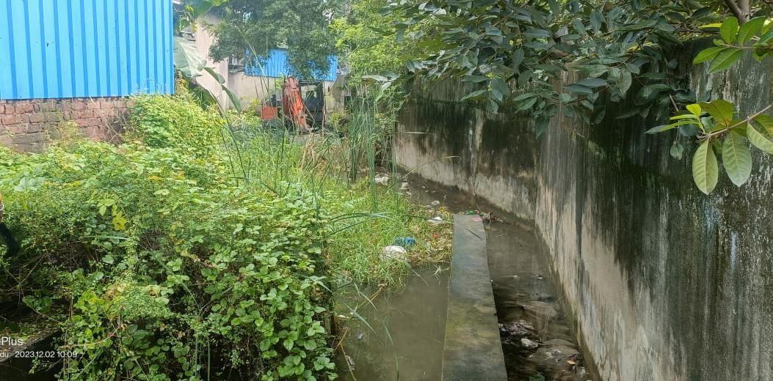
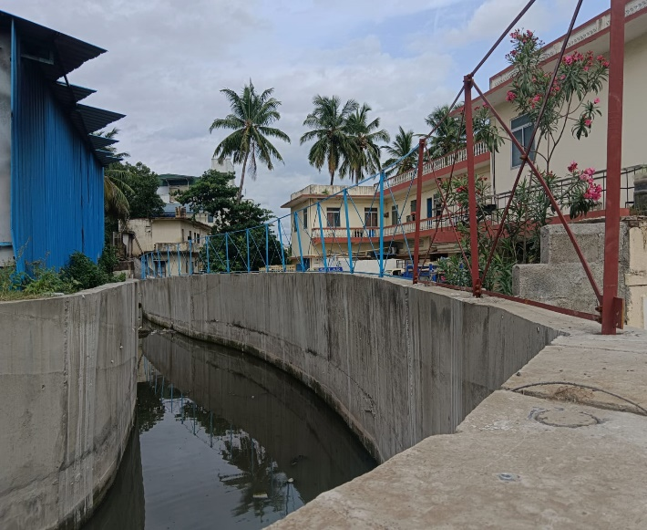
Gerugambakkam Channel
Improvements to Gerugambakkam Channel from LS 160m to LS 1500m in Gerugambakkam Village in Kundrathur Taluk of Kancheepuram District.
Estimate Amount (Rs.in Crore) | Present Stage | Date of Commencement | Probable Date of Completion
19.16 | 92% of work completed. Culvert works completed. Fencing work is in Progress | 31.10.2023 | 30.09.2024
BEFORE EXECUTION
DURING EXECUTION

Slide 8
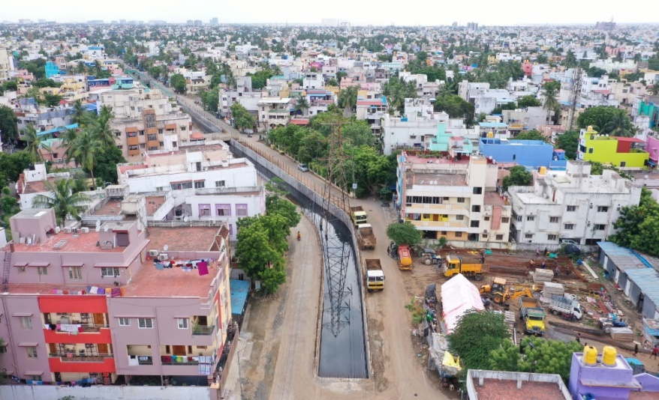
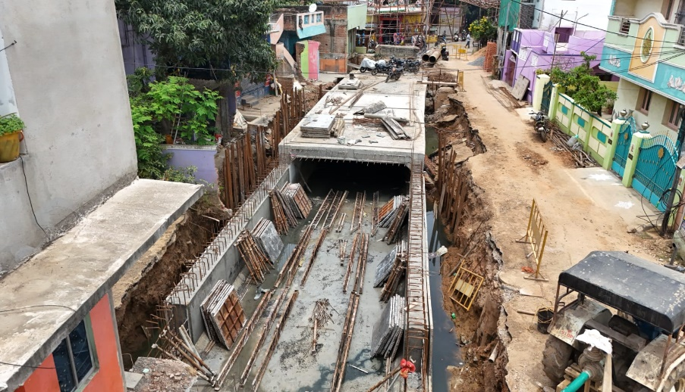
Construction of open channel and cut & cover channel in Thanikachalam nagar drain in Madhavaram and Ayanavaram Taluk in Chennai District
THANIKACHALAM NAGAR DRAIN
Estimate Amount (Rs.in Crore) | Present Stage | Date of Commencement | Probable Date of Completion
91.36 | 65% Work completed. 1600m cut and cover completed.700m open channel completed. Balance work is in progress | 30.08.2023 | 30.09.2024
BEFORE EXECUTION
DURING EXECUTION

Slide 9
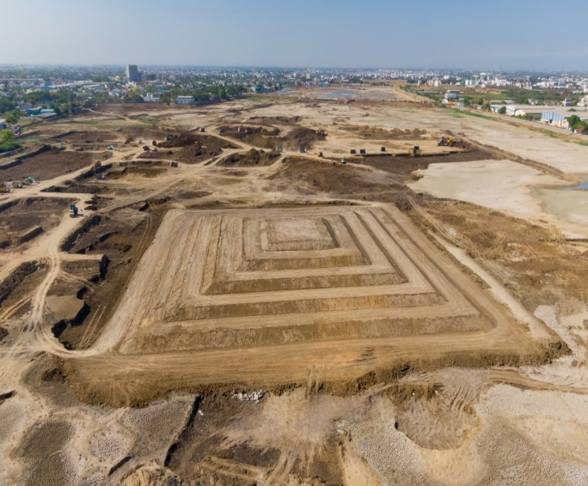
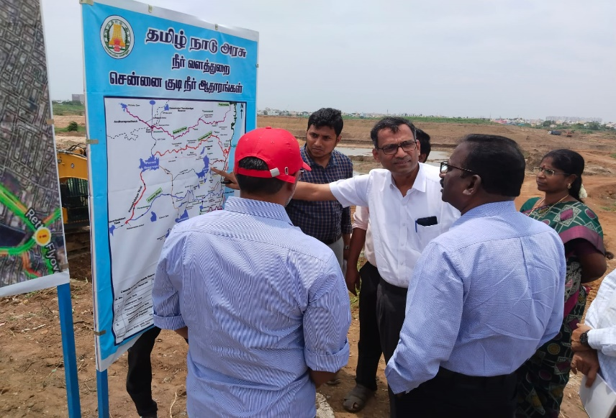
Conversion of Madhavaram Retteri into drinking water source by deepening the Bed and Providing Regulator arrangements and improvements to foreshore area of Madhavaram tank in Madhavaram taluk of Chennai District.
MADHAVARAM RETTERI
Estimate Amount (Rs.in Crore) | Present Stage | Date of Commencement | Probable Date of Completion
43.19 | 55% of work completed. Regulator work completed. 1700m grade beam completed Toe wall 310m completed. Island 80% completed Bund work 80% completed. Compound wall 1350m completed, Island formation and toe wall with revetment work is in Progress. | 21.08.2023 | 31.10.2024
DURING EXECUTION
DURING ACS, WRD INSPECTION

Slide 10
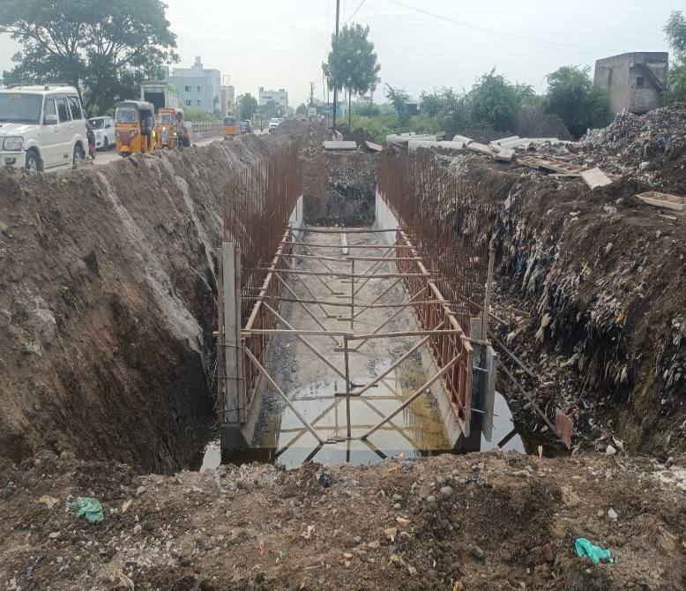
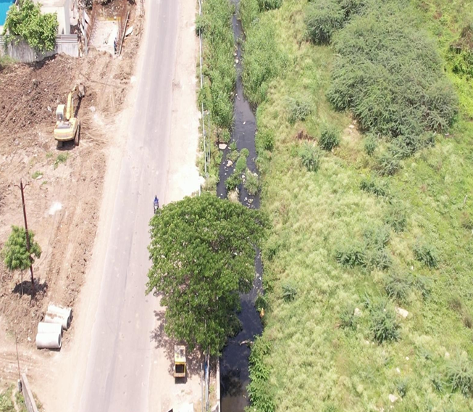
Construction of Cut and Cover along the Dargas road from Pappan channel to Adyar river in Tambaram village & taluk of Chengalpattu District.
Estimate Amount (Rs.in Crore) | Present Stage | Date of Commencement | Probable Date of Completion
12.00 | 25% work completed. Balance Work is in progress | 10.06.2024 | 31.10.2024
DURING EXECUTION
DURING EXECUTION

Slide 11
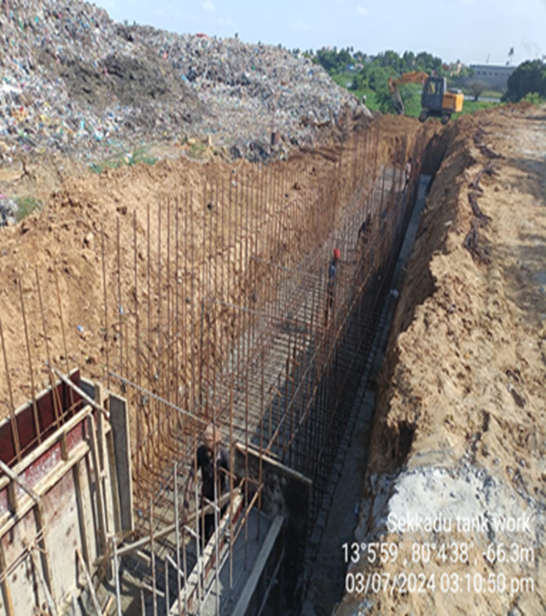
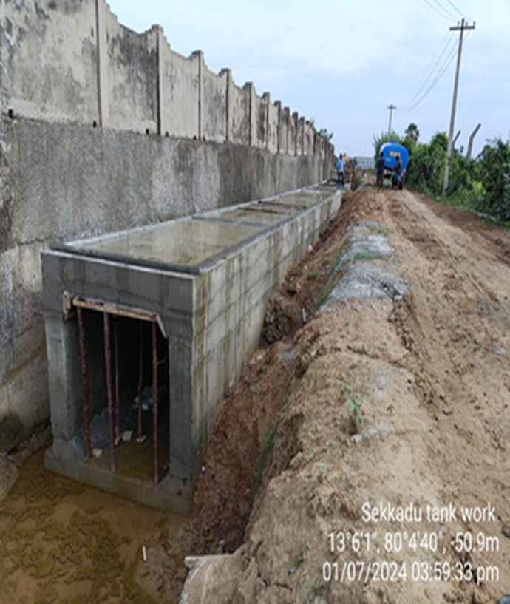
Construction of Regulator arrangements and improvements to surplus course in Sekkadu Tank in Sekkadu Village in Avadi Taluk of Thiruvallur District.
Estimate Amount (Rs.in Crore) | Present Stage | Date of Commencement | Probable Date of Completion
5.00 | 62% work completed. cut & cover 160m completed.42m Raft and Wall work completed. Regulator wing wall work completed. Balance work is in progress | 07.03.2024 | 31.10.2024
DURING EXECUTION
DURING EXECUTION

Slide 12
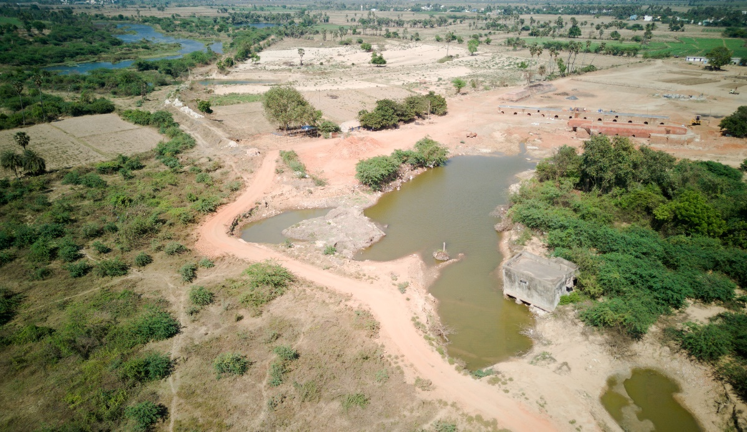
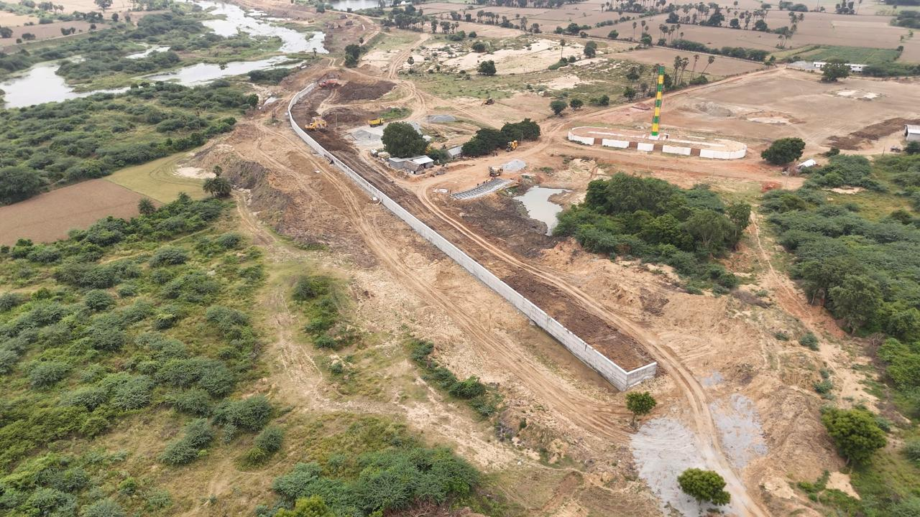
Strengthening and formation of Left Flood Bank with River Training Works damaged due to Cyclone Michaung in Araniyar River from LS 119.700 km to 123.900 km in Ponneri Taluk of Thiruvallur District
Estimate Amount (Rs.in Crore) | Present Stage | Date of Commencement | Probable Date of Completion
19.00 | 60% work completed. Balance Work is in progress | 07.03.2024 | 31.10.2024
BEFORE EXECUTION
DURING EXECUTION

Slide 13
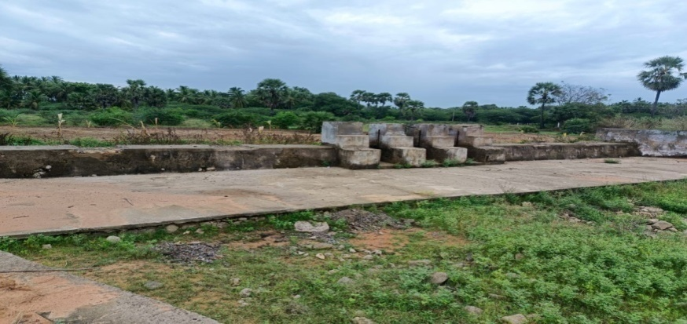
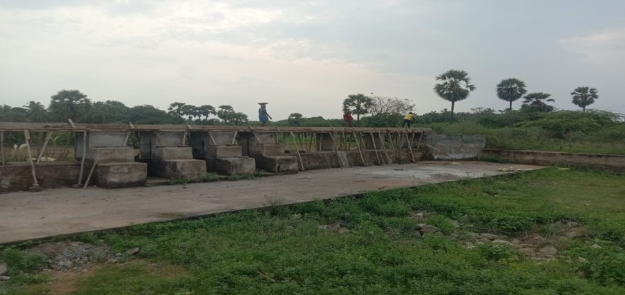
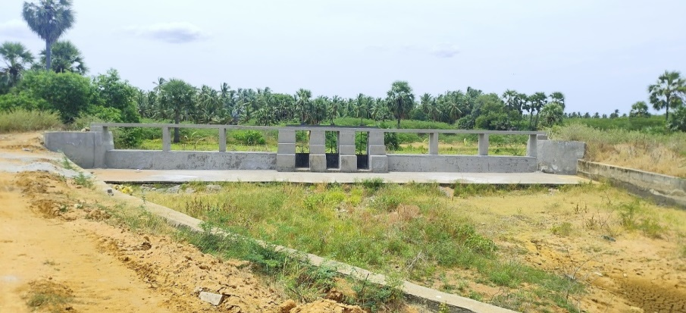
Permanent Breach Closing Sadayaneri Tank in Meignanapuram Village in Tiruchendur Taluk in Thoothukudi District. Est.Amt :Rs 60.00 Lakhs
Before Execution
During Execution
After Execution;
PROVISION OF OPERATING PLATFORM AND SHUTTERS TO SURPLUS WEIR

Slide 14
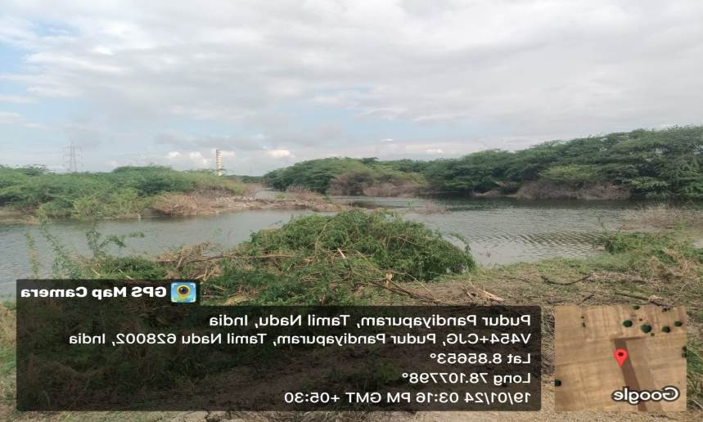
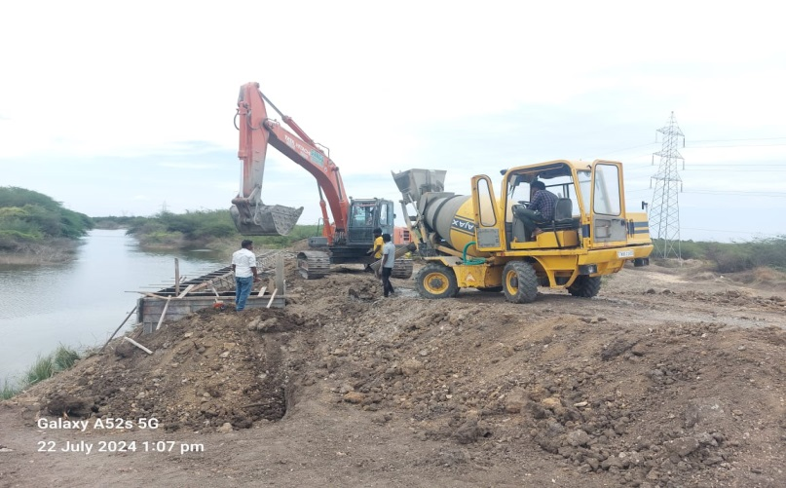
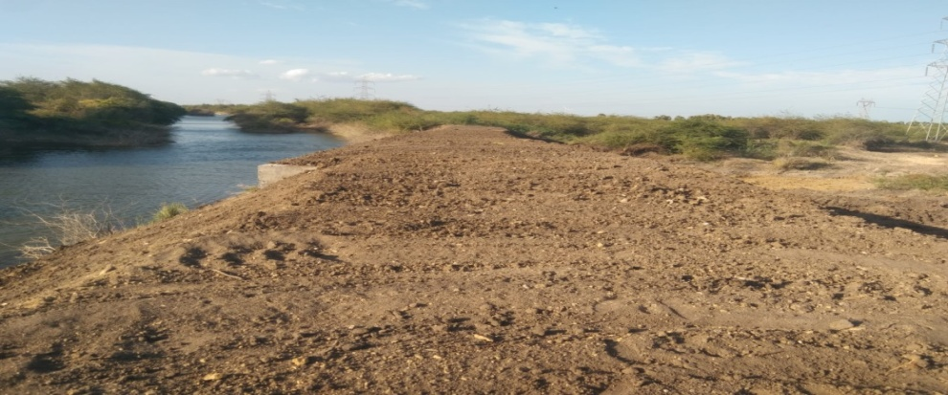
Permanent Restoration of Velayuthapuram Tank Bund Breached Portion between LS 1700 M to LS 1735M affected by 17/12/2023 heavy rains in Velayuthapuram Village of Ottapidaram Taluk in Thoothukudi District. Est.Amt:Rs 29.30 Lakhs
BEFORE EXECUTION
DURING EXECUTION
AFTER EXECUTION
CONSTRUCTION OF PROTECTIVE WALL

