Slide 1
Review of
Water Resources Department
by the
Chief Secretary to Government
20.09.2024
Andiappaanur odai dam, Thirupathur District

Slide 2
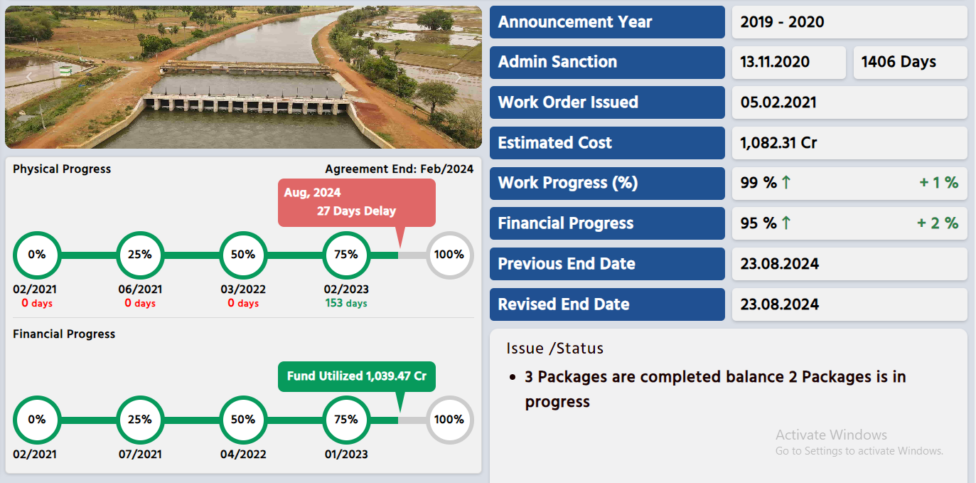
Extension, Renovation and Modernisation Grand Anaicut Canal phase 1(package No 1,2,3,4 & 8)
31.03.2025
Out of 5 packages, 4 packages in phase –I have been completed, 1 package is nearing completion

Slide 3
To restore the original full supply discharge of 4,200 cusecs in Grand Anicut Canal, to increase the conveyance efficiency from 45% to 61.60%.
To enhance production by bridging gap area of 67,500 acre and to benefit total ayacut of 2,27,472 acre in Thanjavur and Pudukkottai Districts.
Administrative Sanction accorded for Rs.1036.70 crore in G.O.(Ms) No.282 Public Works (WR.1) Dept., dated 13.11.2020
Revised Administrative Sanction accorded for Rs.1082.31 crore in GO (Ms) No.10 WR(WR1) Dept., dated 05.02.2024.
Components: Lining –101.41km, Regulators-5 , Repair of Head sluices & Pipe Sluices- 79, Bridges-3, Drops- 24, Canals Syphon – 4, Aqueducts- 2, Syphon & Syphon Aqueducts- -23, road-31.56 km, bund strengthening – 45.21 km, protection wall – 7.58 km, Revetment – 2.8 km

Slide 4
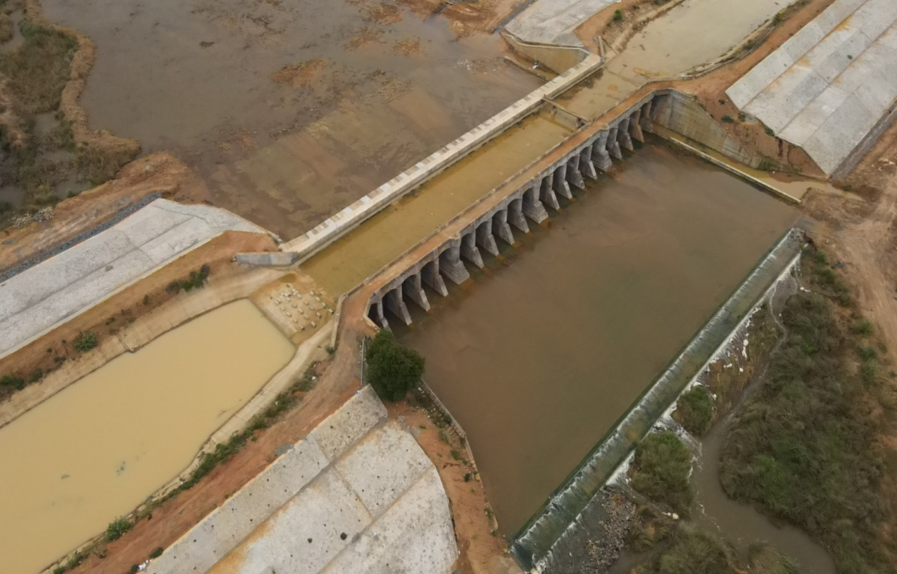
Before Execution
Maharajasamuthiram Aqueduct at Sillathur (Vettikadu) Village in Orathanadu Taluk of Thanjavur District.
After Execution

Slide 5
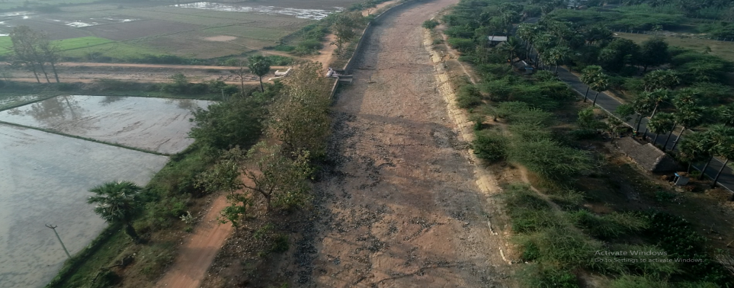
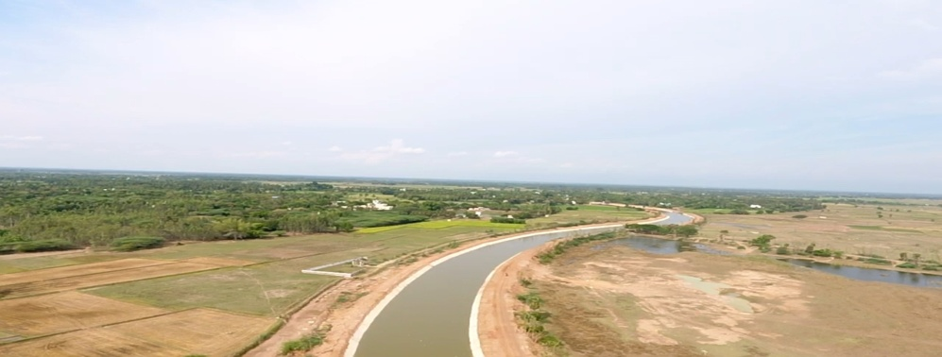
Before Execution
Lining – LS 80.00 Km to 89.045 Km in Vettuvakkottai village of Orathanadu Taluk in Thanjavur District.
After Execution

Slide 6
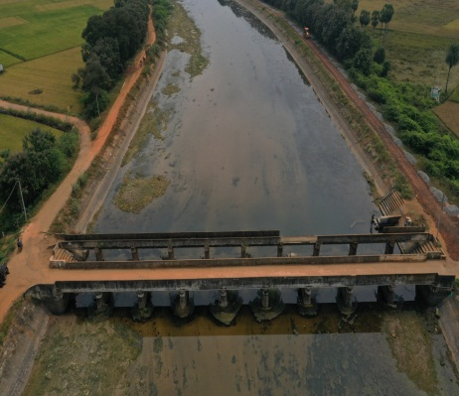
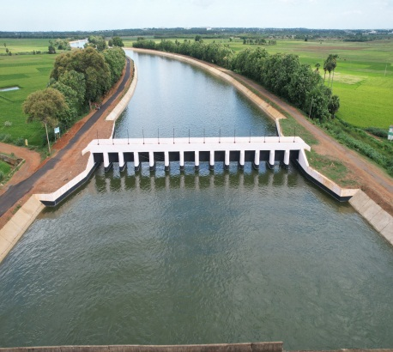
Before Execution
New regulator at L.S (29.900km)- Kuruvadipatti Village of Thiruvaiyaru Taluk in Thanjavur District.
After Execution

