Slide 1
Review of
Water Resources Department
by the
Chief Secretary to Government
20.09.2024
Andiappaanur odai dam, Thirupathur District

Slide 2
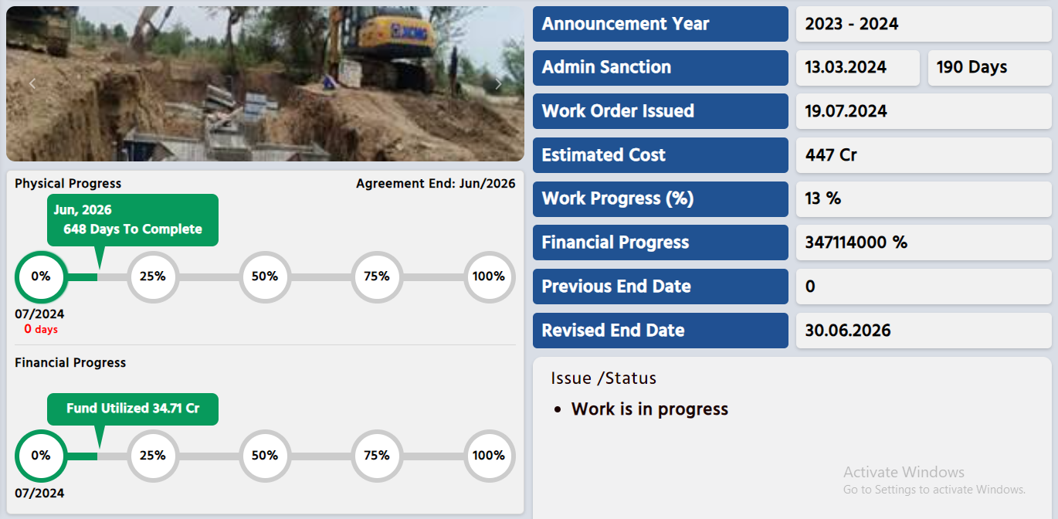
Extension , Renovation and Modernisation Grand Anaicut Canal phase 2 (package No.5,6,7,9,10&11)
8 %
All the 6 packages in phase –II are in progress.

Slide 3
Administrative Sanction accorded for Rs.447.00 crore in G.O.(Ms) No.51,Water Resources (WR.1) Department dt.15.03.2024.
Standardisation of Canals, Channels, Reconstruction / Repair of Head sluices, Pipe Sluices, Regulators, Drops, Syphon Aqueduct, Under Tunnel, Bed dam & Grade wall strengthening of protection works etc are envisaged.
Work commenced during July 2024 and 13 % of work completed. Proposed to complete the works on 18.07.2026
Lining –58.20 km, Regulators-8 , Repair of Head sluices-17, Pipe Sluices- 104, Drops- 18, Canals Syphon – 7, Aqueducts- 3, Syphon Aqueducts- -20,under tunnels-10, super passages - 4
Expenditure incurred in phase II: Rs.34.71crore

Slide 4
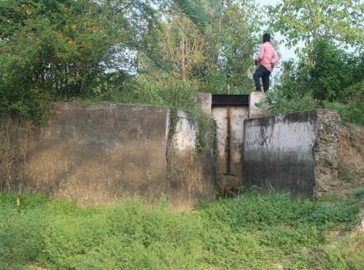
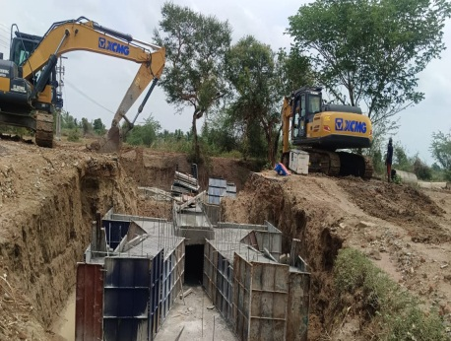
Before Execution
Rehabilitation of GA No.18 Head Sluice in GA Canal at LS 94.499 KM in Seruvaviduthy Village of Peravurani Taluk in Thanjavur District.
Present Stage

Slide 5
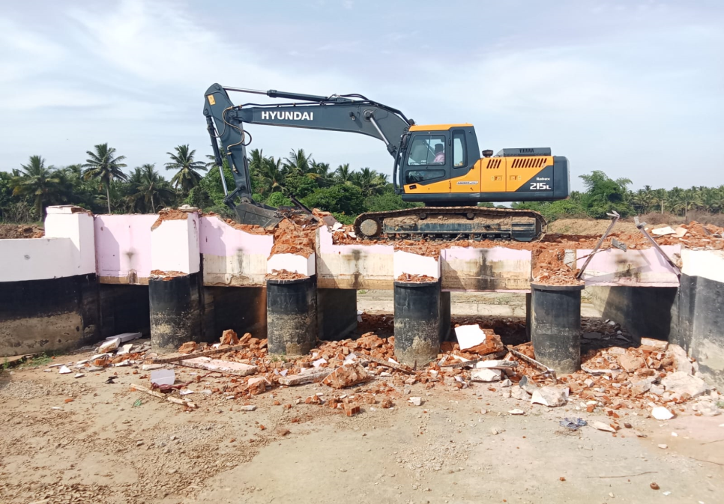
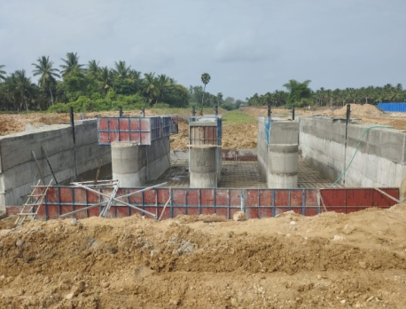
During Execution
Rehabilitation of Kalanivasal Regulator in GA Canal at LS 102.82 KM in Avanam Village of Peravurani Taluk of Thanjavur District.
During Execution

