Slide 1
Review of
Water Resources Department
by the
Chief Secretary to Government
20.09.2024
Andiappaanur odai dam, Thirupathur District

Slide 2
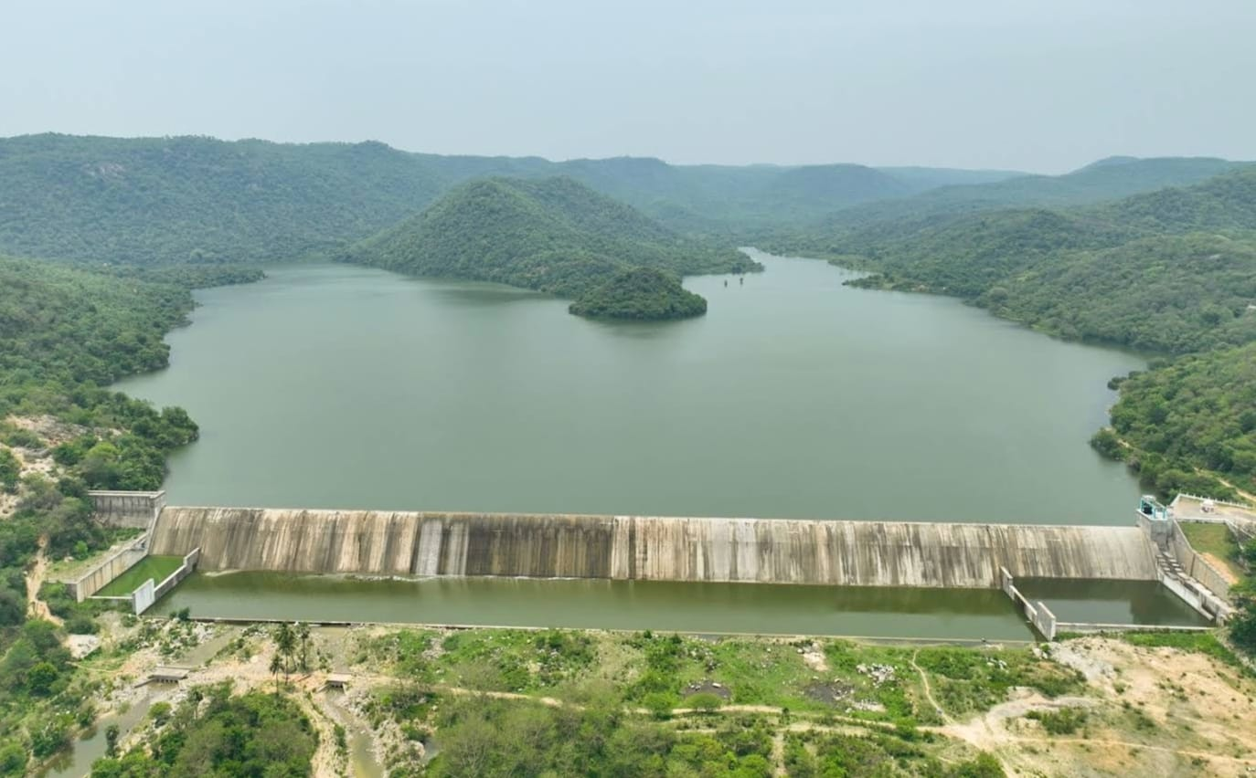
Flagship Schemes
Mordhana Dam, Vellore District

Slide 3
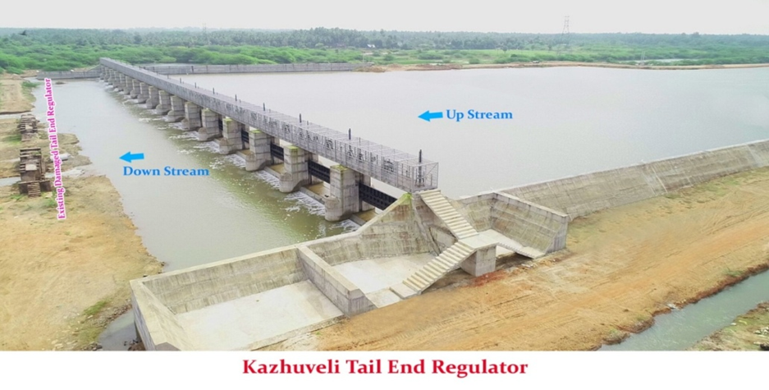
5. Reclaiming Kazhuveli tank for storage of fresh water and sea water intrusion control measures and recharge shaft Well/ Shafts in Marakanam Block of Villupuram District
Attach Photo Only
Announcement Year
2019-2020
Admin Sanction
2020
Work Order Issued
24.02.2021
Est. Cost (Rs. in cr)
Rs. 166.75 cr
Work Progress(%)
37%
Financial Progress (%)
37%
AS | G.O (3D) No.12 PWD (T1) Dept, dated.24.02.2020, Rs. 161.00 cr
RAS | G.O (Ms) No.40 WR(S1) Dept, dated.11.03.2024, Rs. 166.75 cr
Commenced on
24.02.2021
Prob. Date of Completion
31.03.2025
Ayacut Benefited in Ha.
----

Slide 4
The Project is located in Kanthadu village of Marakkanam Taluk in Villupuram District.
The length of the structure is 196.00 m with storage capacity of 6.6TMC water having a water spread area of 5700 ha.
It consists of 18 vents of size 9.00 x 1.75 m with the discharging capacity of 30,000 cusecs.
Work commenced on 24.02.2021 and about 37% of works has been completed with an expenditure of 52.69 crore.
Issues:
The Water Spread has been announced as Birds Sanctuary. Online application under scrutiny to obtain Forest and Wildlife Clearance.

Slide 5
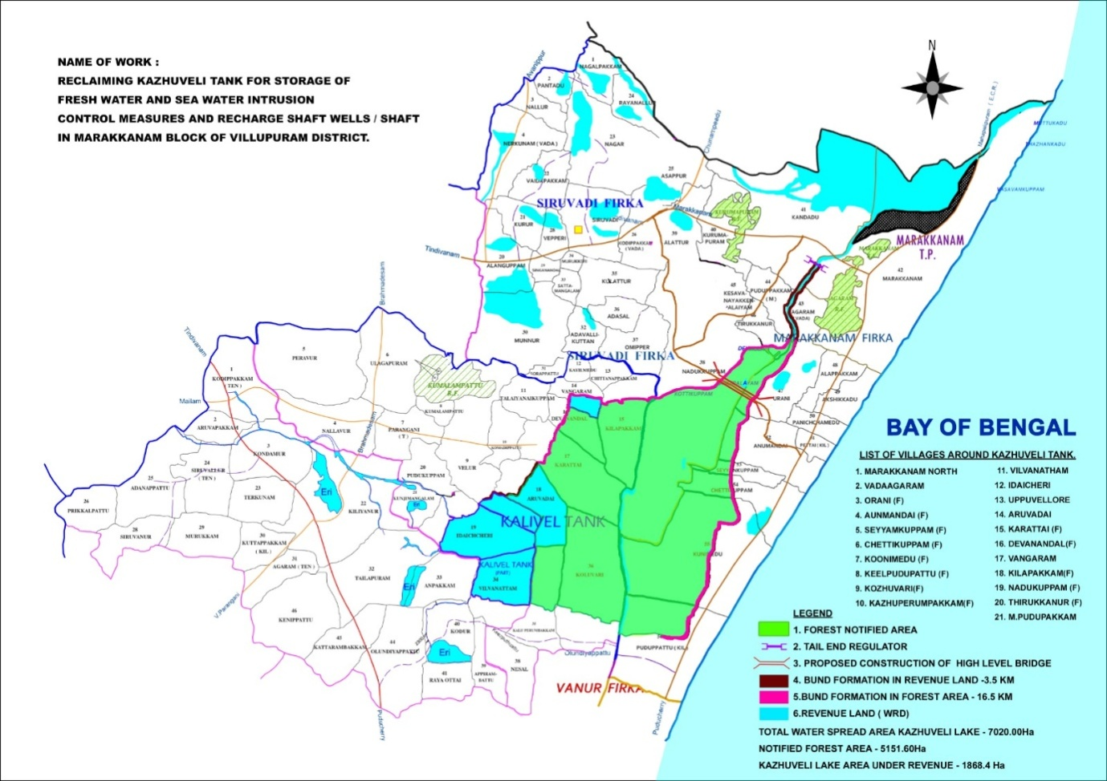
Scheme Area

Slide 6
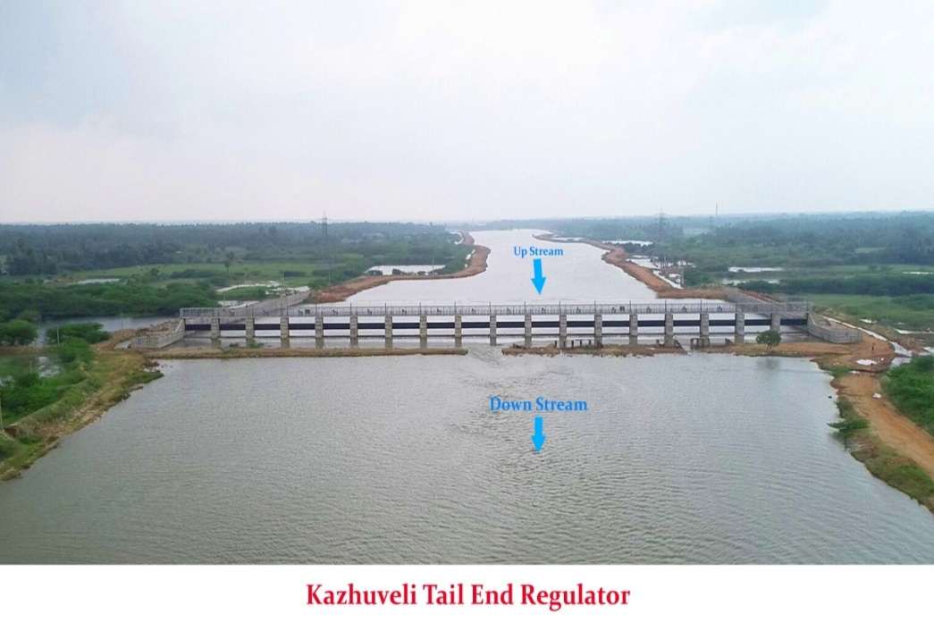

Slide 7
