Slide 1
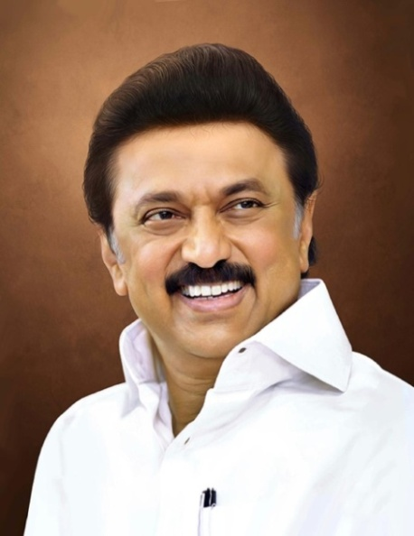
Review of
Water Resources Department
by the
Chief Secretary to Government
20.09.2024
Andiappaanur odai dam, Thirupathur District

Slide 2
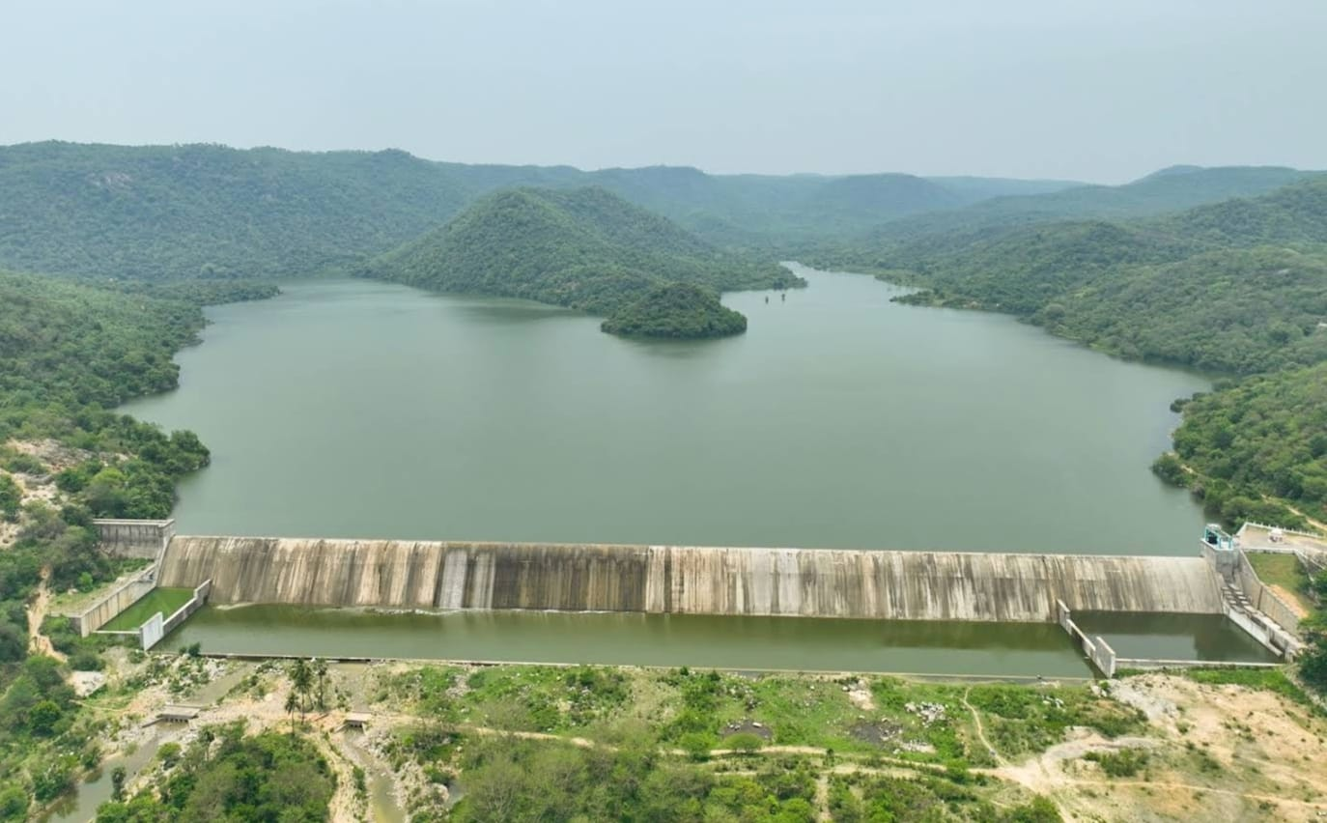
Flagship Schemes
Mordhana Dam, Vellore District

Slide 3
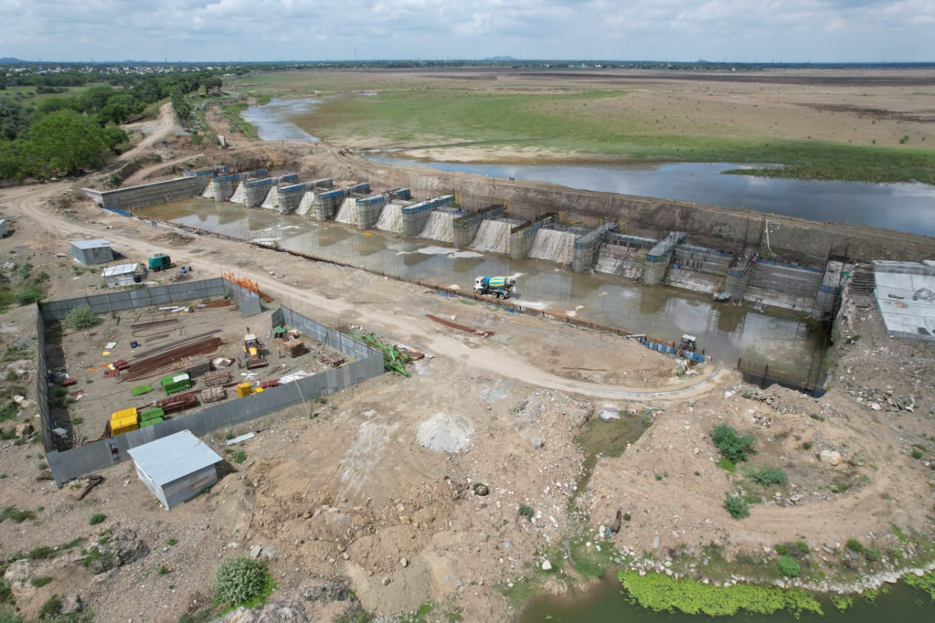
6.Capacity addition by deepening, strengthening of the bund and remodeling of spillways of the Maduranthagam Tank of Chengalpattu District.
Attach Photo Only
Announcement Year
2020
Admin Sanction
15.02.2021
Work Order Issued
06.06.2022
Est. Cost (Rs. in cr)
Rs. 172.66 cr
Work Progress(%)
88%
Financial Progress (%)
88%
AS | G.O.(Ms).No.45 Public Works (T2) Department, Dated.15.02.2021 / Rs. 120.24 cr
RAS | G.O.(Ms) No.44 W.R. (S1) Dept, Dated.13.03.2024 / Rs/ 172.66 cr
Commenced on
06.06.2022
Prob. Date of Completion
31.03.2025
Ayacut Benefited in Ha.
3077.47 ha

Slide 4
The length of the weir is 181.20 m with a Controlled Spillway with storage capacity of 791Mcft water having a water spread area of 1058 ha.
It consists of 12 vents of size 12.10 x 4.41 m with the discharging capacity of 1,12,889 cusecs.
To stabilize an Ayacut of 3077.47 ha in vilages – Vilagam, Murukancheri, Munnuthikuppam, Kathiricheri, Uluthamangalam, Mulli, Valarpirai, Madurantakam-A, Madurantakam-B, Kadapperi.
Work commenced on 06.06.2022 and about 88% of works has been completed with an expenditure of Rs.119.58 crore.

Slide 5
Increasing the existing FTL by 0.50 m by Remodeling the existing Weir No.1,2,3,4 & 5 for new raised FTL.
Remodeling of Weir No.6 as Controlled Spillway using 12 Nos. of Radial Shutter to discharge 1,12,000 Cusecs.
Reconstruction of the old and damaged Sluice No.2 and Repairs to the Sluice No.1,3 & 4.
Construction of Retaining wall for a length of 1567 m.
Desilting and strengthening the banks of Nelvoy Maduvu, Kiliyar river and Kallar river.
Strengthening of the tank bund including BT Road for a length of 1567 m
Formation of new foreshore bund for a length of 18500 m and foreshore reclamation works.

Slide 6
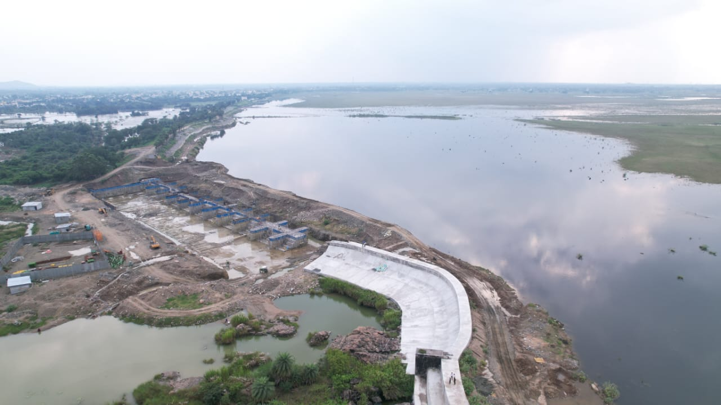
Pond ID : 0266EGB411VP

Slide 7
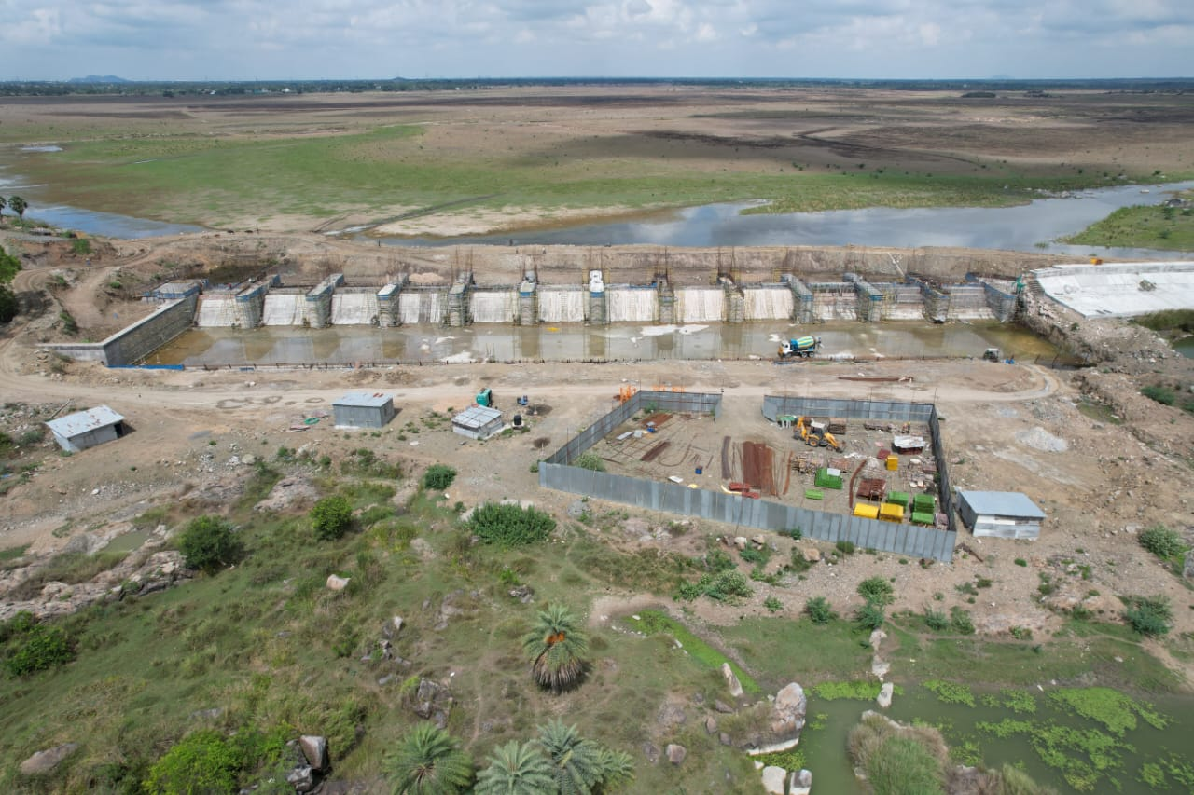
Pond ID : 0266EGB411VP

