Slide 1
Review of
Water Resources Department
by the
Chief Secretary to Government
20.09.2024
Andiappaanur odai dam, Thirupathur District

Slide 2
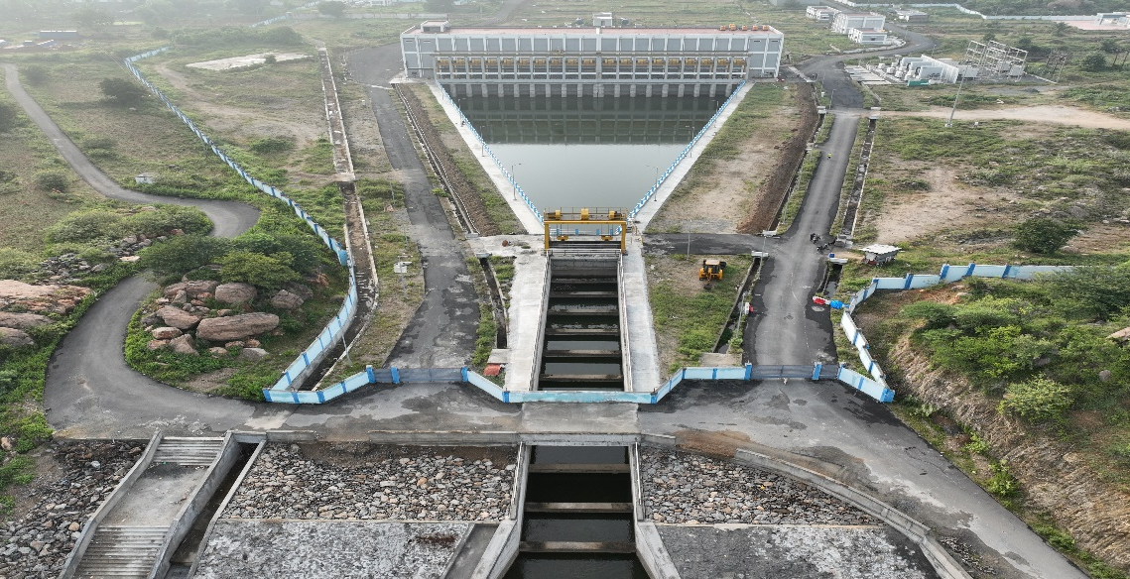
8.Diversion of flood surplus water from the Mettur Dam to the dry tanks in the Sarabanga Basin in Salem District by lift irrigation
Attach Photo Only
Announcement Year
2019-2020
Admin Sanction
2019
Work Order Issued
04.05.2020
Est. Cost (Rs. in cr)
Rs.673.88 cr
Work Progress(%)
96%
Financial Progress (%)
92%
AS | G.O.(Ms) No.193 PW (N1) Department, dated 12.11.2019, Rs. 565.00 cr
RAS | G.O.(Ms) No.22 WR (W2) Department, dated 26.04.2023, Rs. 673.88 cr
Commenced on
04.05.2020
Prob. Date of Completion
31.12.2024
Ayacut Benefited in Ha.
1643.49

Slide 3
This is an Irrigation, Groundwater Recharge and Drinking water supply scheme.
When the water level of Mettur Dam reaches the FRL of 120 feet, surplus water from Mettur Dam will be diverted at the rate of 214 cusecs through 19 pumps to the dry tanks in the Sarabanga Basin in Salem District by Lift Irrigation.
82 tanks / ponds in Salem District would be benefited and an ayacut of 4061.16 Acres stabilized and drinking water purpose fulfilled.
Trial run has been conducted on 01.08.2024 and 511.232 Mcft of surplus water has been pumped and 40 tanks have been filled.
Project commenced on 05.04.2020 and proposed to complete on 31.12.2024. So far 96 % of works have been completed and Rs.622.18crore expenditure has been made.

Slide 4
LAND ACQUISITION DETAILS
1 | Total Land Acquisition- private land (Ha) | : | 116.23.00
2 | Land acquired and Registration done so far-private land (Ha) | : | 94.68.00
3 | Land to be acquired -private land(Ha) | : | 6.85.00
4 | Total Poramboke land to be acquired(Ha) | : | 48.82.50
Land Acquisition Status: 1. Withdrawal proposal to be submitted for an extent of 14.71 Ha. 2. Additional fund requirement proposal to the tune of 32.00 crore for sent to Government vide CLA office Lr.No.LA VII/3226474/2022/Dated: 09.09.2022. 3. Final award to be published for an extent of 6.85 Ha.

Slide 5
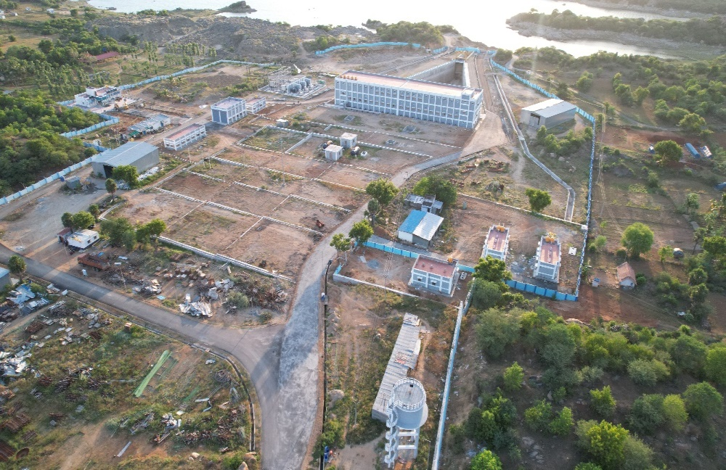
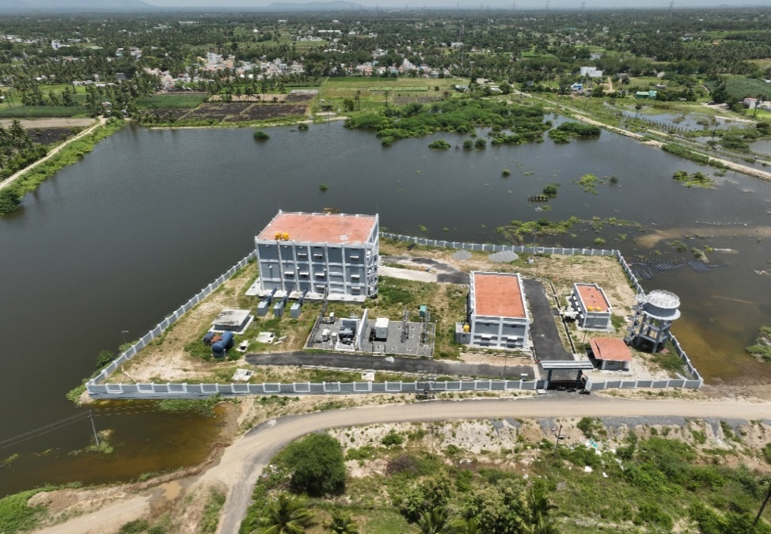
THIPPAMPATTI MAIN PUMP HOUSE LAYOUT
VELLALAPURAM SUB PUMP HOUSE

Slide 6
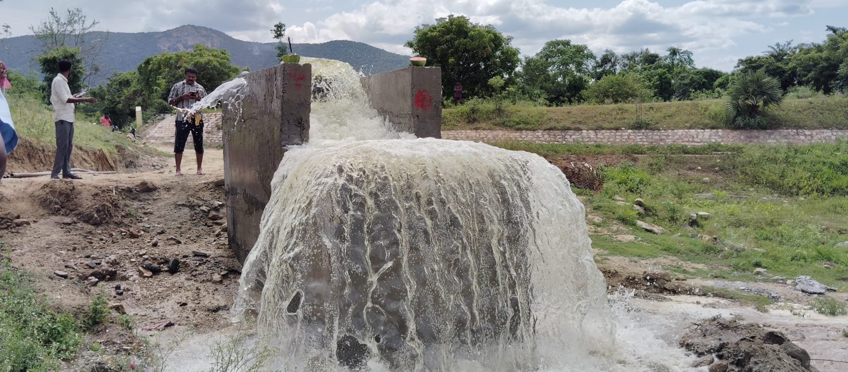
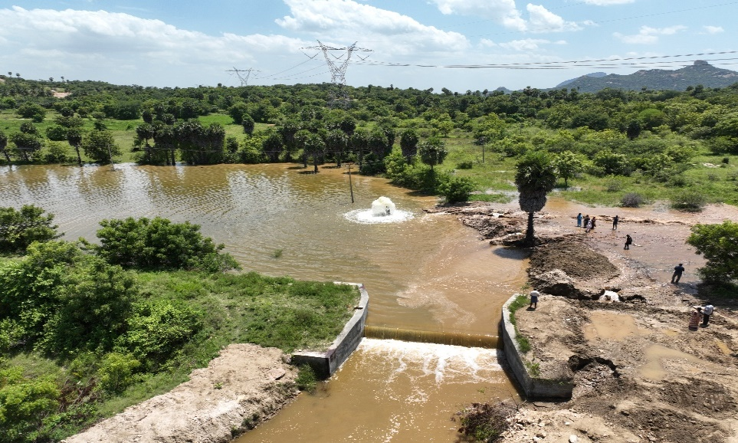
TANKS SURPLUS ON 12.09.2024
KOTHI KUTTAI
VANNAN KUTTAI

Slide 7
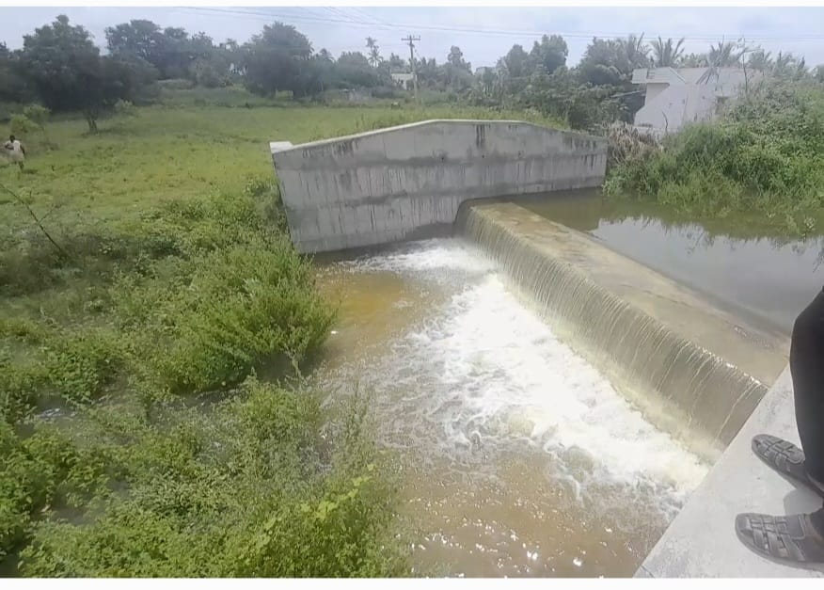
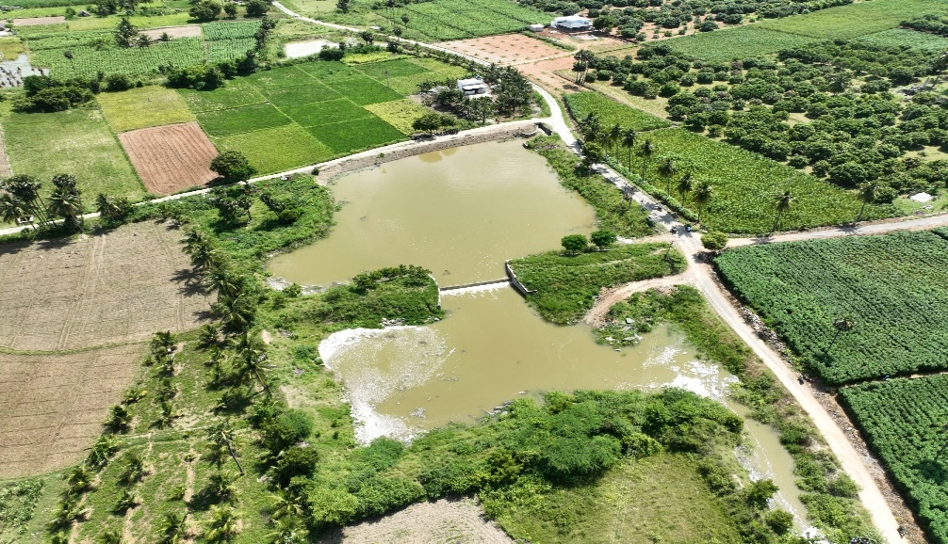
TANKS SURPLUS ON 12.09.2024
ETTIKUTTAI
RAGAS KUTTAI

