Slide 1
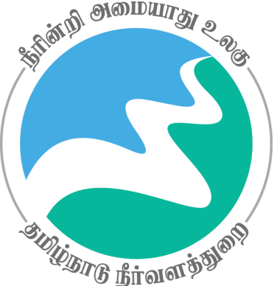
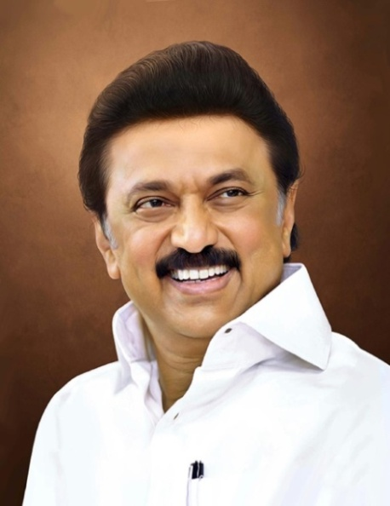
Review of
Water Resources Department
by the
Chief Secretary to Government
20.09.2024
Andiappaanur odai dam, Thirupathur District

Slide 2
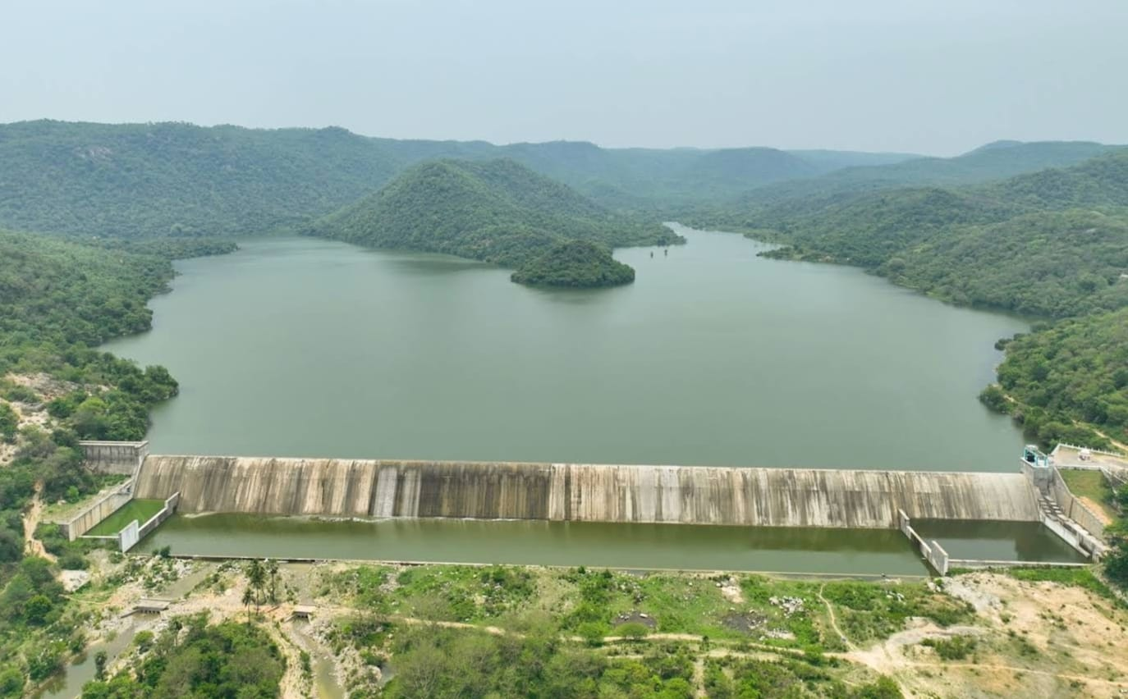
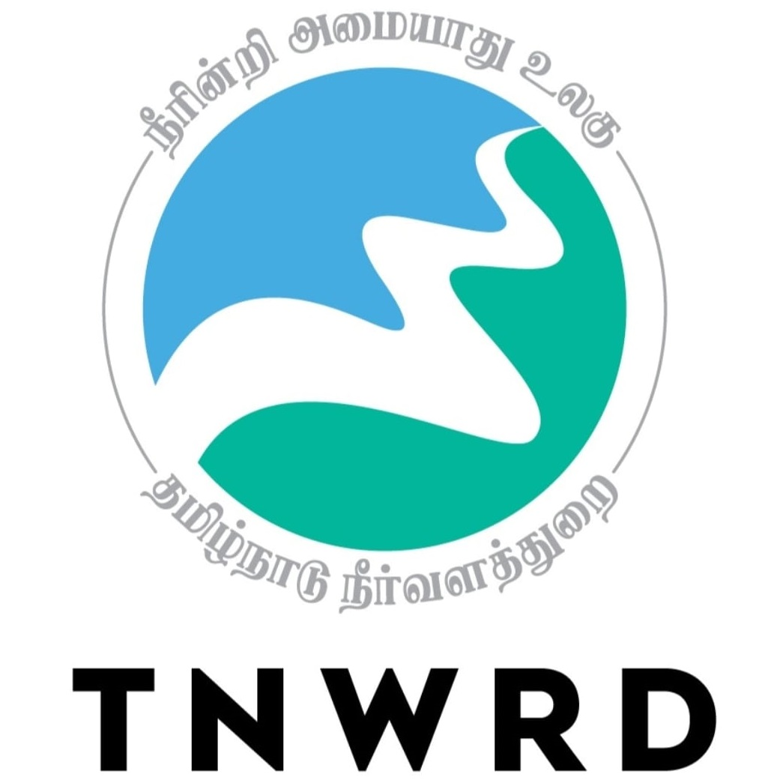
Flagship Schemes
Mordhana Dam, Vellore District

Slide 3
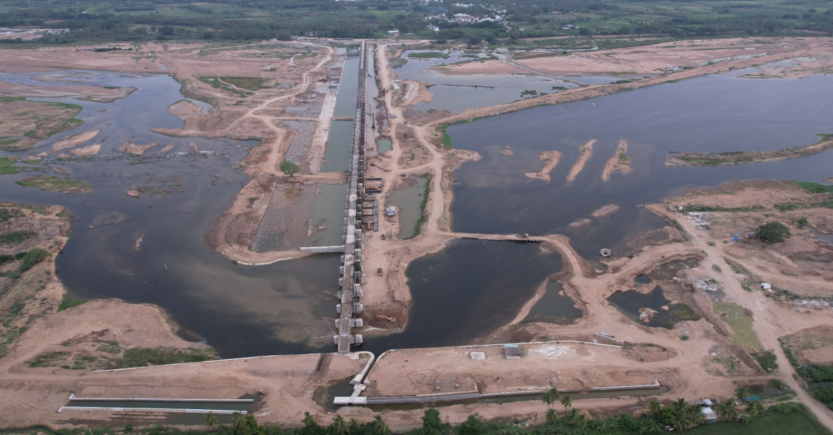
4. Construction of Barrage across River Cauvery in Nanjai Pugalur Village in Karur District
Attach Photo Only
Announcement Year
2019-2020
Admin Sanction
2020
Work Order Issued
22.02.2021
Est. Cost (Rs. in cr)
Rs. 406.50 Cr
Work Progress(%)
76%
Financial Progress (%)
73.5%
AS | G.O.(Ms) No.149 PW (N2) Department, dated 04.06.2020 / Rs.406.50 cr
Commenced on
22.02.2021
Prob. Date of Completion
21.02.2025
Ayacut Benefited in Ha.
1635.335

Slide 4
Construction of a barrage across the river Cauvery for a length of 1056m with 56 vents of size 12 x 4.40m and 17 scour vents of size 12 x 5.00m is in progress.
The barrage is designed to discharge 3,60,000 cusecs water with a storage capacity of 0.8 TMC.
By constructing a head sluice in Mohanur channel which is off-taking on the left side of the river, the water needs for 2583 acres of ayacut in Namakkal district is ensured.
Through rehabilitation of Vaangal channel in Karur district an ayacut of 1458 acres gets benefited.
The need of water requirement of Tamil Nadu Newsprint and Papers Limited (TNPL) gets ensured through infiltration well which is located at about 3.50 km on the upstream side.

Slide 5
This project benefits 15 Combined Drinking Water Supply Schemes of Tamil Nadu Water Supply and Drainage Board in Karur and Namakkal districts.
The project is taken up under NIDA assistance at a cost of Rs.406.5 crore.
The work commenced on 22.02.2021 and it is proposed to be completed by 21.02.2025.
so far, 76 % of works have been completed and an expenditure of Rs.299.26 crore incurred.
RAS for Rs.583.54 crore is under consideration.
Issues:
To construct the flood bank in left bank of river Cauvery, land to be acquired from forest department such as velur 11.57.40 Ha., Devarayasamudram 6.77.90 Ha., Pandamangalam 17.43.90 Ha., Vengarai 22.83.70 Ha.

Slide 6
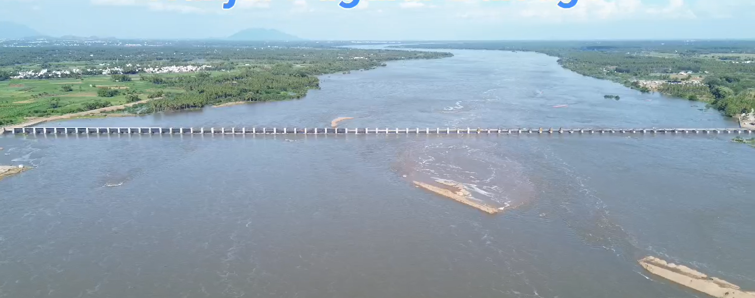

Slide 7
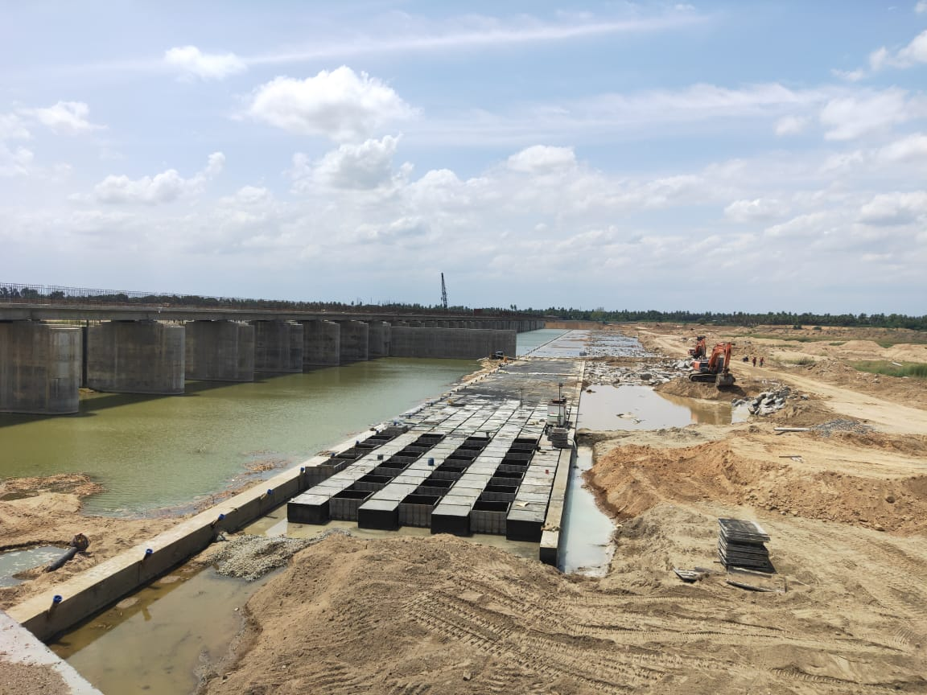
During construction

