Slide 1
1. Extension, Renovation and Modernisation of Noyyal River System

Slide 2
1. Extension, Renovation and Modernisation of Noyyal River System
Project Components : Retaining wall in supply Channel, Lining in Supply Channel, Rehabilitation of Anicut, Tanks, Checkdam, Fencing work, Sluices, Sluices of Channels Surpuls courses works.
Estimate Amount: Rs. 230 crore Overall Expenditure (31.03.2023): Rs. 226.87 crore Percentage: 98.75%
Location : Coimbatore, Erode, Karur & Tiruppur Districts
Package Details | Package I | Package II | Package III
G.O.No. & Date | G.O.(Ms).No.209 PW(W1) Dept dated : 22.11.2019
Funding Agency | State fund
Estimated Cost (Rs. in crore) | 88.63 | 86.33 | 55.04
Work commencement Date | 01.06.2020 | 01.06.2020 | 10.06.2020
Actual Physical Progress(in %) | 100 | 100 | 100
Expenditure (Rs. in crore) | 86.03 | 85.97 | 54.87
Financial Progress (in %) | 97 | 99.58 | 99.69
Date of Completion as per schedule | 30.07.2022 | 31.05.2022 | 09.06.2022
Probable date of completion | 14.07.2022 | 16.11.2021 | 31.10.2021

Slide 3
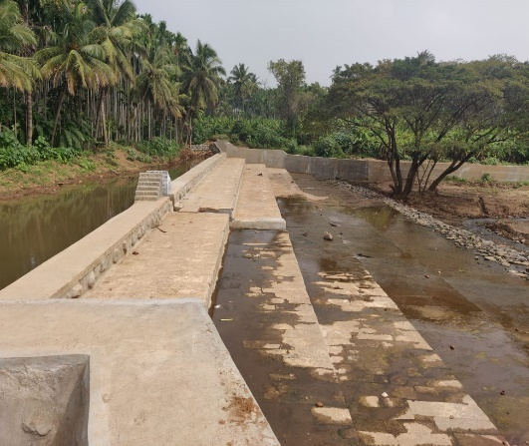
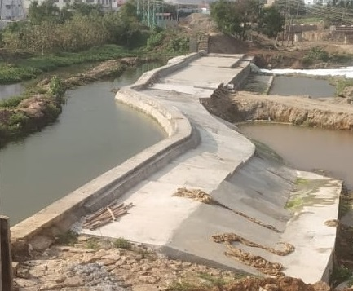
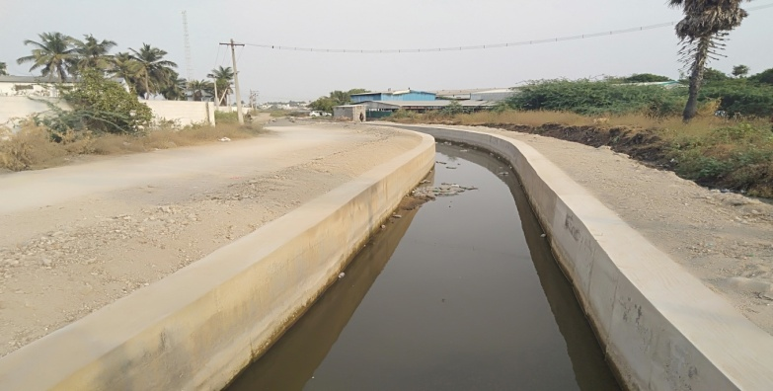
1. Extension, Renovation and Modernisation of Noyyal River System
Kurichi Anicut
Irugur Anicut
Retaining wall in Andipalayam Supply Channel

Slide 4
1.2. Extension, Renovation and Modernisation of Noyyal River System
Package Details | Package I | Package II | Package III
LS | LS 0 km to 34 km | LS 34 km to 72 km | Ls 72.00 km to 158.35 km
Tender Date | 23.12.2020 | 23.12.2020 | 24.12.2020
Tender Value | 80.05 | 78.62 | 44.73
Work order date | 03.02.2021 | 18.02.2021 | 18.02.2021
Constituency | Thondamuthur | Kinathukadavu, Sulur, Palladam, Singanallur | Tiruppur south, Tiruppur North, Kangeyam, Aravakurichi, Karur,, Perundurai
Taluk | Perur, Coimbatore south | Sulur, Palladam, Coimbatore south | Tiruppur south, Uthukuli, Kangeyam, Perundurai, Pugalur

Slide 5
2. Extension, Renovation and Modernisation of Kattalai High Level Canal Irrigation System in Cauvery Basin

Slide 6
2. Extension, Renovation and Modernisation of Kattalai High Level Canal Irrigation System in Cauvery Basin
Project Components: Canal lining, Reconstruction of Sluices, Reconstruction and repairs of Syphon, Reconstruction and repairs of Under Tunnel, Reconstruction and repairs of foot Bridges, Trough Aqueduct, inlets, Outlets.
Location : Karur District
Package Details | Package
G.O.No. & Date | G.O. No: 207, dated 22.11.2019
Funding Agency | NABARD
Estimated Cost (Rs. in crore) | 335.50
Work commencement Date | 25.05.2020
Actual Physical Progress (in %) | 95
Expenditure (Rs. in crore) | 301.00
Financial Progress (in %) | 90%
Date of Completion as per schedule | 31.03.2023
Probable date of completion | 31.05.2023

Slide 7
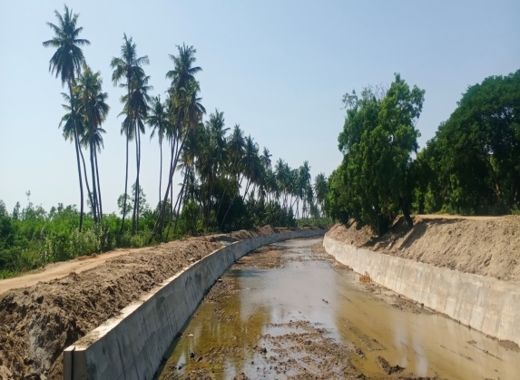
Timeline for completion of works | 25% | 50% | 75% | 100%
 | 31.08.2021 | 31.05.2022 | 31.03.2023 | 31.05.2023
Present Stage

Slide 8
2. Extension, Renovation and Modernisation of Kattalai High Level Canal Irrigation System in Cauvery Basin
Details | Kattalai High Level Canal Irrigation System
LS | LS.0 km to LS 60 km
Tender Date | 10.01.2020
Tender Value | 315.97 crore
Work order date
Constituency | Krishnarayapuram, Kulithalai, Karur, Sri Rangam
Taluk | Krishnarayapuram, Kulithalai, Sri Rangam
Remarks (if any) | Continuous water flow in canal – Two more months needed for completion of work

Slide 9
3. Extension, Renovation and Modernization of Raja Vaikkal System

Slide 10
3. Extension, Renovation and Modernization of Raja Vaikkal System
Project Components :Canal lining, Construction of Sluices, Bridges, inlets, Outlets.etc
Estimate Amount: Rs. 184 crore Overall Expenditure (31.03.2023): Rs. 157.25 crore Percentage: 86%
Location : Namakkal District
Package Details | Package I | Package II
G.O.No. & Date | G.O. No: 208, dated 21.11.2019
Funding Agency | NABARD-NIDA
Estimated Cost (Rs. in crore) | 92.00 | 92.00
Work commencement Date | 04.05.2020 | 04.05.2020
Actual Physical Progress | 100 | 100%
Expenditure (Rs. in crore) | 77.24 | 80.01
Financial Progress (in %) | 84% | 87%
Date of Completion as per schedule | 03.05.2022 | 03.05.2022 ( completed)
Probable date of completion | 31.03.2023 | 31.03.2023

Slide 11
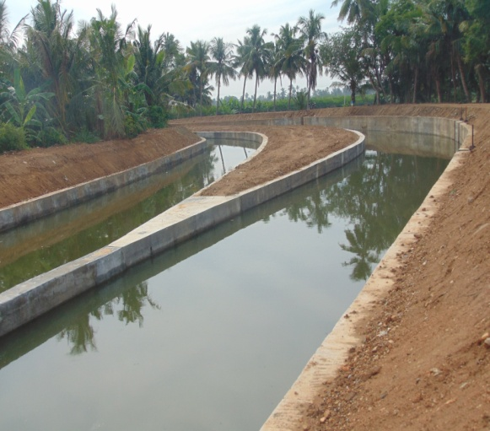
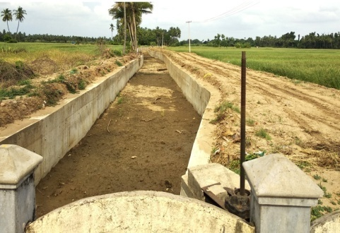
Timeline for completion of works | 25% | 50% | 75% | 100%
 | 30.06.2020 | 31.08.2020 | 30.09.2020 | 31.03.2023
Present Stage

Slide 12
3. Extension, Renovation and Modernization of Raja Vaikkal System
Package Details | Package I | Package II
LS / Length | 38.17 km | 39.94 km
Tender Date | 10.01.2020 | 10.01.2020
Tender Value | 82.11 crore | 84.60 crore
Work order date | 04.05.2020 | 04.05.2020
Constituency | Paramathi Velur | Paramathi Velur, Namakkal
Taluk | Paramathi Velur, Mohanur | Paramathi Velur, Mohanur
Remarks (if any) | Awaiting for approval in Additional quantity and additional item proposal under scrutiny in Government.

