Slide 1
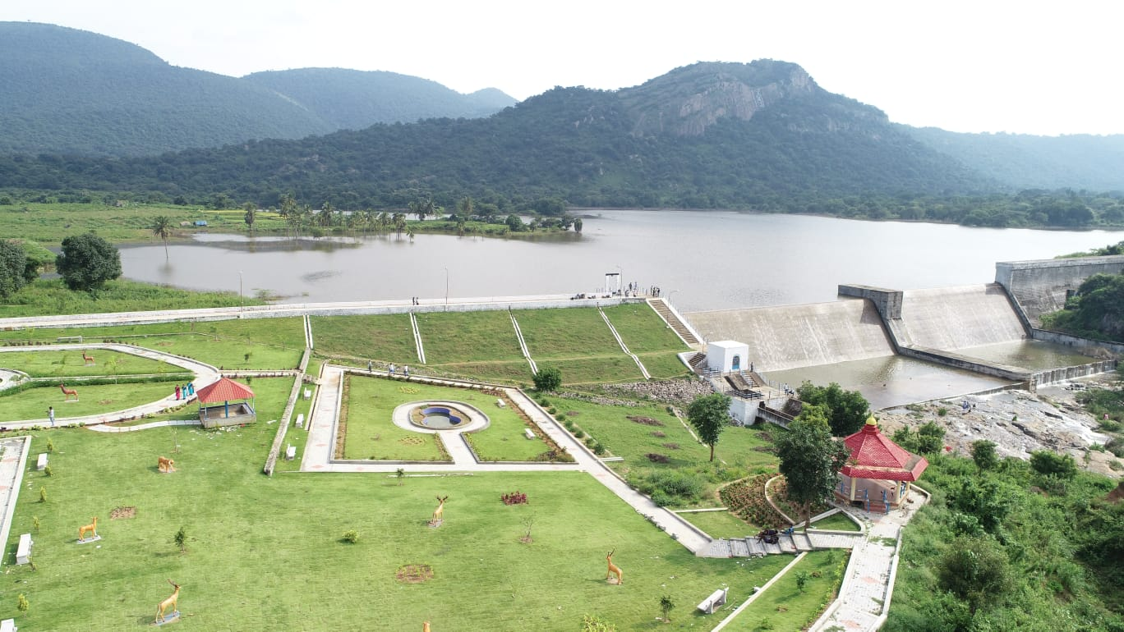



Review of
Water Resources Department
by the
Chief Secretary to Government
20.09.2024
Andiappaanur odai dam, Thirupathur District

Slide 2
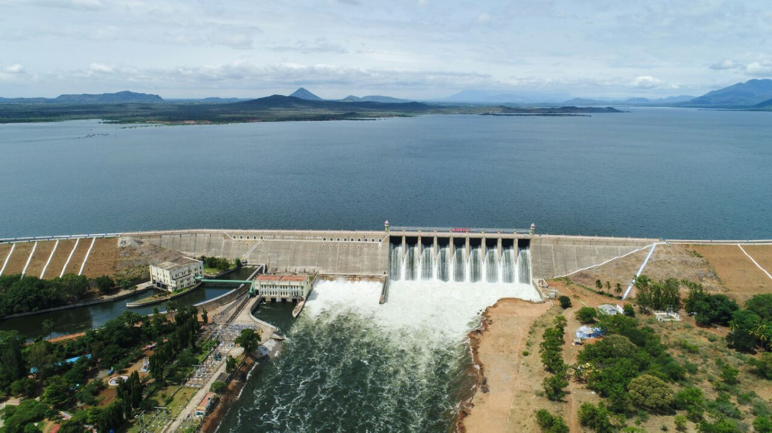

Centrally Sponsored Schemes
Bhavani Sagar Dam, Erode District

Slide 3
Repair, Renovation and Restoration (RRR) of water bodies
Repair, Renovation and Restoration (RRR) is a Centre-State shared scheme under PMKSY.
This scheme involves the following components:
Standardisation of tank bund to standards.
De-silting the tank bed to restore the storage capacity
Reconstruction / Improvements to sluices and surplus arrangements
De-silting and strengthening of feeder channel to ensure supply to tanks

Slide 4
Repair, Renovation & Restoration (RRR)of Water bodies
(Rs. in crore)
Phase | No. of works | Completed | In progress | To be taken up | Est. Amt. | Expr. | State share | Government of India
 |  |  |  |  |  |  |  | Share | Released | To be released
I,II & III | 153 | 153 |  |  | 77.75 | 73.26 | 25.00 | 48.26 | 18.21 | 30.06
IV & V | 92 | 92 |  |  | 51.04 | 47.39 | 20.27 | 30.31 | 27.48 | 2.83

Slide 5
(Rs. in crore)
Phase | No. of works | Completed | In progress | To be taken up | Est. Amt. | Expr. | State share | Government of India
 |  |  |  |  |  |  |  | Share | Released | To be released
VI | 115 | 95 | 20 |  | 75.00 | 41.40 | 31.87 | 43.13 | 24.94 | 18.19
VII | 85 | 54 | 31 |  | 90.08 | 49.75 | 41.58 | 48.50 | 30.08 | 18.42
VIII | 100 | 59 | 41 |  | 92.83 | 46.84 | 42.57 | 50.26 | 28.26 | 21.99
IX | 100 | 1 | 99 |  | 111.48 |  | 50.93 | 60.56 |  | 60.56
X | 123 |  |  | 123 | 100.07 |  | 40.03 | 60.04 |  | 60.04
TOTAL | 768 | 454 | 191 | 123 | 598.25 | 258.64 | 252.25 | 341.06 | 128.97 | 212.09

Slide 6
Physical Progress
Chennai Region
Trichy Region
Phase | No. of works | No. of works Completed | No. of works in progress
VI | 38 | 33 | 5
VII | 26 | 19 | 7
VIII | 26 | 17 | 9
IX | 11 | 0 | 11
Total | 101 | 69 | 32
Phase | No. of works | No. of works completed | No. of works in progress
VI | 32 | 18 | 14
VII | 25 | 10 | 15
VIII | 30 | 8 | 22
Total | 87 | 36 | 51
Madurai Region
Phase | No. of works | No. of works Completed | No. of works in progress
VI | 45 | 44 | 1
VII | 34 | 25 | 9
VIII | 44 | 34 | 10
IX | 89 | 1 | 88
Total | 212 | 104 | 108

Slide 7
Tank bund Strengthening
Before Execution
After Execution
Phase IV-Elagiri Tank in Nallampalli Block of Dharmapuri Taluk in Dharmapuri District

Slide 8
Sluice Reconstruction
Before Execution
After Execution
Phase VIII - Agarakulam in Kalangudi Village of Alangudi Taluk in Pudukkottai District

Slide 9
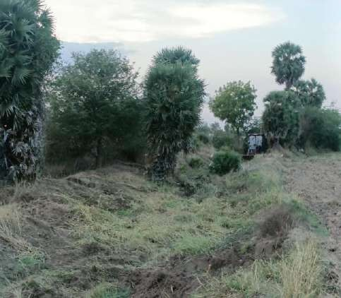
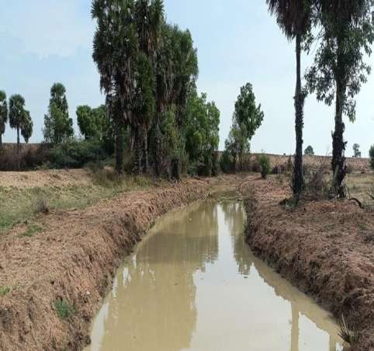
Desilting of Surplus Course
Before Execution
After Execution
Phase VII - Illupaikulam Big and Small Tank in Illupaikulam Village of Kariapatti Taluk in Virudhunagar District

