Slide 1
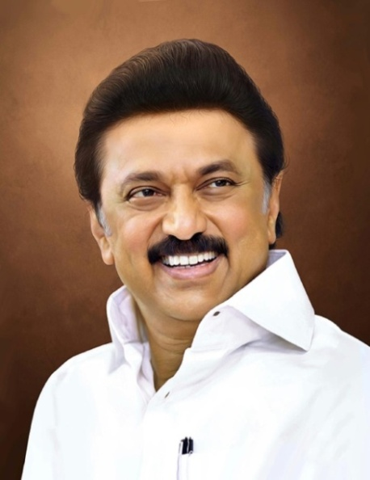
Review of
Water Resources Department
by the
Chief Secretary to Government
20.09.2024
Andiappaanur odai dam, Thirupathur District

Slide 2
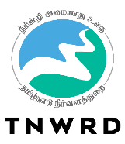
Pre-monsoon Works 2024-2025
The Government have accorded Administrative Sanction for the Pre-monsoon preparedness works at a cost of Rs.35.00 Crore, vide the G.O.(Ms).No.29/ Water Resources (I.Spl.2) Department dated 06.02.2024.
Additional Pre-monsoon Works
The Government have accorded Administrative Sanction for 13 Nos. of Additional Pre-monsoon preparedness works at a cost of Rs. 3.50 Crore, vide the G.O.(Ms).No.84/ Water Resources (I.Spl.2) Department dated 23.08.2024 in flood vulnerable reaches of Central Buckingham Canal, Otteri Nullah and Virugambakkam – Arumbakkam Drain in Chennai District.

Slide 3
Pre-monsoon Works 2024
Name of Division | Total no of Works | Total Estimate amount Rs.in Crore | Present stage
Premsonsoon works
Kosasthalaiyar Basin Division, Thiruvallur | 43 (22 GCC & 21 Non GCC) | 8.50 | All works are in Progress
Lower Palar Basin Division, Kancheepuram | 59 (12 GCC & 47 Non GCC) | 9.00 | All works are in Progress
Araniyar Basin Division, Chepauk, Chennai | 33 (22 GCC & 11 Non GCC) | 12.00 | All works are in Progress
Krishna Water Supply Project Division-1, Chennai-5 | 3 Non GCC | 1.00 | All works are in Progress
Total | 138 | 30.50
Additional Premonsoon Works
Araniyar Basin Division, Chepauk, Chennai | 13 | 3.50 | All works are in Progress
Grand Total | 151 | 33.50

Slide 4
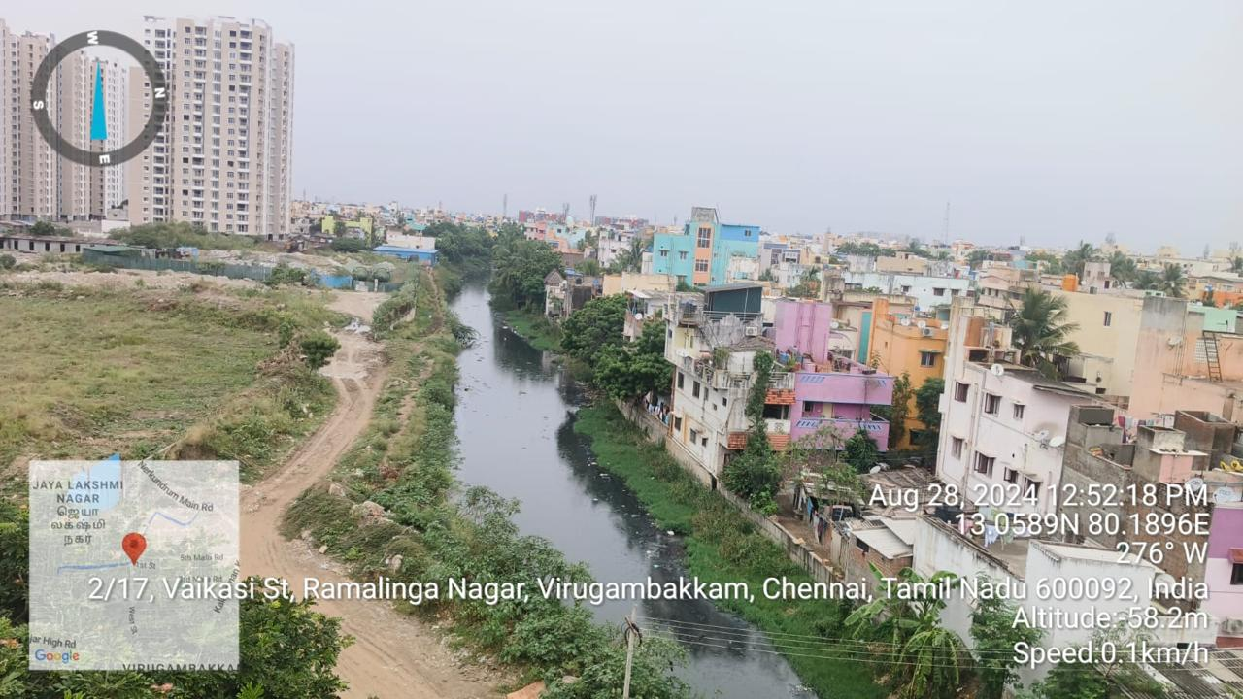
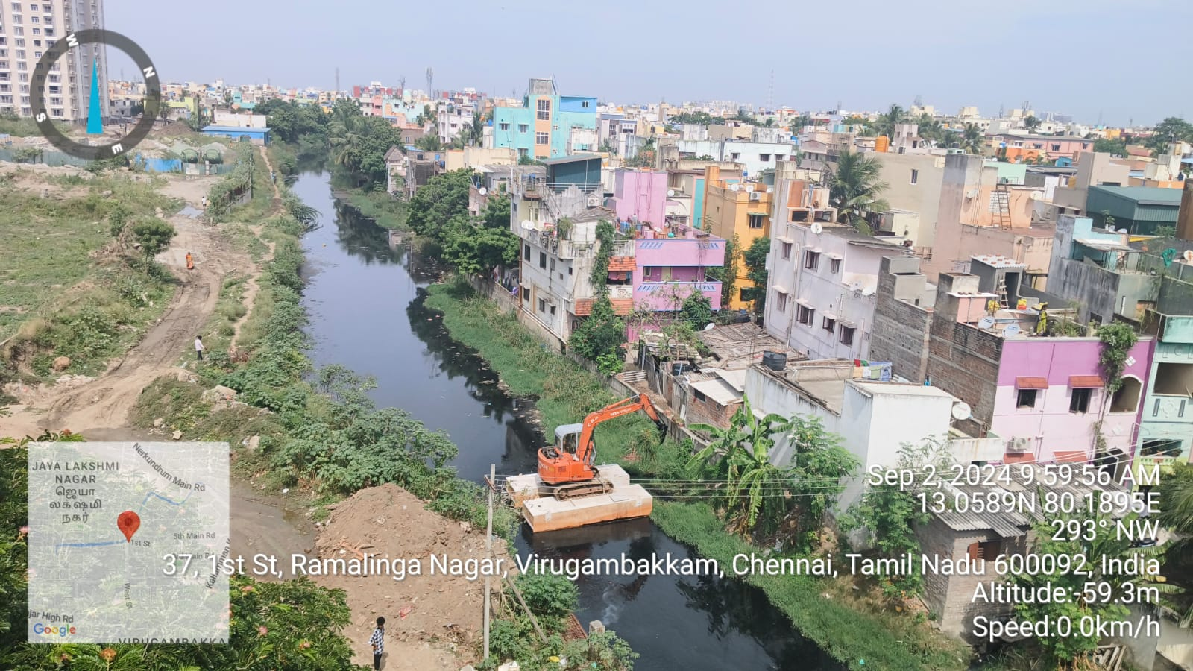
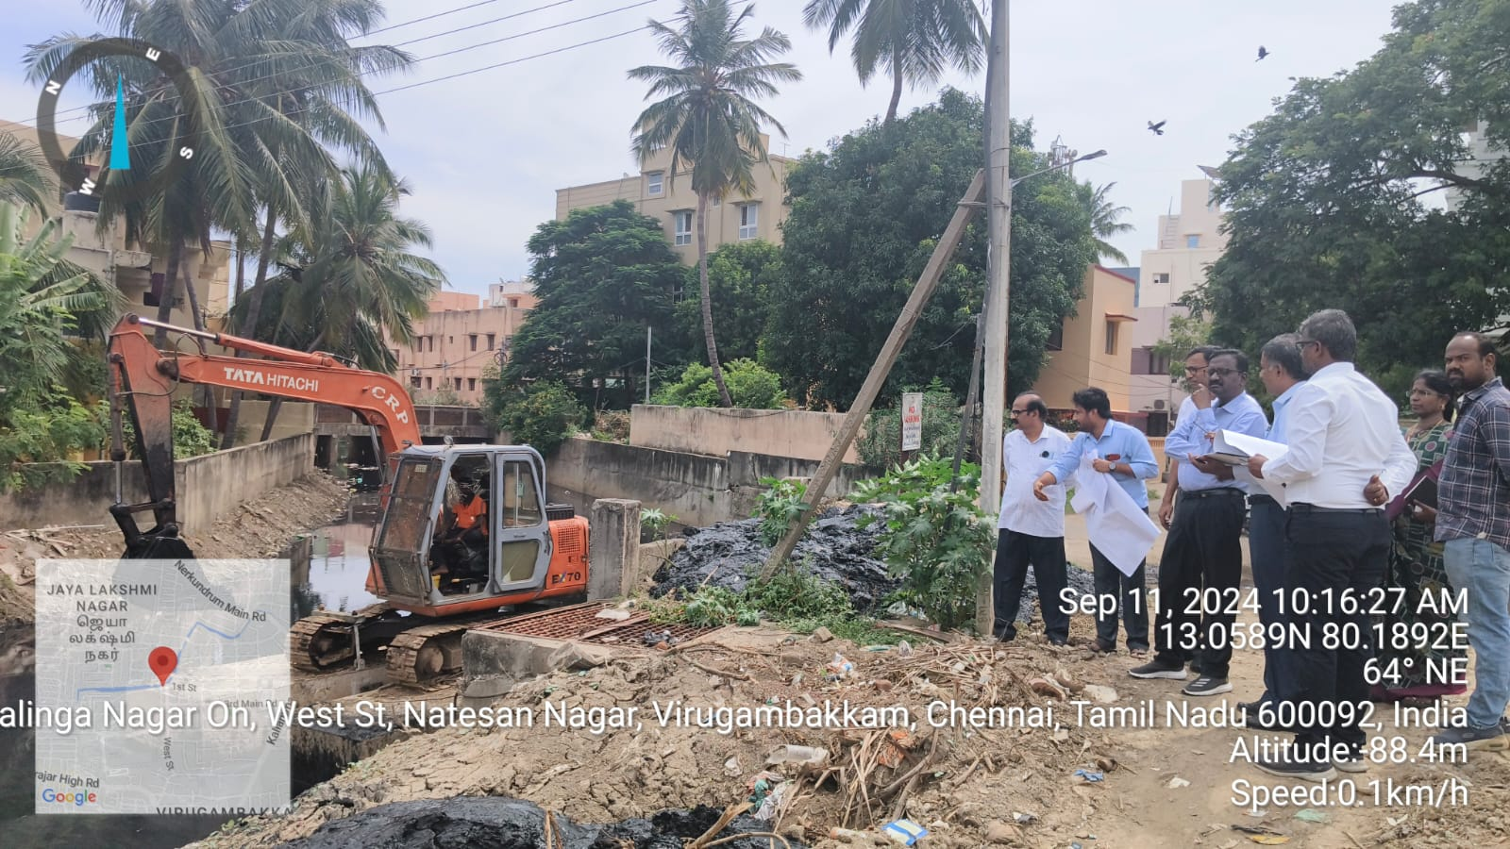
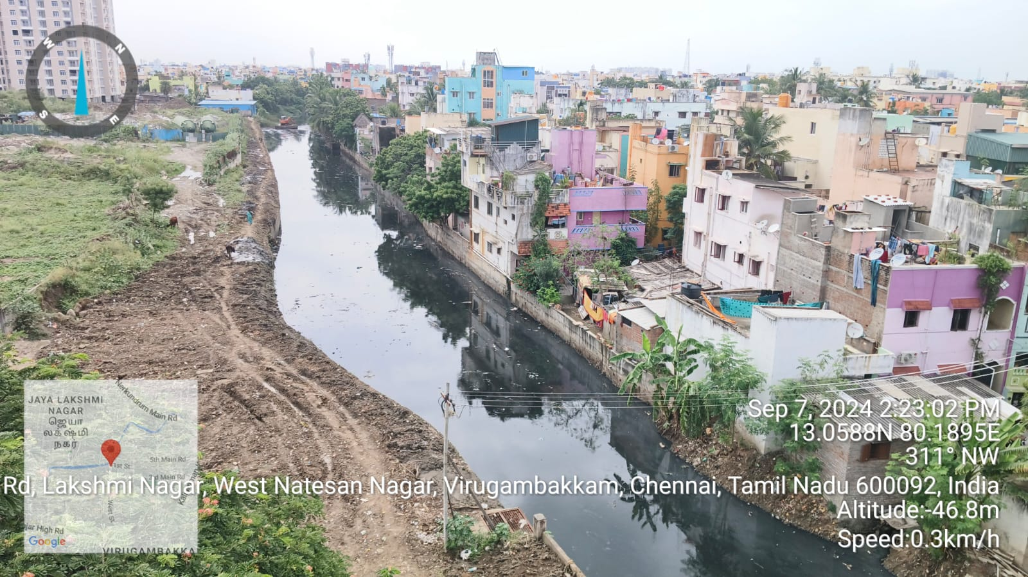
Name of Work: Removal of floating matters, vegetation and obstructions for free flow of water in Virugambakkam - Arumbakkam Canal from (LS 0m to 2100m) Muthamizh Nagar Bridge in Chennai District.
REACH 1 – RAMALINGA NAGAR at LS 500m (NEAR TAISHA)
BEFORE EXECUTION
DURING EXECUTION
DURING ACS, WRD., INSPECTION
AFTER EXECUTION

Slide 5
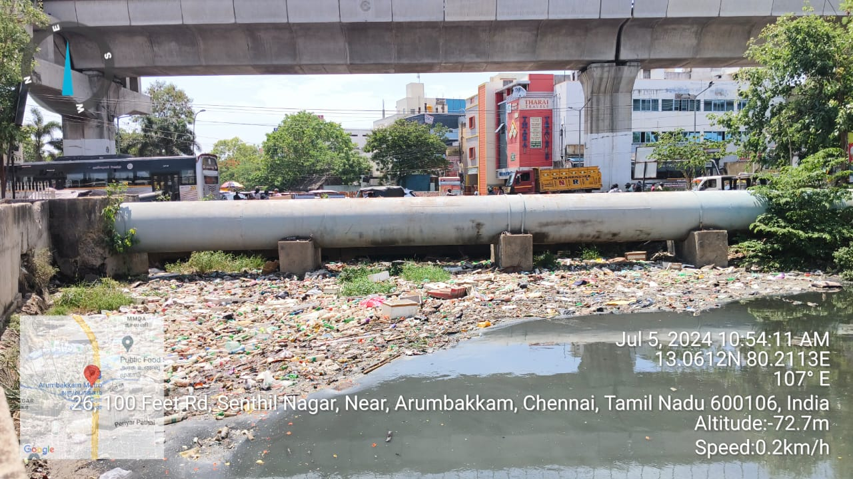
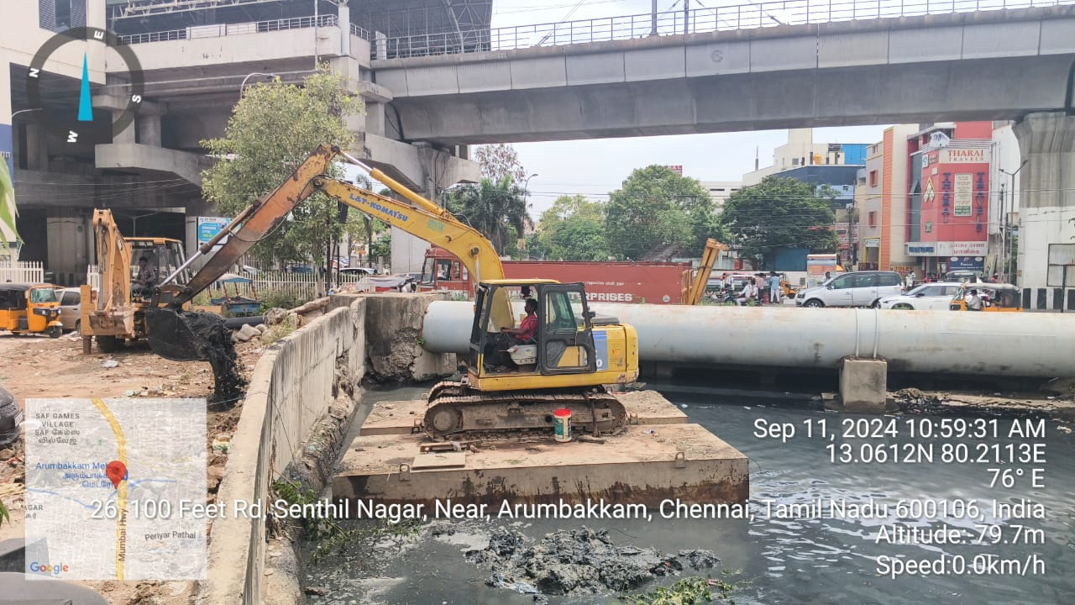
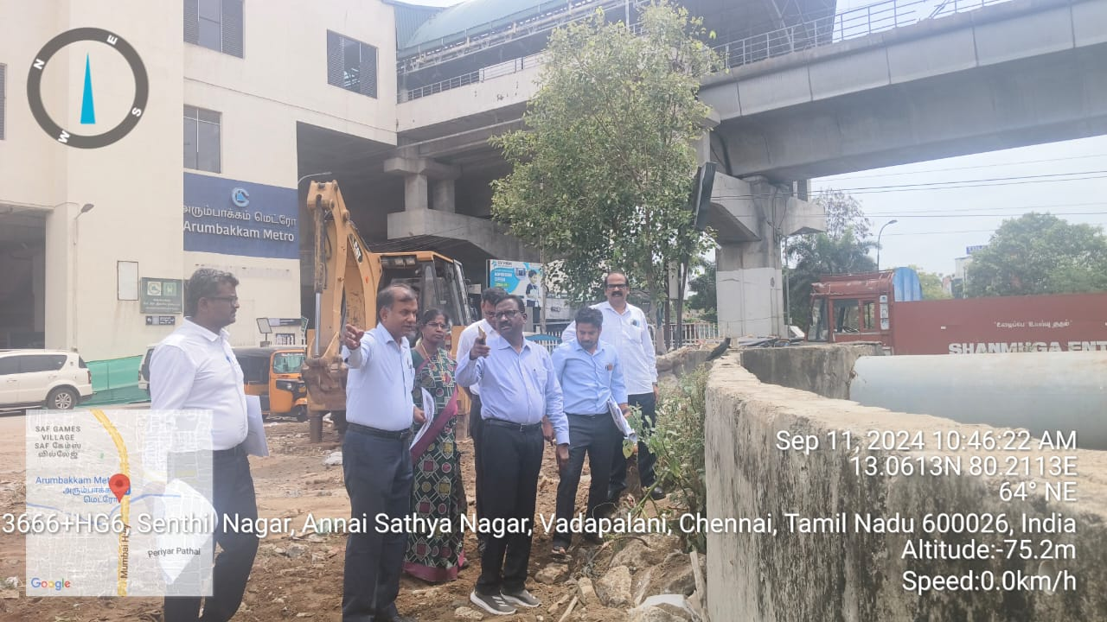
Name of Work: Removal of floating matters, vegetation and obstructions for free flow of water in Virugambakkam - Arumbakkam Canal from (LS 2100m to 4200m) in Muthamizh Nagar Bridge to Kannagi Street in Chennai District.
REACH 2 – 100 FEET ROAD NEAR ARUMBAKKAM METRO at LS 3200m
BEFORE EXECUTION
DURING EXECUTION
DURING ACS, WRD., INSPECTION

Slide 6
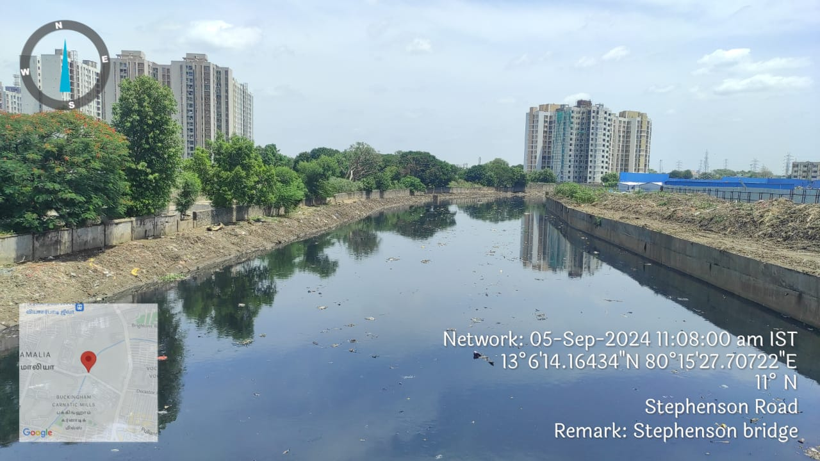
Removal of floating matters, vegetation, obstructions for free flow of water in Otteri Nullah Canal from LS 8065m to LS 9550m Ambedkar College Road Bridge in Chennai District.
OTTERI NALLUH
BEFORE EXECUTION
Stephenson Bridge D/s
DURING EXECUTION Stephenson Bridge D/s
DURING EXECUTION Stephenson Bridge D/s

Slide 7
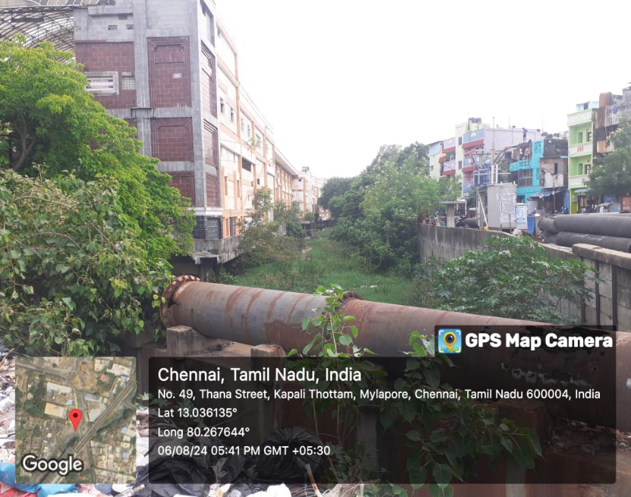
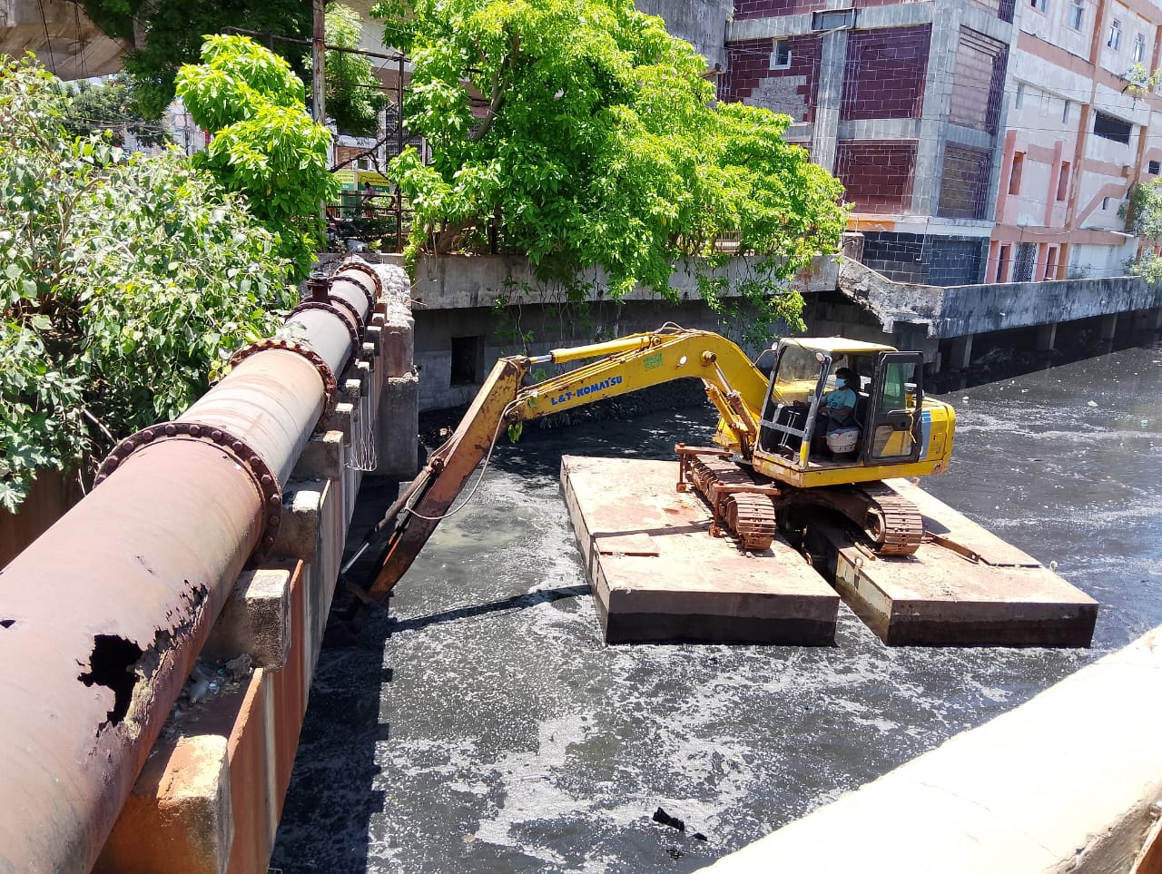
CENTRAL BUCKINGHAM CANAL
Removal of floating matters, vegetation and obstructions the removed materials in the Central Buckingham Canal from LS 3600m to 7200m in Chennai District.
BEFORE EXECUTION
Mylapore Railway Station
DURING EXECUTION
Mylapore Railway Station

Slide 8
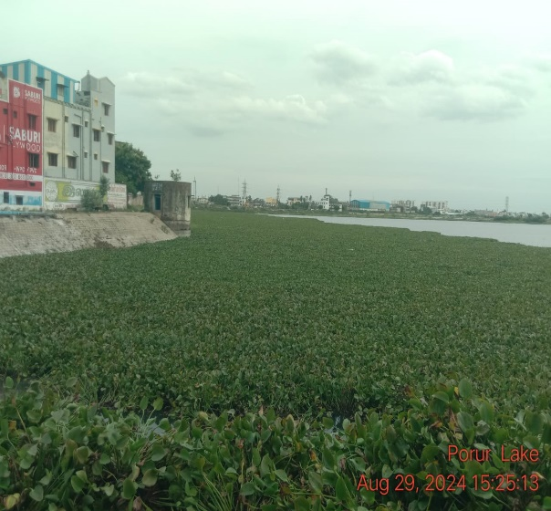
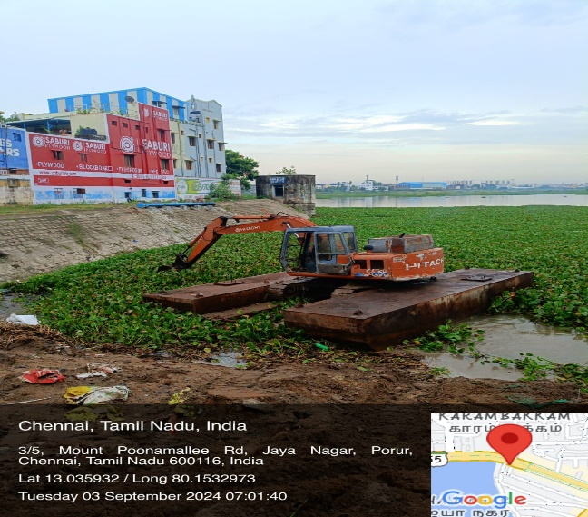
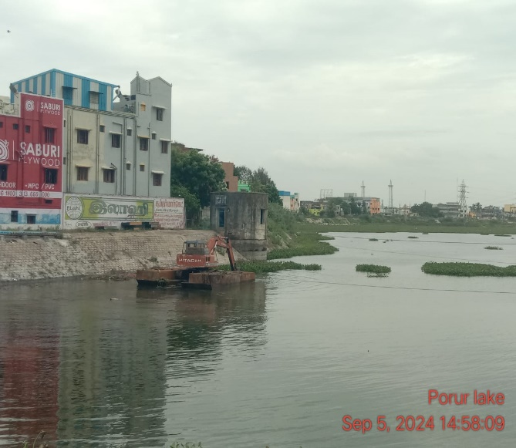
Removal Of Weeds, Hyacinth and floating material Porur tank, Maduravaoyal taluk in Chennai District.
PORUR TANK
BEFORE EXECUTION
DURING EXECUTION
DURING EXECUTION

Slide 9
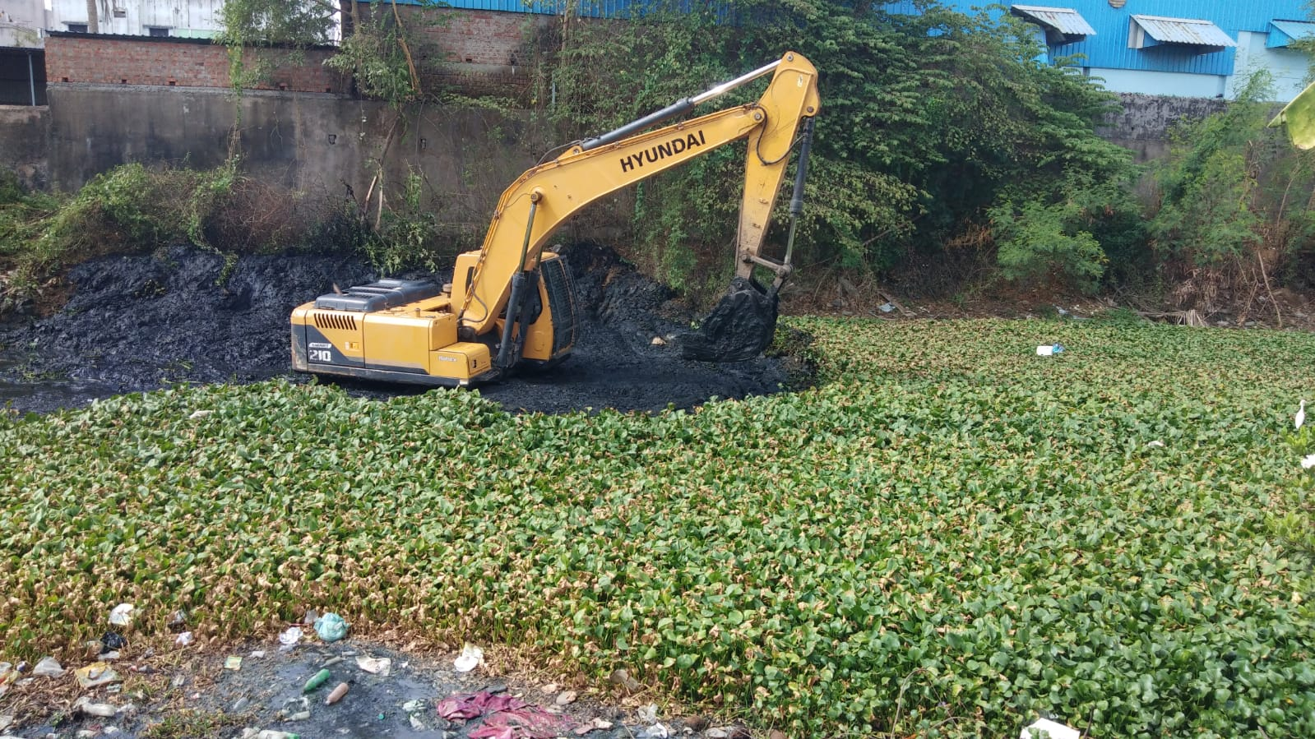
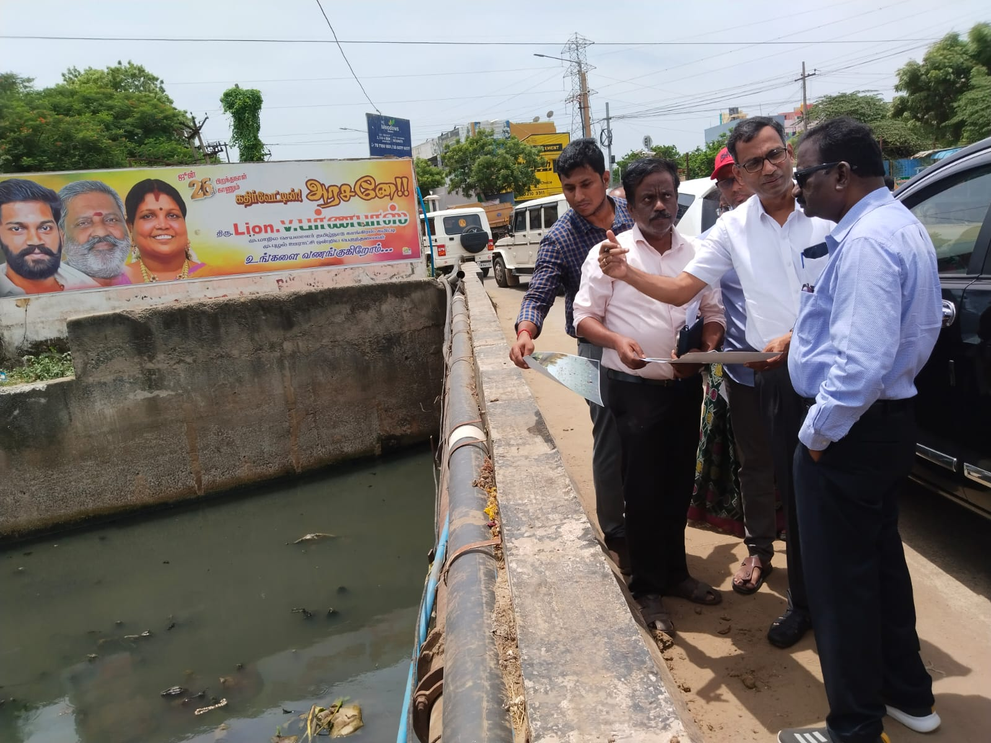
KORATTUR SURPLUS
Removal of Debris, Weeds, Vegetation, Floating Material and other Obstructions for free flow of water in Vulnerable places and dumping removed materials to the suitable locations for Premonsoon work 2024 in Korattur surplus inlet portion in Madhavaram tank, Thanikachalam drain from LS 0 to 3050M, Vinayagapuram drain in Madhavaram Taluk of Chennai District.
DURING EXECUTION
DURING ACS, WRD., INSPECTION

Slide 10
Removal of Weeds, Vegetations and Floating Materials in Velachery Tank Surplus course in Velachery Taluk of Chennai District.
VELACHERY TANK
Estimate Amount (Rs.in Lakh) | Total Length (in m) | Length completed (in m) | Machine deployed | Present Stage | Remarks
30.00 | - | - | 1 float with pocalin, 1 Poclain | Work is in progress | Scheduled date of completion 31.12.2024
BEFORE EXECUTION
200 Feet Road
DURING EXECUTION
200 Feet Road

