Slide 1
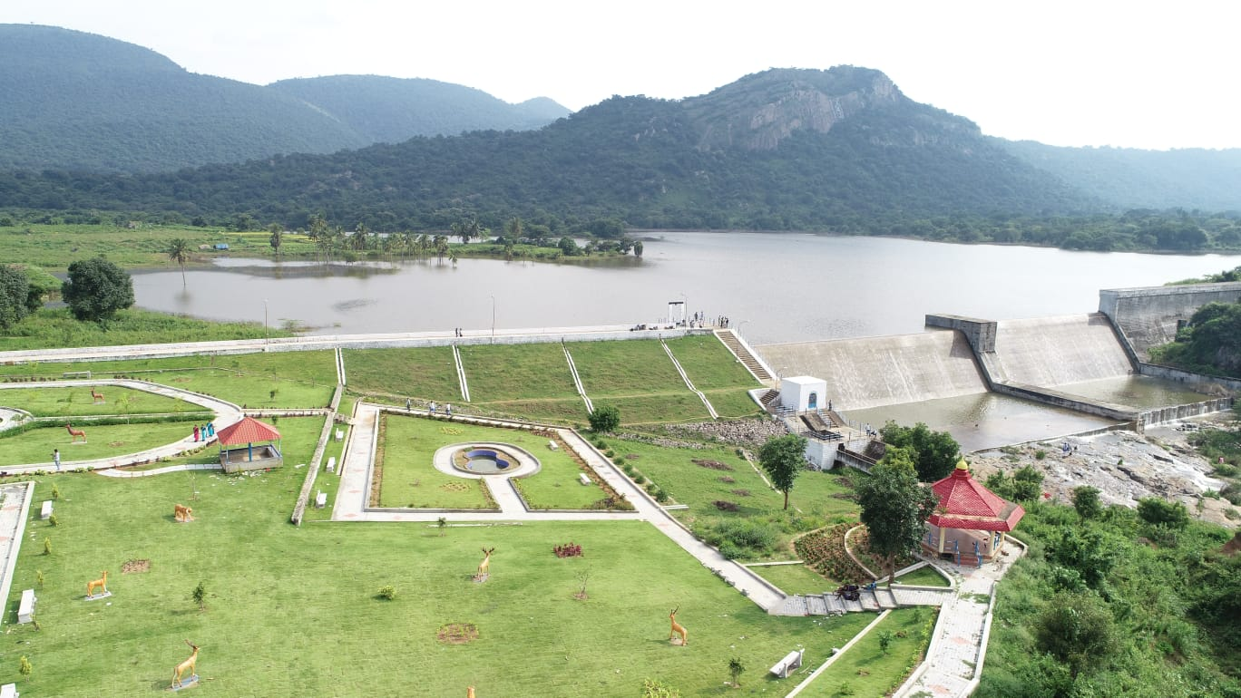



Review of
Water Resources Department
by the
Chief Secretary to Government
20.09.2024
Andiappaanur odai dam, Thirupathur District

Slide 2
Inter linking of Tamirabarani – Karumeniyar – Nambiyar River
To utilize 2.765 TMC of surplus flood flows out of 13.758 TMC in Tamiraparani river by excavating a new Flood Carrier Canal from LS 6.50 km of existing Kannadian channel near Vellankuzhi village to M.L.Teri near Thisayanvilai.
Administrative Sanction accorded for Rs.369.00 crore in G.O.(Ms) No.204, Public Works (P2) Dept., dated 12.06.2008
Revised Administrative Sanction accorded for Rs.1060.76 crore in GO (Ms) No.33, WR(ISW2) Dept., dated 02.03.2024.
Carrying capacity of canal is 3200 c/s which interlinks the Rivers Tamiraparani, Karumeniyar and Nambiyar.
This scheme was taken up in anticipation of GoI funds under Accelerated Irrigation Benefits Programme (AIBP).
Foundation stone for the Project was laid by the Honourable Chief Minister Dr.Kalaingar M.Karunanidhi on 21.02.2009.

Slide 3
32 villages,177 tanks,2657 wells in Tirunelveli District and 18 villages, 75 tanks, 2563 wells in Thoothukudi District would be benefited.
By implementing this scheme, totally 56933 Acres of land including 41995 acres of new ayacut will be benefited.
The project is implemented in 4 Stages. Works in first 3 stages have been completed fully. The works under stage IV is nearing completion.
Out of the total length of 75.175 km canal, so far 73.530 km has been completed. Balance 1.645 km could not be excavated due to court case. The last hearing was held on 31.07.2024 and arguement concluded. Judgment is reserved.
The above Scheme is included under PMKSY-AIBP. The Ministry of Jal Sakti have ordered to release the Central Assistance of Rs.44.22 crore on 31.03.2022.

Slide 4
Central assistance of Rs.34.7425 crore has so far been released. Action is being taken to get the balance Central Assistance of Rs. 9.4775 crore.
Expenditure incurred - Rs.1023.95 crore.
Land Acquisition status
District | Land Required in (Ha) |  |  | Land Acquired in (Ha) |  |  | Land To be Acquired in (Ha)
 | Patta | Poram boke | Total | Patta | Poram boke | Total | Patta | Poramboke | Total
Tirunelveli | 904.49 | 155.62 | 1060.11 | 896.67 | 147.50 | 1044.17 | 7.82 | 8.12 | 15.94
Thoothukudi | 157.42 | 4.63 | 162.05 | 157.42 | - | 157.42 | - | 4.63 | 4.63
Total | 1061.91 | 160.25 | 1222.16 | 1054.09 | 147.50 | 1201.59 | 7.82 | 12.75 | 20.57

Slide 5
During North East Monsoon, surplus water was released through the Flood Carrier Canal as a trial run on 17.12.2023. Water was released in Flood Carrier Canal from 17.12.2023 to 28.01.2024.
The released surplus water reached up to the additional pond formed at tail end area of Teri sand and the project has been successfully operationalized.
Due to this, the ground water level has risen significantly in the tail end of Flood Carrier canal in Thisayanvilai areas and the salinity of the water in the coastal areas has been considerably reduced.

Slide 6
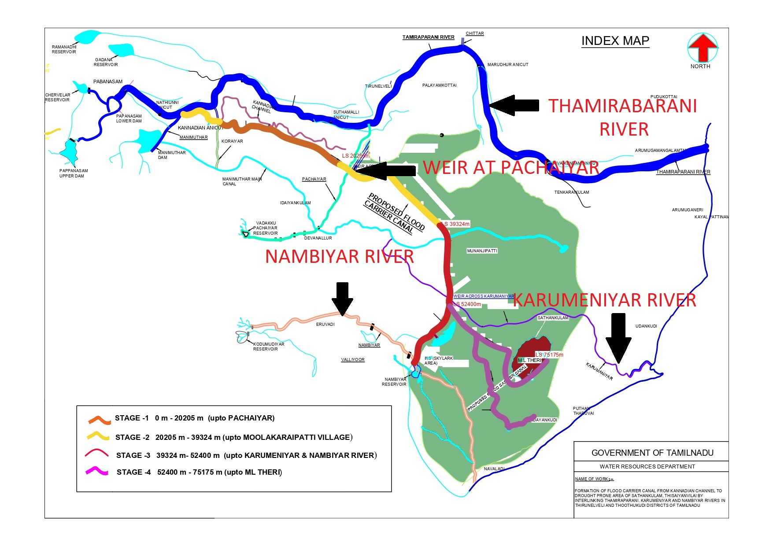

Slide 7
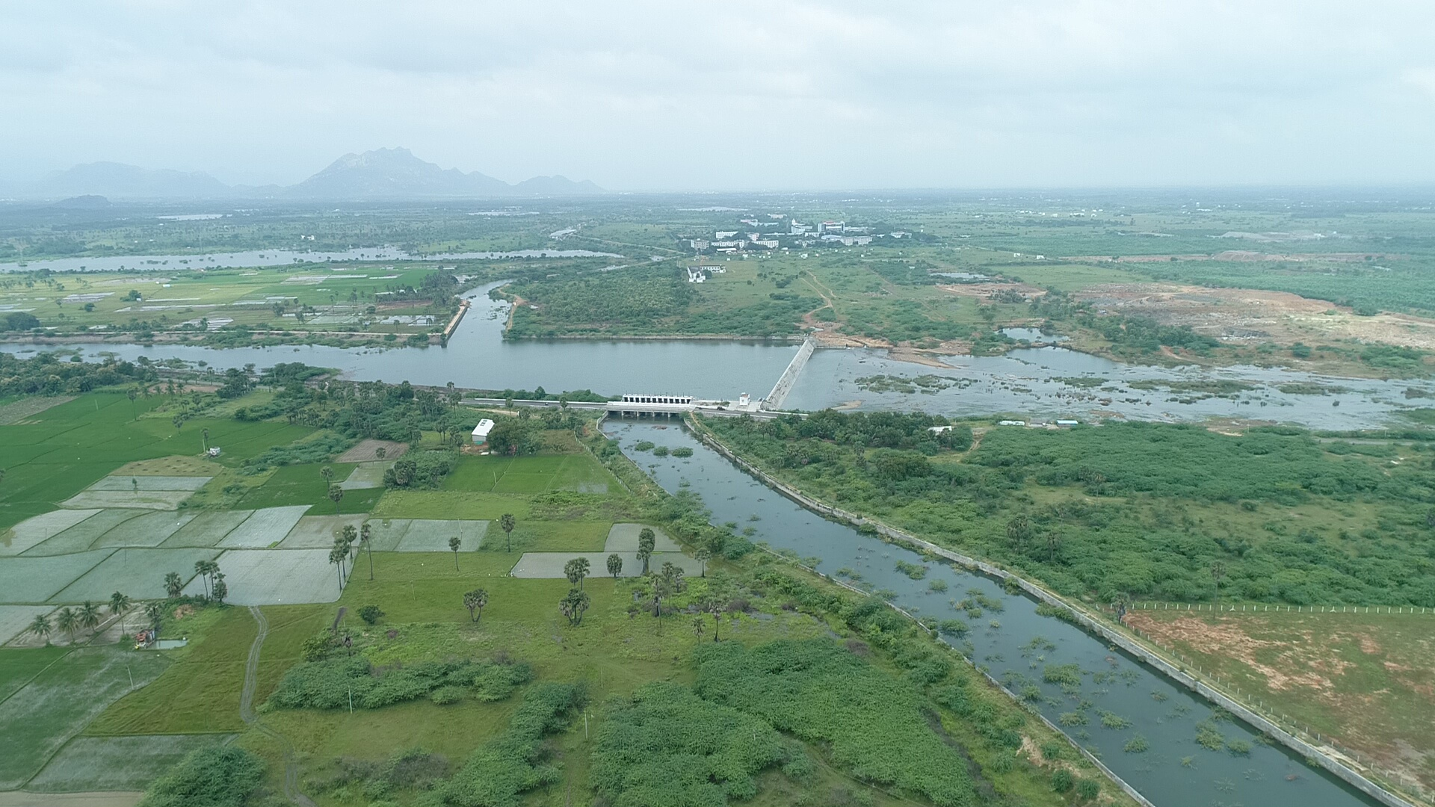
7
Notes:
7

Slide 8
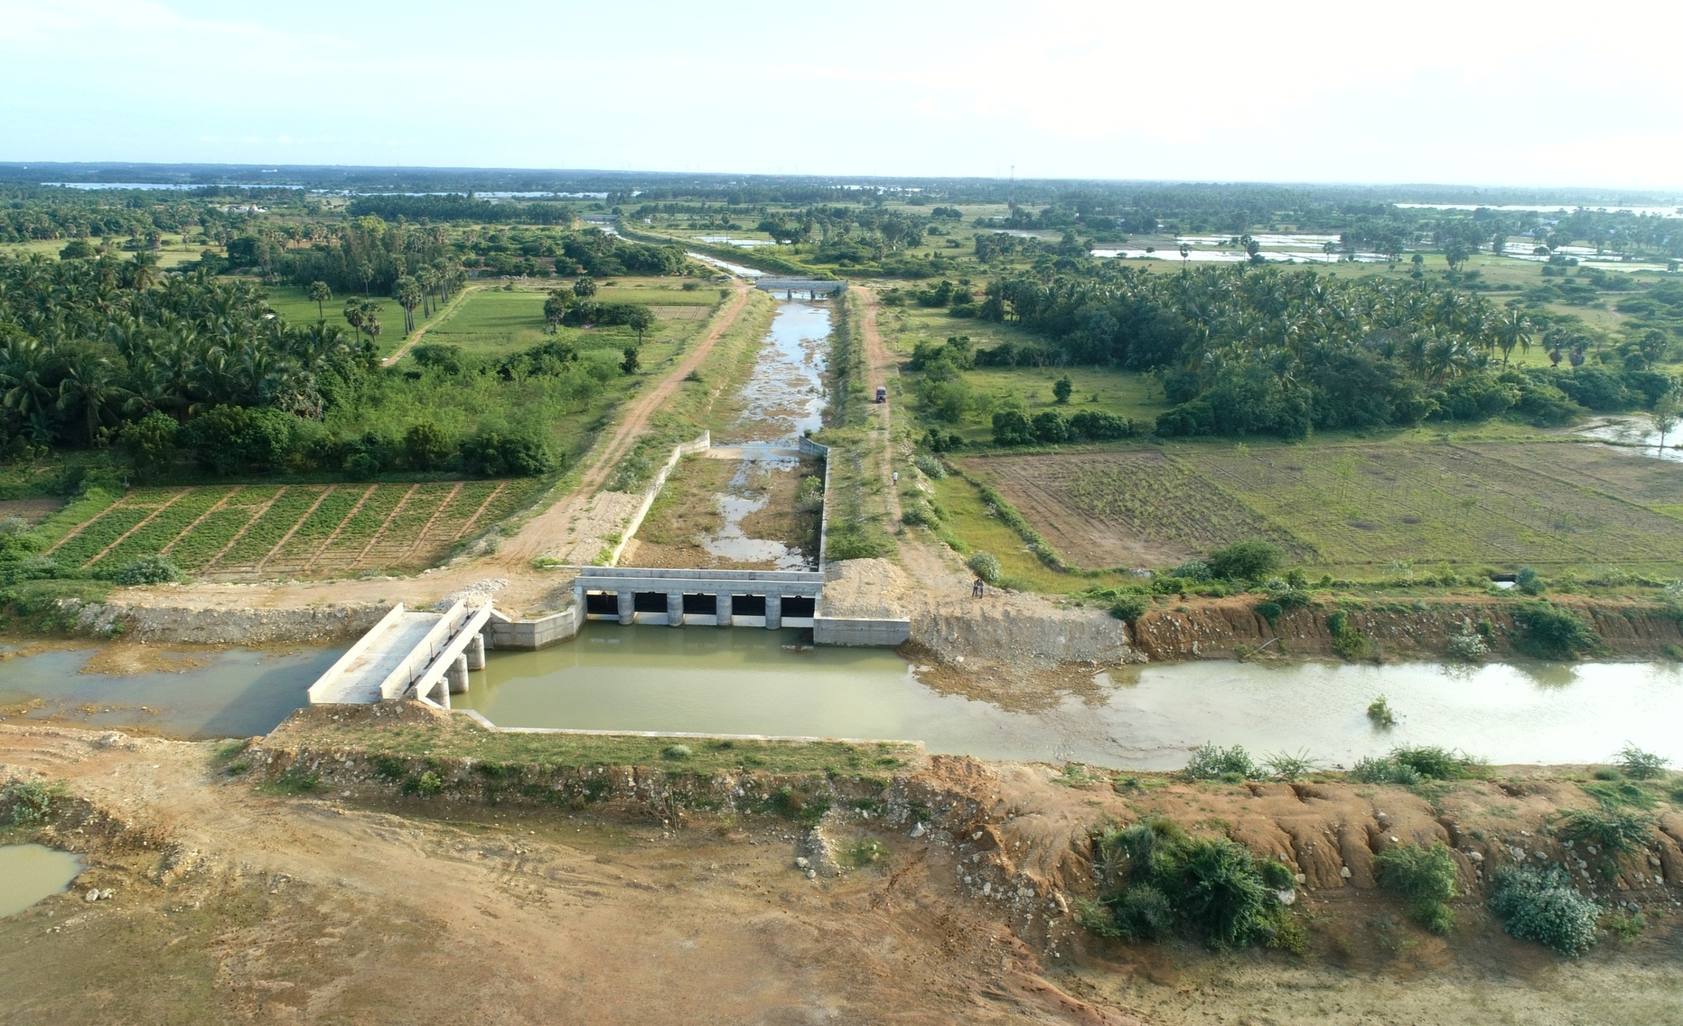
Offtake Point of Idayankudi Supply Channel
8

Slide 9
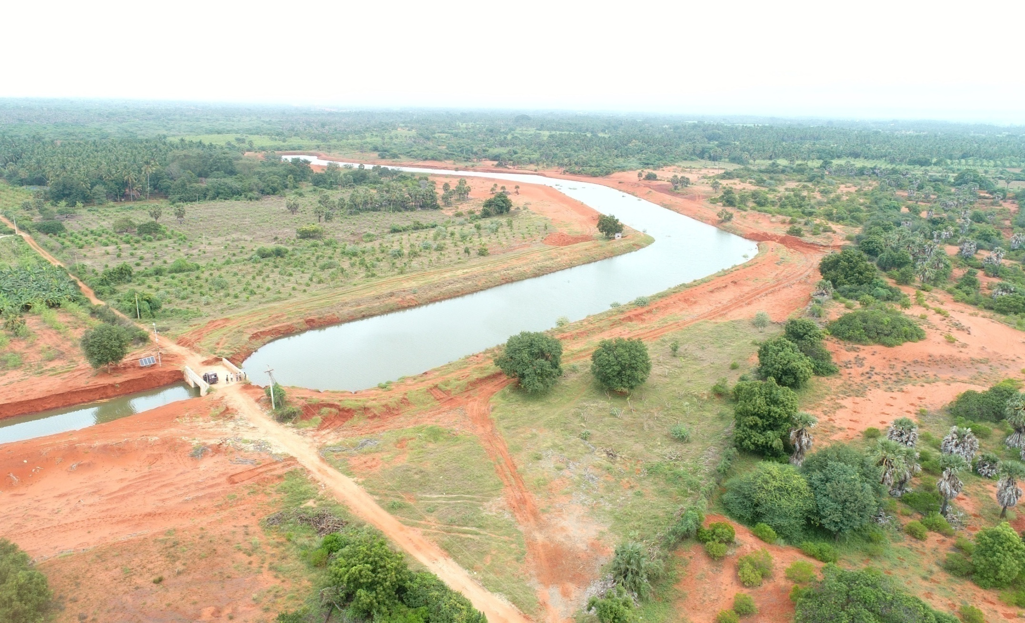
Flood Carrier Canal – Additional Pond
9

