Slide 1
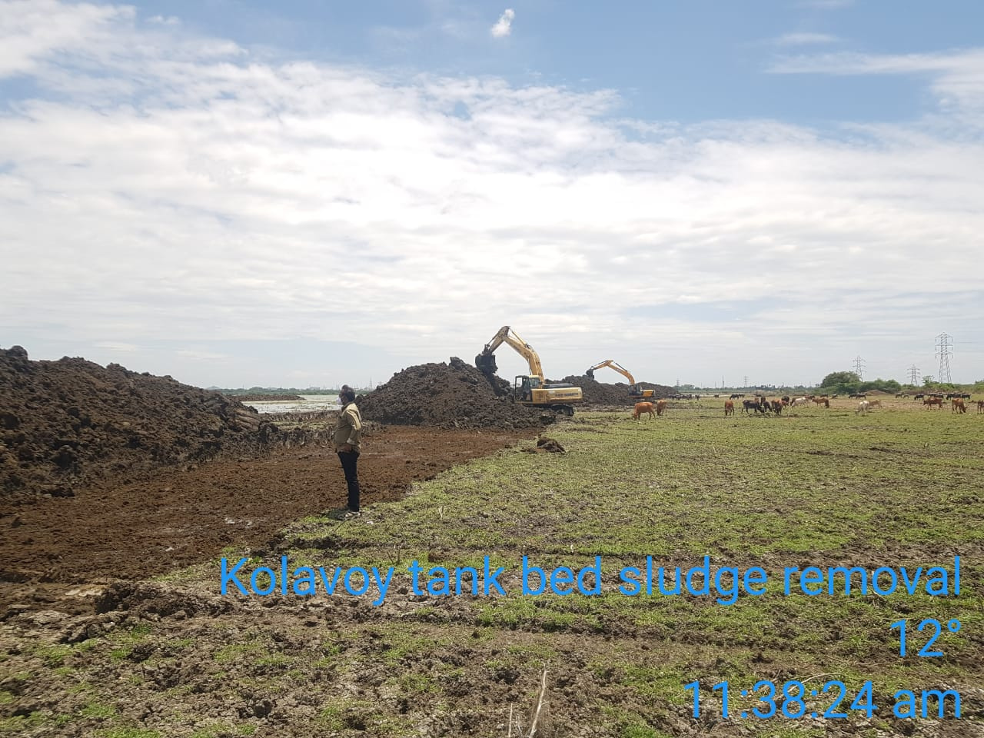
7. Reclaiming and Rejuvenating Kolavoy lake in Chengalpattu District
Photo
Announcement Year
2019-2020
Admin Sanction
16.12.2020
Work Order Issued
27.02.2021
Est. Cost (Rs. in cr)
Rs. 62.38 cr
Work Progress(%)
22%
Financial Progress (%)
22%
AS | G.O (Ms) No.311 PW (T2) Dept, Dated: 16.12.2020, Rs. 60.00 cr
RAS | G.O.(Ms) No.40 W.R. (S1) Dept, Dt.11.03.2024, Rs. 62.38 cr
Commenced on
27.02.2021
Prob. Date of Completion
Ayacut Benefited in Ha.
253.73 ha

Slide 2
Water Spread area of this tank is 882 ha and its storage capacity is 476 Mcft. This tank holds its own catchment and also receives the Surplus from 25 upper tanks.
For more decades this tank has not been desilted and meanwhile the Sewage from the Chengalpattu Town is let into this tank which has led to formation of silt in the tank water spread area and the lake water is also polluted. Due to this the tank storage has been reduced to 330 Mcft.\
The length of the structure is 48 + 12 m (Wier cum Regulator) with storage capacity of 476 MCM.
It consists of 13 vents of size 2.10 x 1.50 m with the discharging capacity of 3,730 cusecs.
Work commenced on 27.02.2021 and about 20% of works has been completed with an expenditure of 12.75 crore.

Slide 3
The components like Supply Channel Standardization & Moat Channel Improvement works and Melamaiyur Tank Bund Strengthening and Weir Reconstruction works are completed.
The components like Construction of Recreational Amenities like Watch tower & Amphitheatre were also under progress similarly.
The major components like Rehabilitation of Kolavoy Tank with reconstruction of Kolavoy Tank Head Regulator and deepening of the Kolavoy Tank bed, Standardisation of Tank Bund including Foreshore Reclamation, Formation of Approach Road, Recreational Island, Pedestrian Bridge & Ferry Jetty, Park Arrangements with Landscaping etc., can be taken up only after draining out the polluted water from the tank bed.

Slide 4
Issues:
To drain the polluted water from the tank, several proposals were submitted to the Southern Railways, requesting the construction of a box culvert across the railway bridge. After multiple requests, Southern Railways agreed to the project, and Rs.2,02,89,649 was deposited for the execution of the box culvert. Southern Railways has initiated the process of constructing the culvert across Bridge No. 178 near the railway crossing.
Once the box culvert is completed, the tank water will be drained, allowing the major reclamation and rejuvenation work on Kolavoy Lake to proceed.

Slide 5
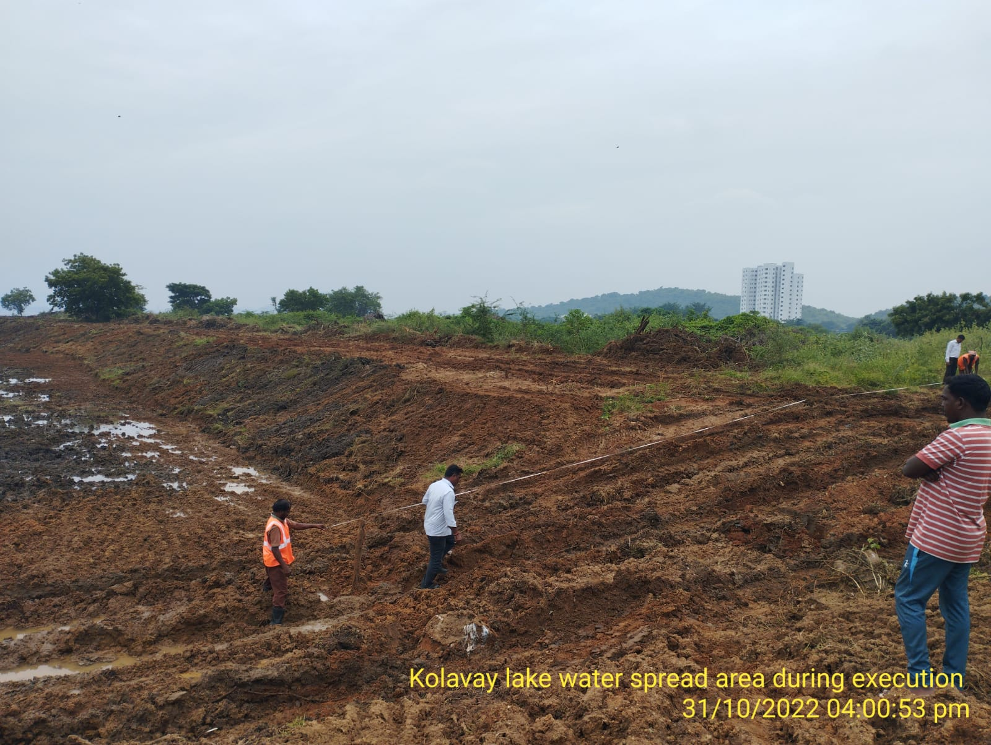

Slide 6
