Slide 1
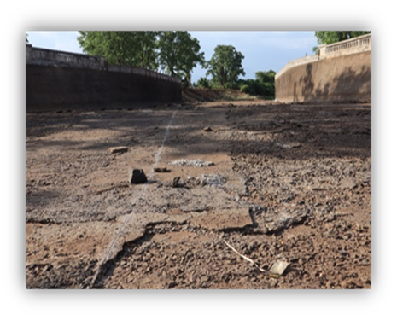
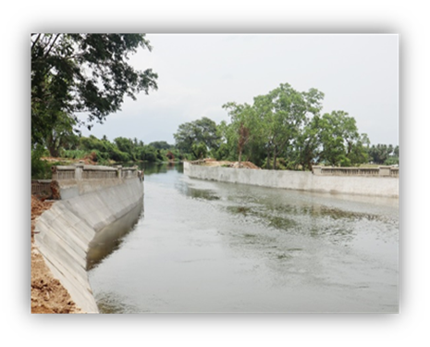
Extension, Renovation and Modernisation of Lower Bhavani Project Main Canal in Erode, Tiruppur and Karur Districts. (Package I to VI)
Before Execution
Announcement Year | 2020-2021
Funding (State / NABARD/…) | NABARD-NIDA
AS / RAS Amount (Rs. In lakhs) | Administrative Sanction : Rs. 93310 RAS : Rs. 92965
G.O No & Date (AS/RAS) | AS - GO.(Ms)No. 276, Public Works(W1) Department, Dated. 09.11.2020 RAS - G.O.Ms.No.60 / Water Resources (S1) Department,Dated.13.05.2024
Estimate Amount (Rs. In lakhs) | Rs. 93310
Date of commencement | 03.05.2021 (Package I), 25.02.2021 (Package II to V), 03.02.2021 (Package VI)
Scheduled date of completion | -
Expenditure upto 03/2024 (Rs. In lakhs) | Rs. 54205.96
B.E (2024-25) Rs. (In lakhs) | 0
Expenditure in current year (Rs. In lakhs) | 0
Cumulative Expenditure (Rs. In lakhs) | Rs. 54205.96
Overall Progress (in %) | Completed | Pending
Financial Progress | 58% | 42%
Physical Progress | 94% | 6%
During Execution
ACTION PLAN FOR THE PENDING WORKS
 | 2024-25 |  |  | 2025-26
 | Sept | Oct - Dec | Jan - Mar | 1st Quarter | 2nd Quarter | 3rd Quarter | 4th Quarter
Financial (in Lakhs) |  |  |  | 38759.04
Physical (in %) |  |  |  | 6%
Probable date of Completion : 31.07.2025

